Slide 1

INTERACTIVE
RESIDENTIAL PURCHASE AGREEMENT SUMMARY
FOR CONSUMERS
In Plain English
CALIFORNIA ASSOCIATION OF REALTORS® I Residential Purchase Agreement Summary for Consumers

Slide 2
The Residential Purchase Agreement (C.A.R. Form RPA) is a multi-page legal document that establishes the rights and responsibilities of the buyer and seller in a real estate transaction.
This presentation is designed to give you, the buyer or seller, some simple explanations for various paragraphs in the RPA. This presentation is not a legal analysis but instead an introduction into the purpose and meaning of different paragraphs.
You do not have to read through the whole thing but can click on the corresponding bullet to view a pop-up containing all information pertaining to that specific section.
You can go to any page of the RPA from an explanation slide by clicking on the applicable page number in the box in the bottom.
If you have questions or want a more comprehensive explanation, you should consult your REALTOR©.
RESIDENTIAL PURCHASE
AGREEMENT SUMMARY
CALIFORNIA ASSOCIATION OF REALTORS® I Residential Purchase Agreement Summary for Consumers

Slide 3
GLOSSARY
“Acceptance” | Means the time the final offer is accepted in writing by a Party and is delivered to and personally received by the other Party or that Party’s authorized agent in accordance with the terms of this offer or a final counteroffer.
“Agreement” | Means this document and any counter offers and any incorporated addenda, collectively forming the binding agreement between the Parties. Addenda are incorporated only when Signed by all Parties.
“C.A.R. Form” | Means the most current version of the specific form referenced or another comparable form agreed to by the Parties.
“Close of Escrow” | Including “COE”, means the date the grant deed, or other evidence of transfer of title, is recorded.
“Copy” | Means copy by any means including photocopy, NCR, facsimile and electronic.
“Days” | Means calendar days. However, after Acceptance, the last Day for performance of any act required by this Agreement (including Close of Escrow) shall not include any Saturday, Sunday, or legal holiday and shall instead be the next Day.
“Days After” | Means the specified number of calendar days after the occurrence of the event specified, not counting the calendar date on which the specified event occurs and ending at 11:59 PM on the final day.
“Days Prior” | Means the specified number of calendar days before the occurrence of the event specified, not counting the calendar date on which the specified event is scheduled to occur.
“Deliver”, “Delivered”, or “Delivery” | Unless otherwise specified in writing, means and shall be effective upon: personal receipt by Buyer or Seller or the individual Real Estate Licensee for that principal as specified in the section titled Real Estate Brokers on page 10, regardless of the method used (i.e., messenger, mail, email, fax, other).
“Electronic Copy”, or “Electronic Signature” | Means, as applicable, an electronic copy or signature complying with California Law. Buyer and Seller agree that electronic means will not be used by either Party to modify or alter the content or integrity of this Agreement without the knowledge and consent of the other Party.
“Law” | Means any law, code, statute, ordinance, regulation, rule or order, which is adopted by a controlling city, county, state or federal legislative, judicial or executive body or agency.
“Repairs” | Means any repairs (including pest control), alterations, replacements, modifications or retrofitting of the Property provided for under this Agreement.
“Signed” | Means either a handwritten or electronic signature on an original document, Copy or any counterpart.

Slide 4
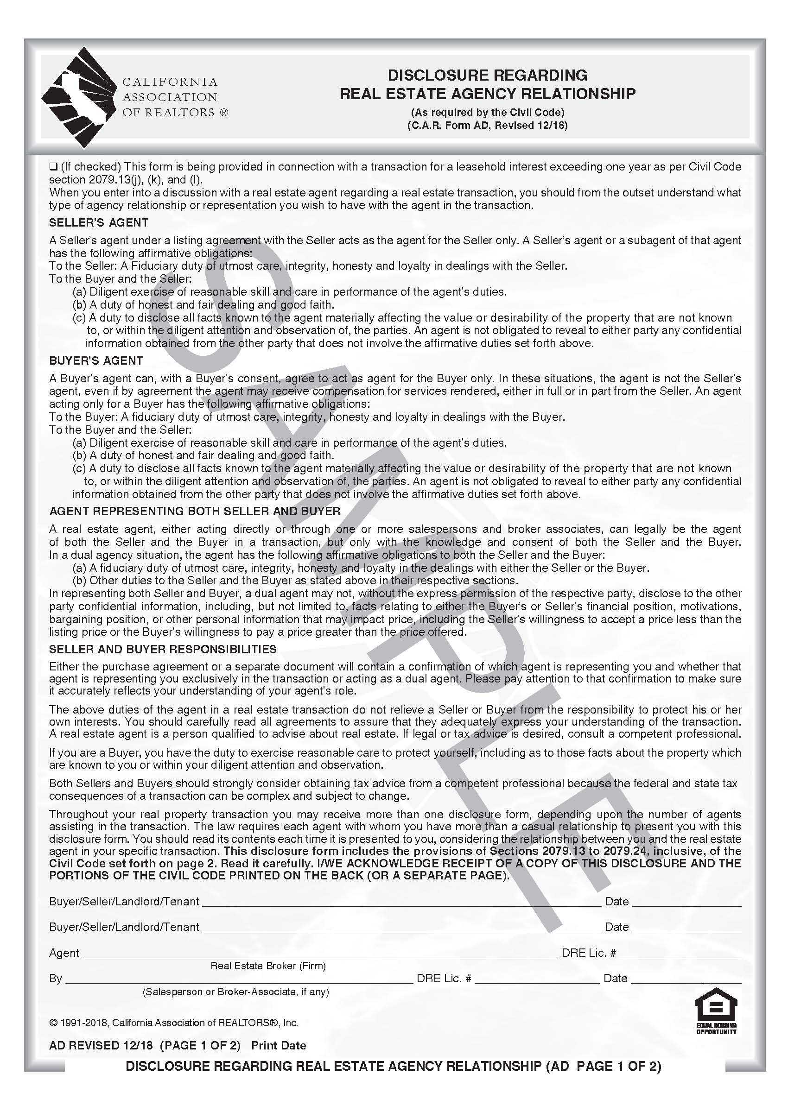
Disclosure Regarding Real Estate Agency Relationship, p.1.
Disclosure Regarding Real Estate Agency Relationship
This form lets you know that a real estate broker can represent only a seller, only a buyer or both buyer and seller in the same transaction.
This form does not tell you specifically who the broker represents; that information comes later in the purchase agreement (paragraph 2B).
The back or second page of the form is simply a reprint of the entire law.
No matter who the broker represents, the broker through its agents must treat all parties honestly and fairly.
x
This Form is pre-attached to the RPA and is the first form you will see.
The RPA starts on slide 7,or you can click on the page number below.
RPA page: 1. 2. 3. 4. 5. 6. 7. 8. 9. 10.
CALIFORNIA ASSOCIATION OF REALTORS® I Residential Purchase Agreement Summary for Consumers
3

Slide 5
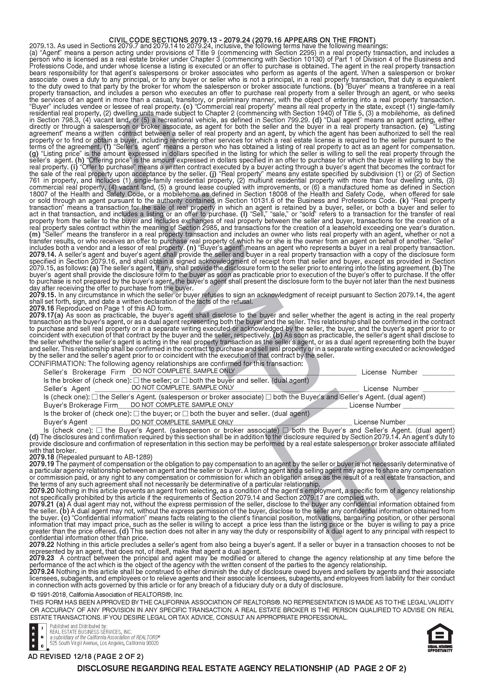
Disclosure Regarding Real Estate Agency Relationship, p.2.
This Form is pre-attached to the RPA and is the first form you will see.
The RPA starts on slide 7,or you can click on the page number below.
RPA page: 1. 2. 3. 4. 5. 6. 7. 8. 9. 10.
CALIFORNIA ASSOCIATION OF REALTORS® I Residential Purchase Agreement Summary for Consumers

Slide 6
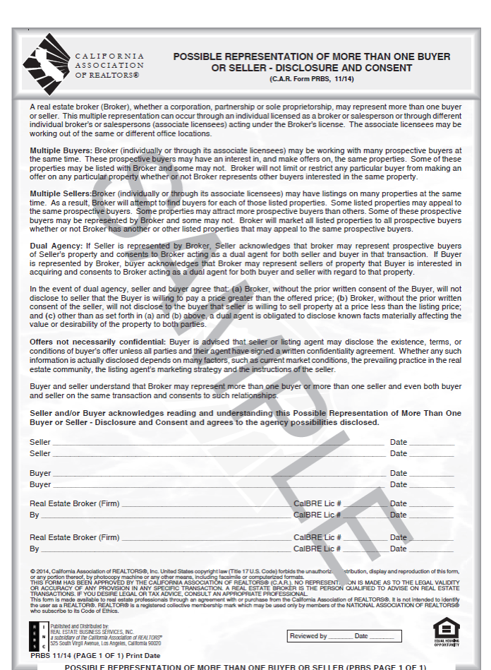
Possible Representation of More than One Buyer or Seller – Disclosure and Consent
AGENCY; POTENTIALLY COMPETING BUYERS AND SELLERS
2.C. All buyers and sellers should have received the form on screen 5.
This form lets you know that a real estate broker, through its agents, can represent many buyers or sellers at the same time.
Some of these buyers or sellers may be competing against you.
If you are writing an offer, the seller and seller’s broker may let others know everything about the offer.
x
This Form is pre-attached to the RPA and is the second form you will see.
The RPA starts on slide 7,or you can click on the page number below.
RPA page: 1. 2. 3. 4. 5. 6. 7. 8. 9. 10.
CALIFORNIA ASSOCIATION OF REALTORS® I Residential Purchase Agreement Summary for Consumers

Slide 7
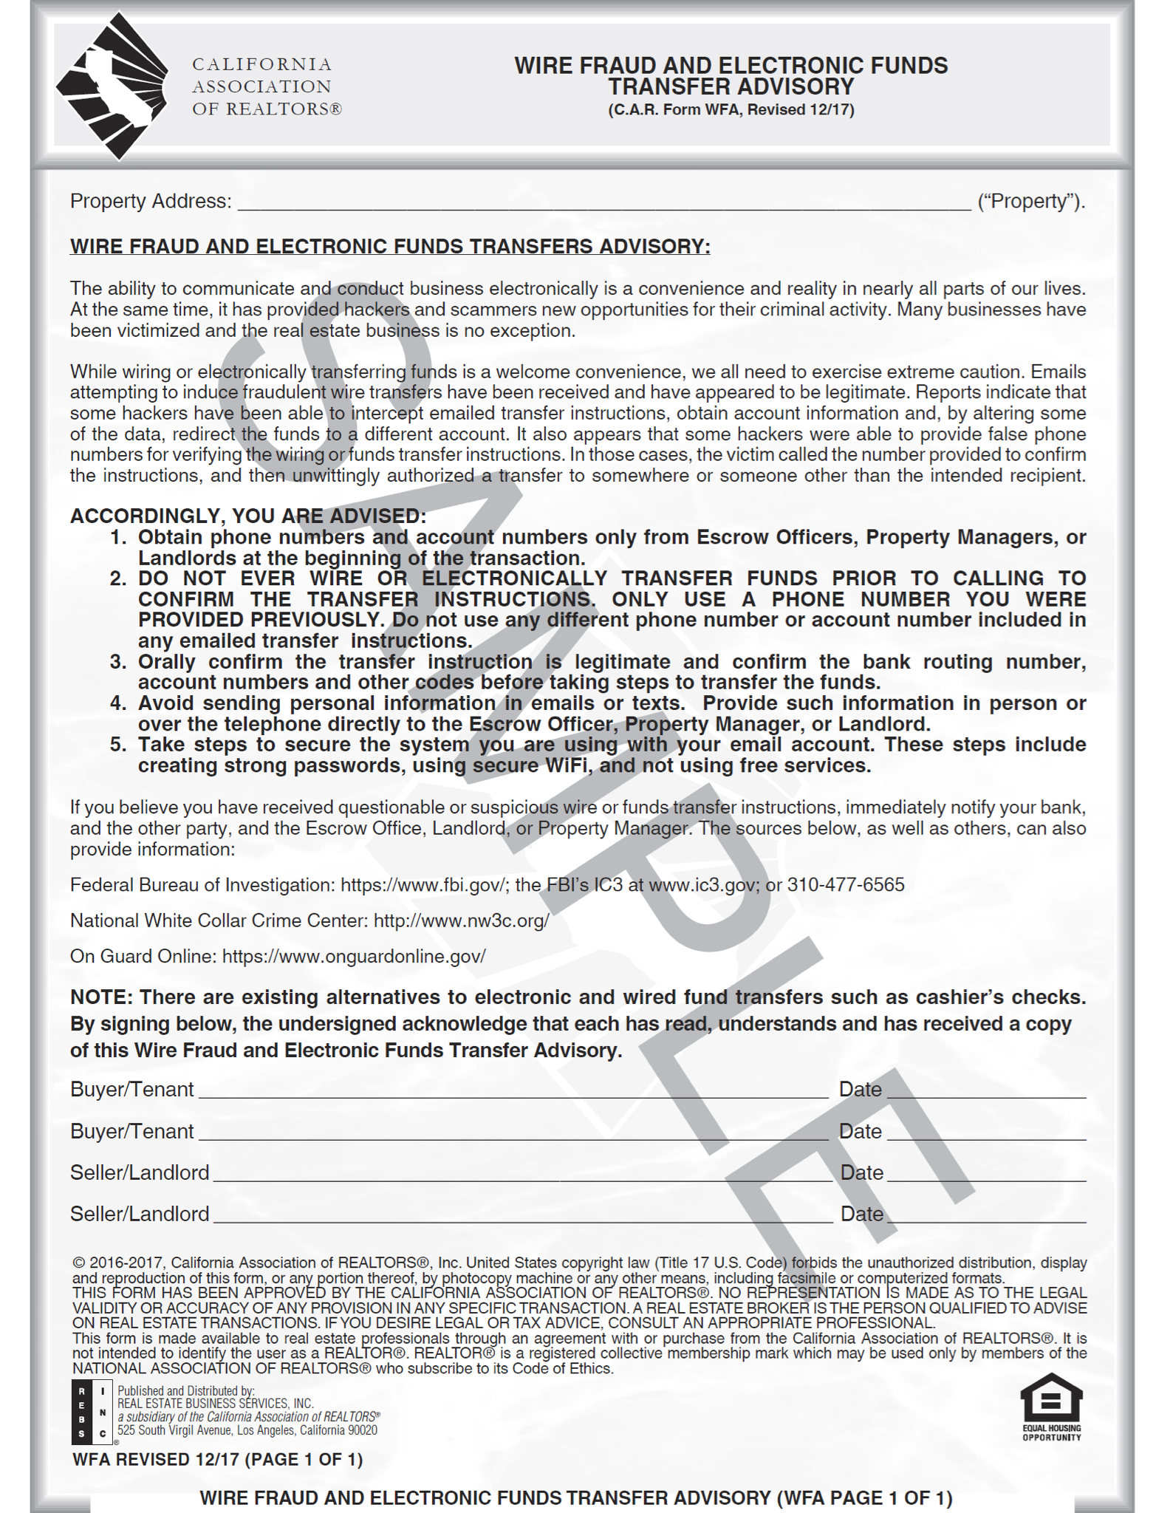
Wire Fraud and Electronic Funds Transfer Advisory
x
WIRE FRAUD AND ELECTRONIC FUNDS TRANSFER ADVISORY
Modern criminals have found ways to interfere with modern ways of transferring money. Whether a deposit, down payment or sale proceeds are transferred from one account to another via some kind of electronic method, such as a wire transfer, hackers have the ability to intercept messages about that transfer and steal the funds. This form advises both buyer and seller of the risks, some ways to minimize the risk, and what to do in case a theft of money being transferred has in fact occurred.
This Form is pre-attached to the RPA and is the third form you will see.
The RPA starts on slide 7,or you can click on the page number below.
RPA page: 1. 2. 3. 4. 5. 6. 7. 8. 9. 10.
CALIFORNIA ASSOCIATION OF REALTORS® I Residential Purchase Agreement Summary for Consumers

Slide 8
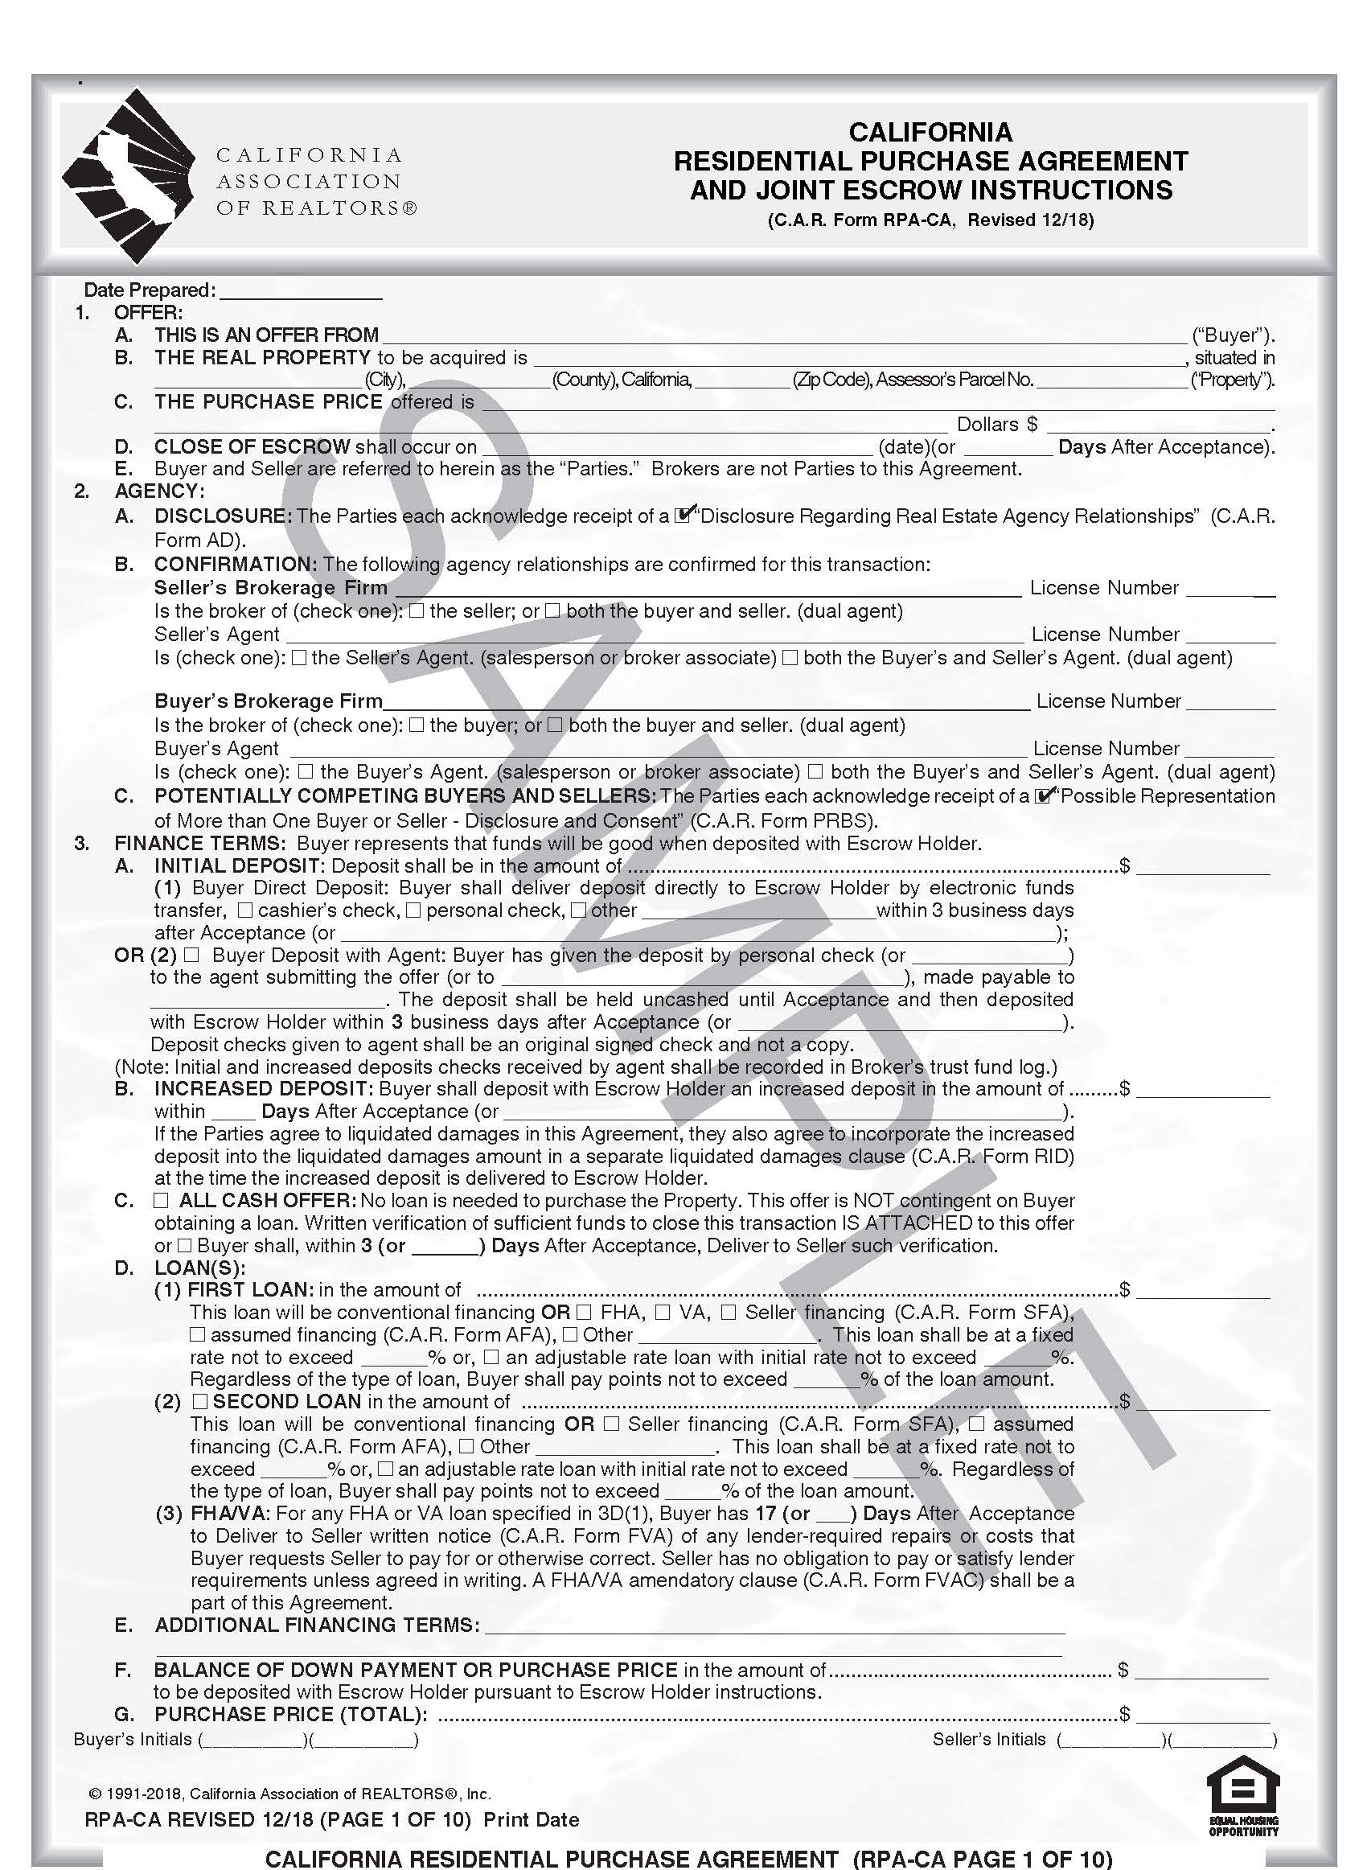

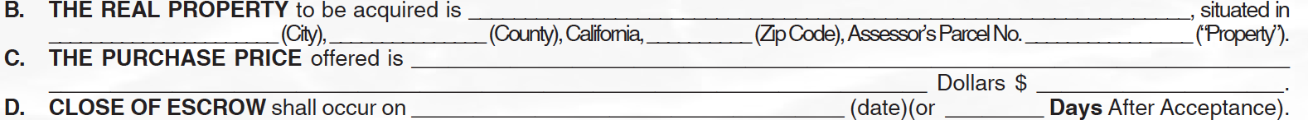
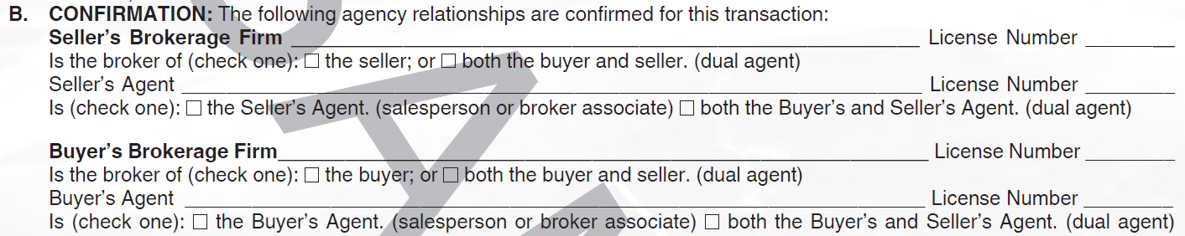
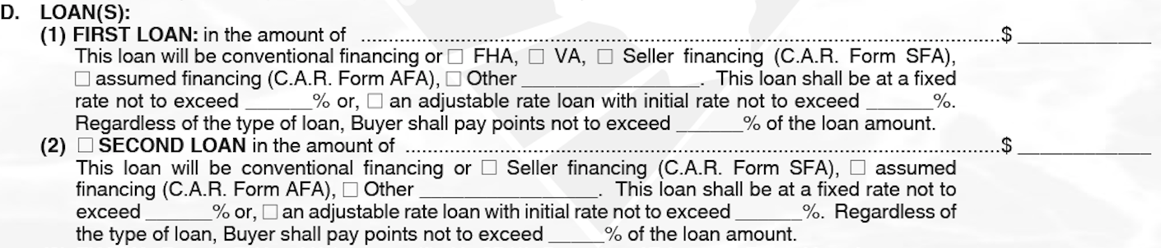
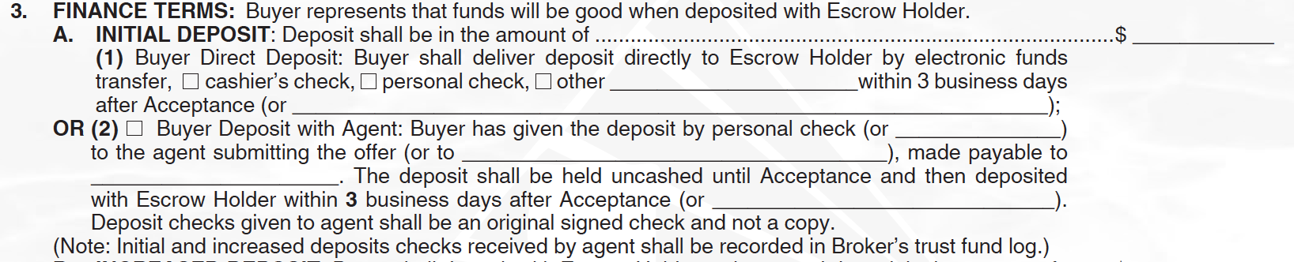
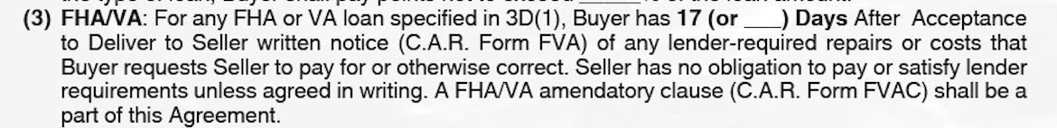
California Residential Purchase Agreement and Joint Escrow Instructions, p.1.
Date Prepared
Date Prepared. This blank line should be filled in with the date that a real estate agent prepares the offer for the buyer’s signature, not the date the buyer (or seller) actually signs.
The purpose of this line is to be able to easily reference this document, as opposed to any other offers received, in any counter offers, addenda or other relevant documents.
Other paragraphs identify when an offer has been accepted and the parties have formed a binding contract (paragraphs 30.A. and 32).
x
RPA TITLE
Title. This form is used by a buyer to make an offer on a seller’s property. Once accepted by the seller, the form creates a binding agreement. It can be used anywhere in California.
x
OFFER
1.A. All buyers should be listed here. If there is not room, use an addendum. If the buyer is a corporation, LLC, or trust, enter the entity or trust name here. When you get to the signature page make sure to check the box to add the form RCSD so everyone knows who will actually sign on behalf of the entity or trust.
1.A. Make sure all buyers listed here are also listed on the signature page. If there are more than two buyers, use an Additional Signature Addendum form for the others.
Paragraph 1.a.
FINANCE TERMS; INCREASED DEPOSIT
3.B. Sometimes, especially if the initial deposit is low, the seller thinks the buyer should put in more money later in the transaction to show the buyer is truly committed to buying the property.
x
x
OFFER
1.B. This identifies the property by address and legally recorded document.
1.C. The price here should match the price in 3.G. Buyer may have other costs such as escrow or title fees. Seller may use the price to pay off loans, and broker, title and escrow fees.
1.D. Close of escrow date is not just aspirational, it is contractual. If one party is not able to close escrow on time, the other party may have a right to cancel.
PARAGRAPH 1.B.,C. & D.
x
Paragraph 3.b.
Agency; Disclosure
2.A. All buyers and sellers should have received the form on screens 3 and 4.
This form lets you know that a real estate broker can represent only a seller, only a buyer or both buyer and seller in the same transaction.
This form does not tell you specifically who the broker represents; that information comes later in the purchase agreement (paragraph 2B).
The back or second page of the form is simply a reprint of the entire law.
No matter who the broker represents, the broker through its agents must treat all parties honestly and fairly.
Paragraph 2.a.
x
FINANCE TERMS; INITIAL DEPOSIT
3.A. (1) This is the amount of money the buyer gives to an escrow to let the seller know the buyer is serious. Most people use wire transfer rather than cash or check. Before wiring funds, confirm instructions with the escrow officer.
3.A. (1) A typical deposit is around 3% of the price. But it could be more or less depending on what the buyer and seller each want.
3.A. (2) Sometimes the buyer gives a check to the broker, but this is rare. Usually, the money goes direct from buyer to escrow.
x
FINANCE TERMS; LOAN(S)
3.D. (1) and (2) Here is where the buyer will show the seller how much money the buyer needs to borrow and the terms on which they are willing to borrow.
x
AGENCY; CONFIRMATION
2.B. Here is where the brokers and individual real estate agents declare who they are representing; it could be seller only; buyer only or both. Even if you are working with a specific agent only, if the brokerage company represents both buyer and seller, so does “your” agent. No matter who has your back, every agent is required to treat all parties honestly and fairly.
Paragraph 2.b.
x
x
Paragraphs
1 – Offer, A-E
2 – Agency, A-C
3 – Finance Terms, A-G
FINANCE TERMS; ALL CASH OFFER
3.C. This paragraph should only be checked when the buyer has enough money to buy the property without getting a loan. Buyer should never bring actual cash to the escrow.
3.C. Some buyers think they can “trick” the seller into accepting their offer by checking this paragraph even if they will still apply for a loan. But the buyer still has to prove the full cash amount is available.
If the buyer really needs a loan but is willing to take the chance the lender won’t approve, the buyer should check paragraph 3.J. (4) instead.
Paragraph 3.D. (1)&(2)
Paragraph 3.A. (1)&(2)
FINANCE TERMS; LOAN(S)
3.D. (1) and (2) Here is where the buyer will show the seller how much money the buyer needs to borrow and the terms on which they are willing to borrow.
x
LOAN(S) – FHA/VA
3.D. (3) Some buyers use specific loan programs rather than getting a conventional loan from a bank. FHA loan programs usually require very little down payment. VA loan programs are only available to U.S. veterans and often involve low or no down payment.
Paragraph 3.c.
x
Paragraph 3.D. (3)
AGENCY; POTENTIALLY COMPETING BUYERS AND SELLERS
2.C. All buyers and sellers should have received the form on screen 5.
This form lets you know that a real estate broker, through its agents, can represent many buyers or sellers at the same time.
Some of these buyers or sellers may be competing against you.
If you are writing an offer, the seller and seller’s broker may let others know everything about the offer.
x
Paragraph 3.D. (1)&(2)
x
FINANCE TERMS; BALANCE OF DOWN PAYMENT OR PURCHASE PRICE
3.F. This paragraph identifies the amount of money the buyer needs to place into escrow after the deposit (paragraph 3A), increased deposits, if any, (paragraph 3B) and loan amount(s), if any, (paragraph 3D) have already been counted. If there are no loans, then this is the cash balance the buyer is responsible for. Escrow holder will require payment a few days before the scheduled close of escrow to make sure the money is in place. Buyers should use caution when transferring these funds electronically or through wire transfer (C.A.R. Form WFA). Seller has the right to verify that the buyer actually has access to the funds (paragraph 3H)
FINANCE TERMS; PURCHASE PRICE (TOTAL)
3.G. The total is the amount of money that is the agreed price the buyer will pay for the property. A buyer who has negotiated for the seller to give a credit (paragraph 3.J. (5)) still pays the total amount. The credit is often used to pay other costs (such as escrow, title or lender fees) the buyer is responsible for in the transaction and may not be returned to the buyer in cash. The seller will usually not receive the total amount because the seller must pay any necessary title fees, escrow fees, repair costs, broker commissions and other expenses out of the total.
x
FINANCE TERMS: ADDITIONAL FINANCING TERMS
3.E. There are things that affect financing which do not necessarily affect the price of the property. An example would be if the buyer wants the seller to pay for certain costs of obtaining a loan (recurring or non-recurring closing costs). Those items can be written into paragraph 3E but no dollar amount is carried over into the column that adds up to the purchase price. These are extras that need to be written into the contract. Some agents use paragraph 6 or 7.D. (8) or (9) instead.
Paragraph 2.c.
x
Paragraph 3.f.
Paragraph 3.e.
Paragraph 3.g.
RPA page: 1. 2. 3. 4. 5. 6. 7. 8. 9. 10.
CALIFORNIA ASSOCIATION OF REALTORS® I Residential Purchase Agreement Summary for Consumers

Slide 9
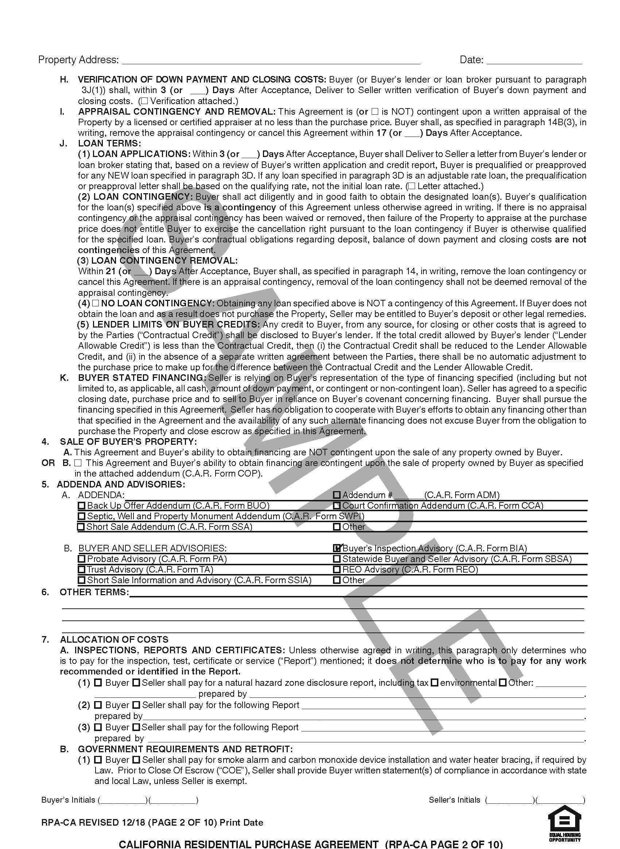
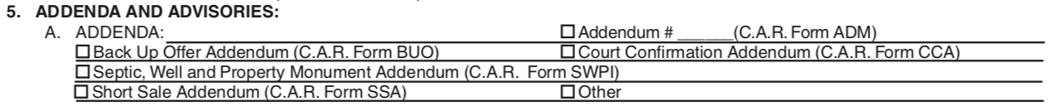
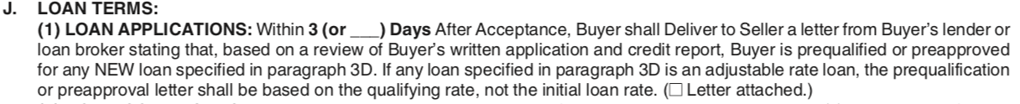
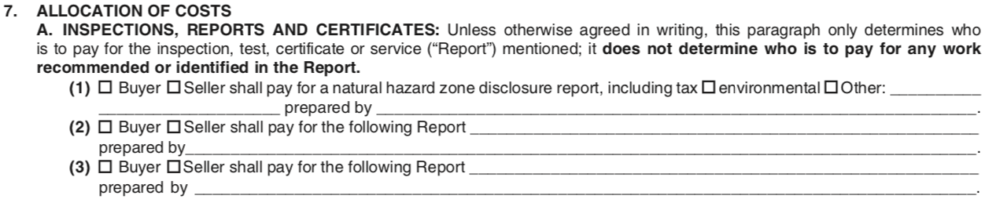
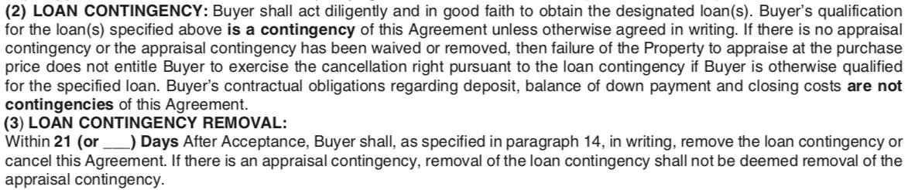
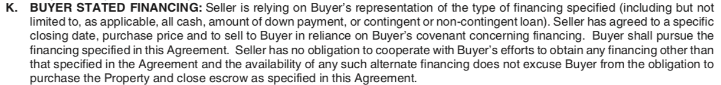
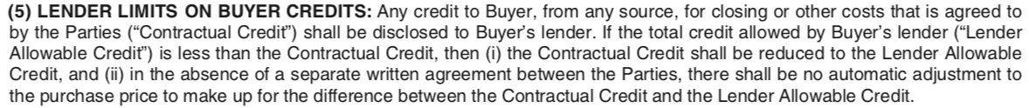
BUYER AND SELLER ADVISORIES
5.B. There are other forms that give both buyer and seller advice but don’t actually require either one to act. They should be read carefully.
Probate Advisory (C.A.R. Form PA): When the owner has died, the sale may go through an estate, which is a court process. This form says what laws do or do not apply.
Trust Advisory (C.A.R. Form TA): If the owner put the property in trust, usually for some tax or planning purpose, the trustee is the actual seller and may not have lived there. This form says what laws do or do not apply.
Short Sale (C.A.R. Form SSIA): There are a lot of considerations, such as taxes, credit, and right of lender to approve or disapprove a sale that should be considered by both buyer and seller in this kind of sale.
Buyer Inspection Advisory (C.A.R. Form BIA): This one-page form mentions many things that the buyer should probably look into, like the size and condition of the property, and the neighborhood.
Statewide Advisory (C.A.R. Form SBSA): This multi-page form mentions lots of things that the buyer should think about and also the seller.
REO Advisory (C.A.R. Form REO): If the former owner does not make payments, the lender, or bank, could become the owner through a foreclosure or similar process. This form says what laws do or do not apply.
ADDENDA
5.A. Many other forms may be attached to this agreement. Most of these boxes will not be checked. A few are named here.
Addendum (C.A.R. Form ADM): This form will include language to be added that is usually unique to the buyer’s situation.
Back-Up Offer (C.A.R. Form BUO): This form is used when the seller is already in a contract with another buyer and the buyer writing this offer wants to be next in line.
Court Confirmation (C.A.R. Form CCA): This form is used when the seller needs to go to court to get permission to sell the property. That can happen, for example, if the seller is going through a bankruptcy, or a divorce, or a business break-up with a partner.
Septic, Well … (C.A.R. Form SWPI): In most cities, water arrives through a water line and waste goes through a sewer line. In more rural, and sometimes suburban, areas, water may come from a well and waste goes into a septic system on the property. Certain inspections and reports are unique to these items and should be addressed in an addendum.
Short Sale (C.A.R. Form SSA): Some sellers owe more on their house than it is worth (the house is “upside down” or “under water”). The seller’s lender needs to approve the sale and this form gives the time to do so.
California Residential Purchase Agreement and Joint Escrow Instructions, p.2.
Paragraph 5.b.
x
Paragraph 5.a.
x
FINANCE TERMS; VERIFICATION OF DOWN PAYMENT AND CLOSING COSTS
3.H. Since a lender will usually not finance the entire purchase, the buyer needs to show the seller that the buyer has the difference, usually in the bank.
Paragraph 3.h.
x
FINANCE TERMS; APPRAISAL CONTINGENCY AND REMOVAL
3.I. An appraisal is a written statement by a professional saying what the property is worth. If the appraiser says the property is not worth the price the buyer agreed to pay, then the buyer could have a legal excuse to get out of the contract and have the deposit returned.
Paragraph 3.i.
x
FINANCE TERMS; LOAN TERMS – LOAN APPLICATIONS
3.J. (1) If a buyer needs a loan to purchase property, this paragraph requires the buyer to prove to the seller that the buyer is making efforts to get the loan. The seller will lose confidence in the buyer’s ability to perform if the buyer has not even started the process of getting a loan. Pre-approval or pre-qualification is not a guarantee the loan will be obtained but rather proof that the buyer is taking the necessary steps to purchase. Seller has the right to potentially cancel on a buyer who cannot even show that this minimum obligation is in process.
ALLOCATION OF COSTS; Inspections, Reports and Certificates
7.A. In most transactions, one of the parties pays for a natural hazard disclosure report. The NHD report is prepared by a professional company that examines public documents to determine if the property is in a flood, fire or earthquake zone designated by the State or Federal government. Many such reports also indicate what tax zones affect the property and if there are other environmental concerns. Knowing these things can affect the availability, and cost, of certain insurance.
x
Paragraph 7.a.
Paragraph 3.J. (1)
x
ALLOCATION OF COSTS; Government Requirements and Retrofit
7.B. California law requires residential property to have certain safety features whether or not the property is being sold. Local law may require that property be inspected prior to a sale or that safety or environmentally conscious features exist in order to even sell a home. This paragraph determines who is to pay for what and under what circumstance.
FINANCE TERMS; LOAN TERMS – LOAN CONTINGENCY AND REMOVAL
3.J.(2)and(3) If the lender will not make the buyer a loan, either because the property is not worth the price or the buyer is not qualified for the loan, the buyer can walk away from the contract without consequence. But, if the buyer already removed the appraisal contingency, then the buyer loses that excuse to cancel the contract even if that’s why the lender will not loan the money.
3.J.(2)and(3) If the buyer removes the loan contingency before the lender makes a decision, the buyer is at risk.
3.J. (2) and (3) The buyer has 21 days to decide whether to remove this contingency or cancel the contract.
Paragraph 7.b. (1)
x
Paragraph 3.J. (2)&(3)
x
FINANCE TERMS; LOAN TERMS – NO LOAN CONTINGENCY
3.J. (4) If the buyer checks this box, the message the buyer is giving is that the buyer needs a loan to purchase the property but is willing to take the risk that the buyer will not get the loan.
OTHER TERMS
6. The contract is created to cover most situations that are legally required or likely to occur in residential purchase and sale transactions throughout California. But, not every scenario can be anticipated. This paragraph allows a buyer, seller or real estate licensee to insert language that may be unique or that one or more of the parties want to emphasize or clarify.
x
Paragraph 6.
Paragraph 3.J. (4)
x
Paragraphs
3 – Finance Terms, H-K
4 – Sale of Buyer’s Property, A-B
5 – Addenda and Advisories, A-B
6 – Other Terms
7 – Allocation of Costs, A-B(1)
FINANCE TERMS; LOAN TERMS – LENDER LIMITS ON BUYER CREDITS
3.J. (5) Some sellers agree to give the buyer back part of the purchase price to help the buyer pay for certain costs. If the buyer is getting a loan, the lender needs to be told about this. And if the lender will not approve the full amount, then the seller only has to give the buyer the amount lender will allow.
Paragraph 3.J. (5)
x
FINANCE TERMS; BUYER STATED FINANCING
3.K. This paragraph tells the buyer that it is important to be honest in how you write your offer. Buyers are expected to pursue the financing they specified. For example, if buyer’s offer says the buyer has 20% down payment then the buyer needs to try and get a 80% loan. The buyer can try to get something different but the buyer should still try to get what was promised in the offer and the seller does not have cooperate with anything else.
3.K. If the buyer says, for example, that the buyer has all cash or a 20% down payment and really doesn’t, then that is like breaking a promise and could cause the buyer to lose the deposit or suffer some other consequences.
Paragraph 3.K.
x
SALE OF BUYER’S PROPERTY
4.A. The buyer says that it is not necessary to sell an existing home in order to purchase the one from the seller.
4.B. Here is where the buyer declares that in order to buy from the seller, the buyer first has to sell a house that the buyer owns. If the buyer cannot sell that house within the identified period, the buyer can get out of the contract. If this paragraph is checked, an additional form, (C.A.R. Form COP) should be attached to the agreement.
Paragraph 4.A.&B.
x
RPA page: 1. 2. 3. 4. 5. 6. 7. 8. 9. 10.
CALIFORNIA ASSOCIATION OF REALTORS® I Residential Purchase Agreement Summary for Consumers

Slide 10
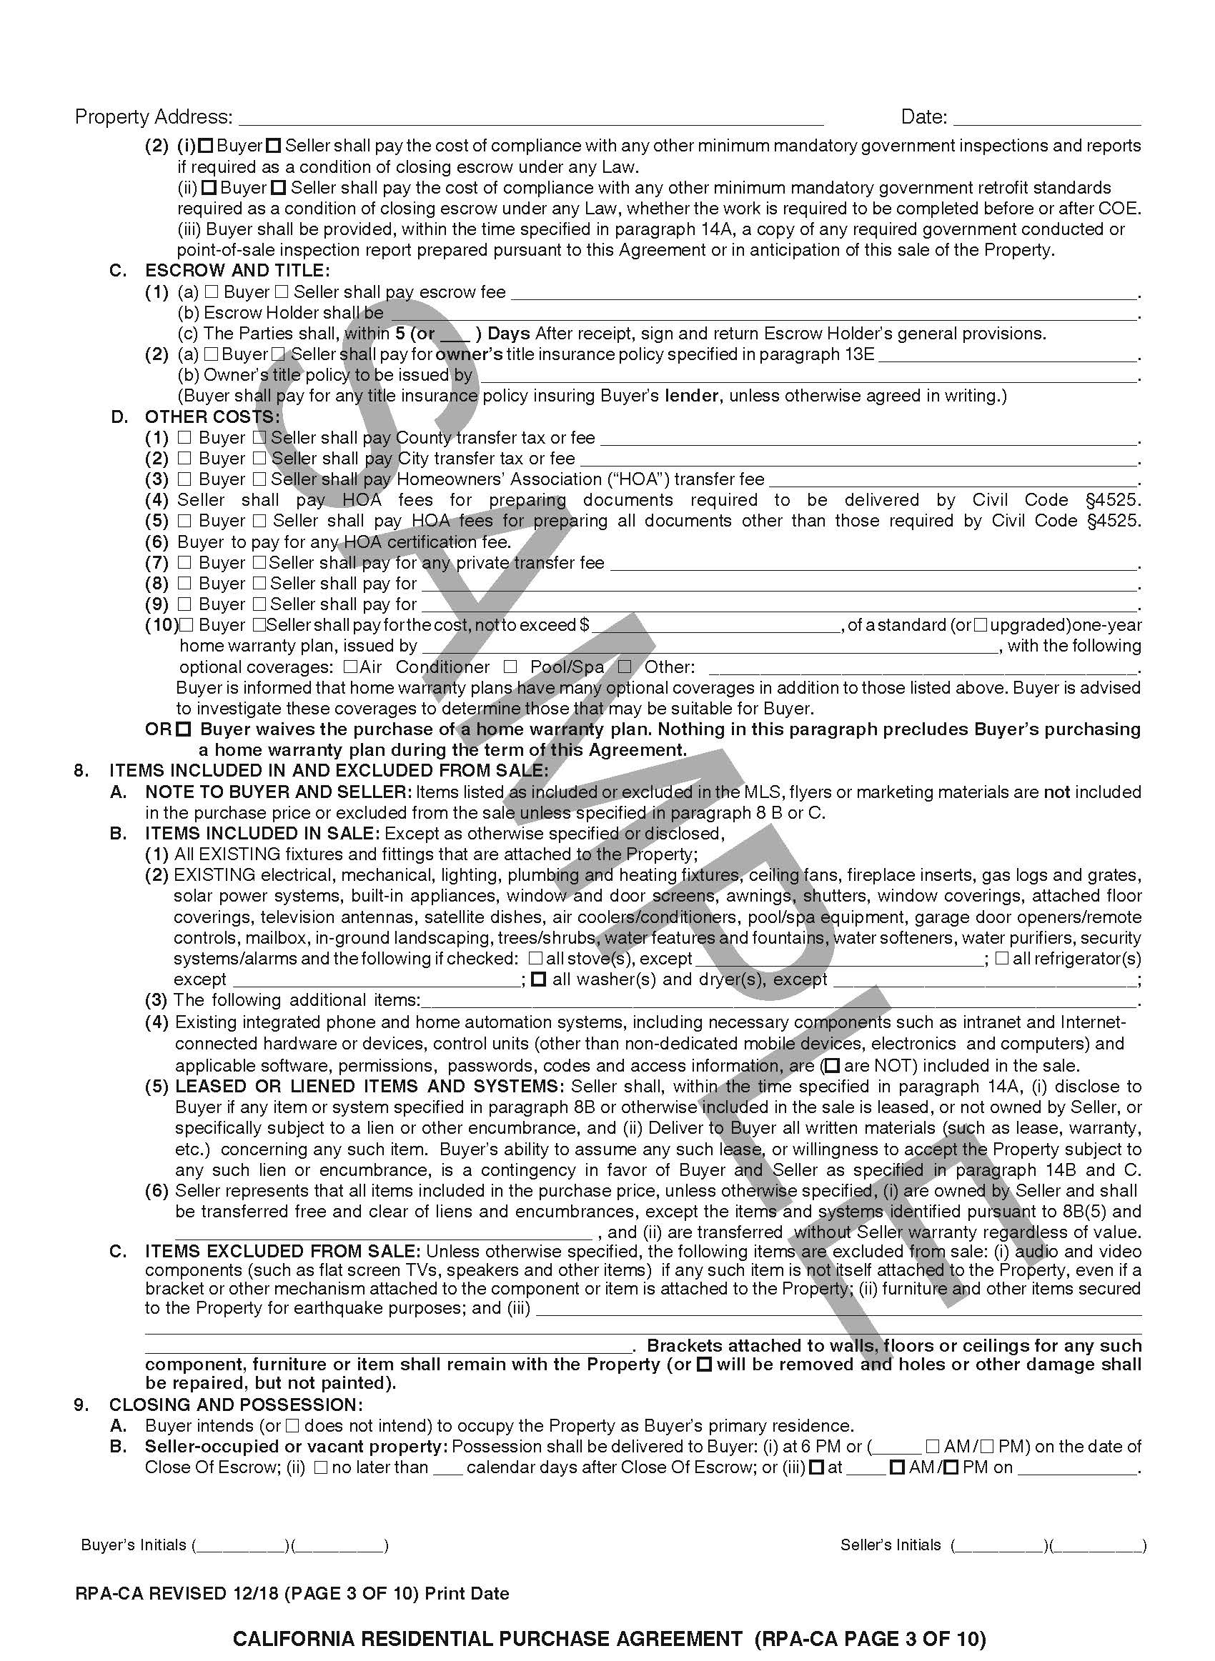
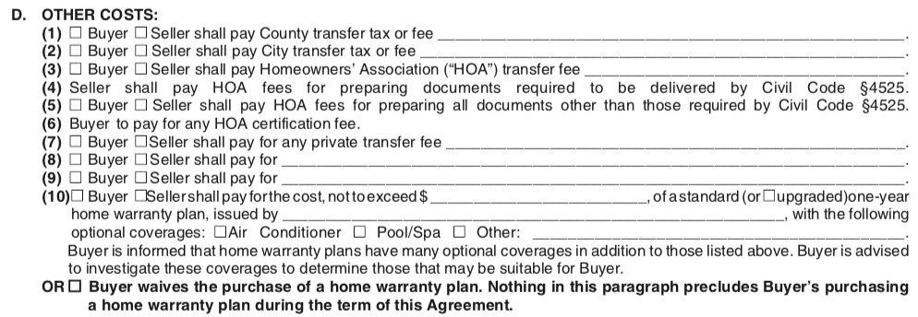
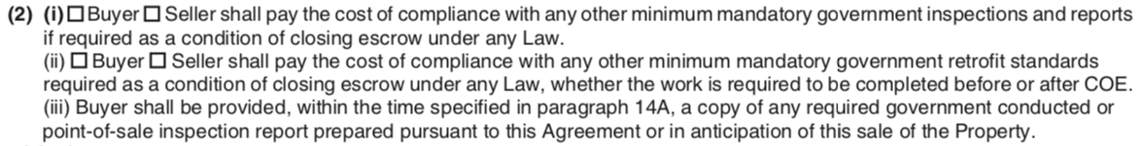
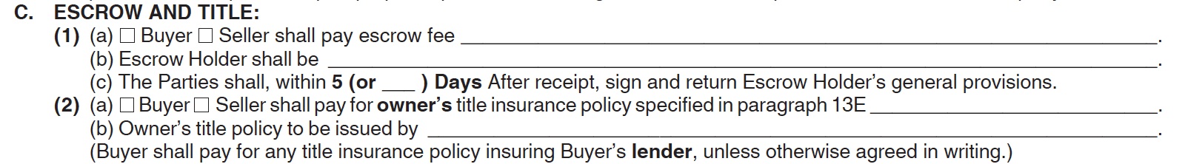
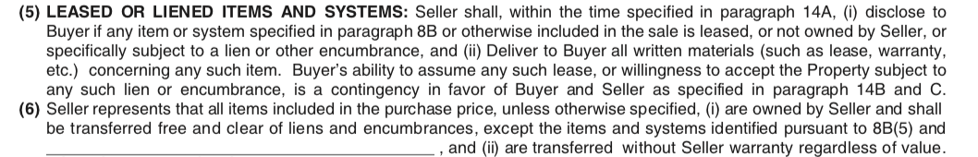
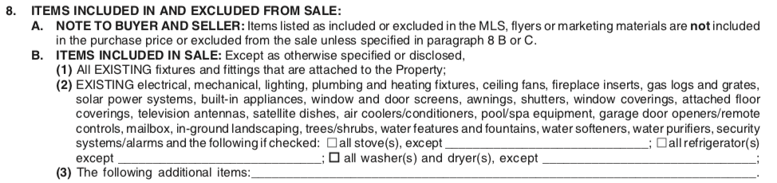
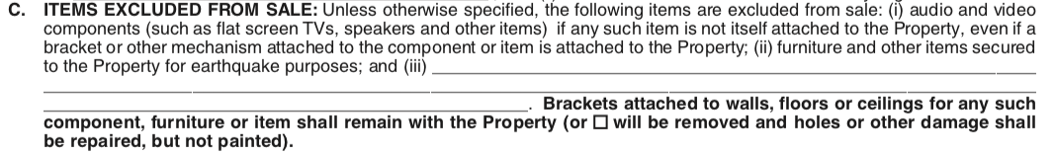
California Residential Purchase Agreement and Joint Escrow Instructions, p.3.
ALLOCATION OF COSTS; OTHER COSTS
7.D. This section designates who will pay various other fees that are included in a typical real estate transaction. Most of these fees are negotiable but in certain parts of the State it is more common for one party to pay than another. Lines (8) and (9) can be used to cover fees for items not covered by the preprinted paragraphs.
7.D.(10) A home warranty is like insurance to help pay for repairs to defects to certain items that develop after close of escrow. If a seller will not pay, a buyer has a right to purchase a home warranty plan during escrow.
Paragraph 7.d.
x
ALLOCATION OF COSTS; Government Requirements and Retrofit
7.B. California law requires residential property to have certain safety features whether or not the property is being sold. Local law may require that property be inspected prior to a sale or that safety or environmentally conscious features exist in order to even sell a home. This paragraph determines who is to pay for what and under what circumstance.
Paragraph 7.b. (2)
x
ALLOCATION OF COSTS; ESCROW AND TITLE
7.C. Here parties pick who is responsible for paying the escrow fee and who the Escrow Holder will be. Escrow is the “middleman” who holds the seller’s deed and buyer’s funds until both buyer and seller meet their obligations under the RPA. Escrow then distributes the money. The clause also designates who pays for the owner’s title insurance policy. Title insurance assures a buyer that it will have proper ownership of the property upon purchase. See paragraph 13 in the RPA.
Paragraph 7.c.
x
CLOSING AND POSSESSION
ITEMS INCLUDED IN AND EXCLUDED FROM SALE
LEASED OR LIENED ITEMS AND SYSTEMS
8.B.(5) This clause addresses leased and liened items on the Property. A good example of leased items are solar panels, as property owners rarely own these outright. Buyers should get relevant documents, such as leases and warranties, pertaining to the item, as these will likely bind the Property even after title is transferred to the Buyer.
Note that there is a contingency for BOTH the buyer AND seller allowing either party to cancel if the Buyer can’t or doesn’t want to assume the lien/encumbrance for the item.
x
Paragraph 8.B.(5)
x
ITEMS INCLUDED IN AND EXCLUDED FROM SALE
8.A. Just because an item or feature appears in a picture or ad, doesn’t mean it comes with the property. It must be mentioned in this paragraph to be included. If a buyer wants something and is not sure if it is included or excluded, the buyer should write the item in 8.B.(3). See paragraph 8.C. for those items that go with the seller.
Paragraph 9.A.&B.
x
Paragraph 8.A.
ITEMS INCLUDED IN AND EXCLUDED FROM SALE
8.B. (2) Anything that is attached to the Property, or a “fixture” is included. Many items that are not attached are also included but only if listed in this paragraph. Pay special attention to the checkboxes towards the end of the clause referencing the stove(s), refrigerator(s), washer(s), and dryer(s)! If you want these items included in the sale, make sure to check the appropriate box!
Paragraph 8B (2)
x
ITEMS INCLUDED IN AND EXCLUDED FROM SALE
LEASED OR LIENED ITEMS AND SYSTEMS
8.B. (6) Unless the seller tells the buyer otherwise (per clause 8.B(5)) the seller is claiming to own and have the ability to transfer clause 8 items, but without warranty. This means that the seller is not promising, for example, the items are in good or working condition or that they will last for a period of time.
ITEMS INCLUDED IN AND EXCLUDED FROM SALE
8.B. (4) Many homes today have “smart” features that are built in to the property, such as interconnected phone systems, thermostat or temperature control system, or even a home specific intranet. To the extent a system like that is fully “integrated” with the property it is included in the sale. Outside components such as the seller’s mobile phone or a cable company’s server are not included. It can often be difficult to tell. To avoid any disputes or confusion, it’s a good practice to communicate specifically what the parties are including in written communications, as well as in this clause or an addendum as needed.
Paragraph 8.B.(4)
x
x
Paragraph 8.B.(6)
Paragraphs
7 – Allocation of Costs, B(2)-D
8 – Items Included in and Excluded from Sale, A-C
9 – Closing and Possession, A-B
ITEMS EXCLUDED FROM SALE
8.C. This is the paragraph where you can list items that are excluded from sale. If a flat screen tv is attached to a bracket which is attached to a wall, the bracket stays with the property but the tv goes with the seller.
Paragraph 8.c.
x
9.A. Whether the buyer plans on occupying the Property as a primary residence can impact what rules and regulations apply to the transaction, the type of loan the buyer will be eligible for, the type of insurance the buyer needs and even the length of notice necessary to terminate the tenancy of any tenants who are already in the Property.
9.B. Here is where Parties agree when possession of the Property will be delivered, and the default rule is 6pm on the date that escrow closes. A seller who can’t deliver possession on time, may be in breach of contract. Note that “Close of Escrow” is defined in the RPA in clause 30D and that delivery of possession means the property is vacant and free from all debris.
RPA page: 1. 2. 3. 4. 5. 6. 7. 8. 9. 10.
CALIFORNIA ASSOCIATION OF REALTORS® I Residential Purchase Agreement Summary for Consumers

Slide 11
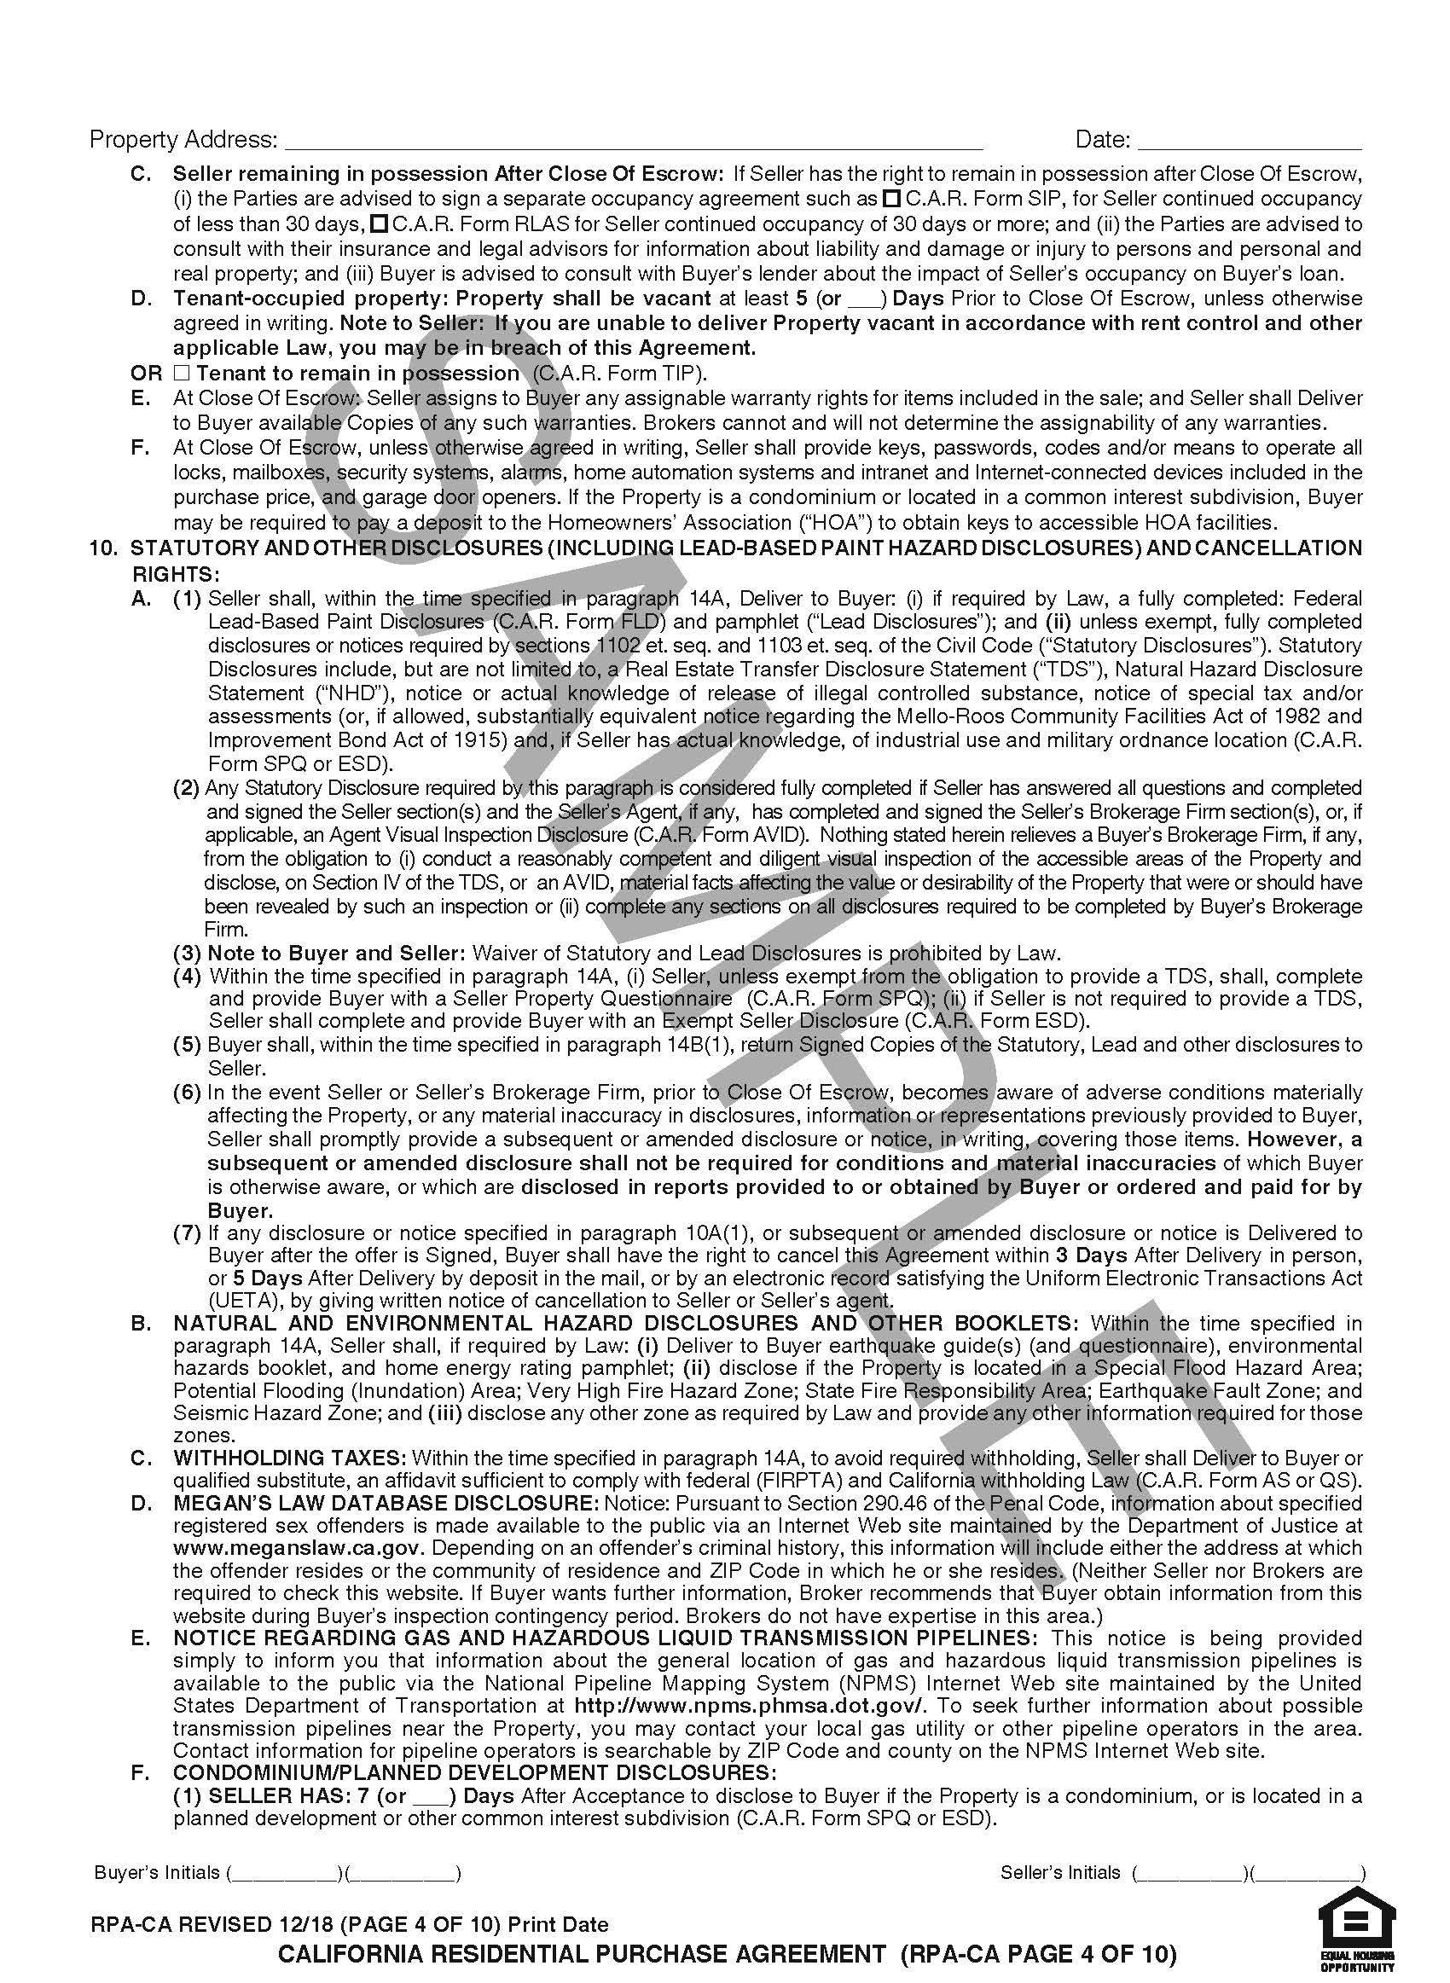
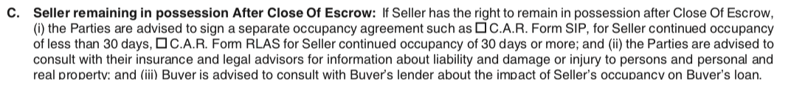
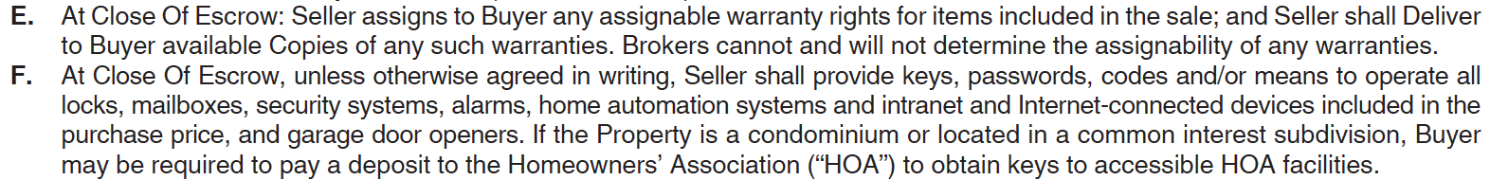
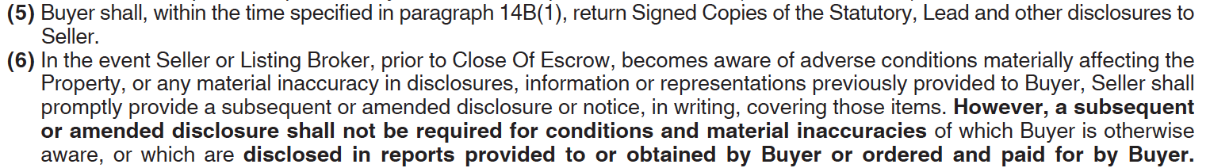
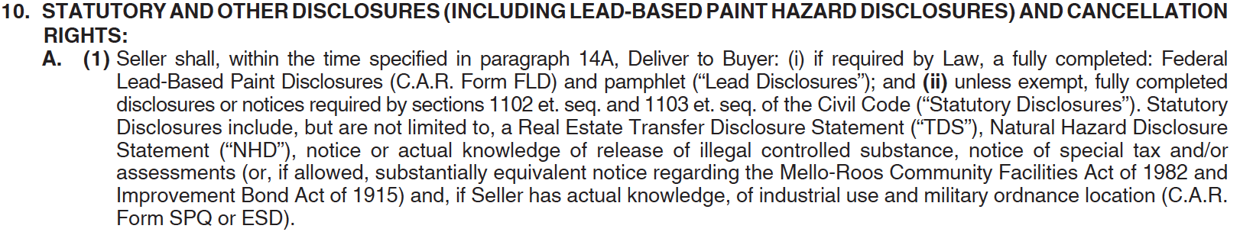
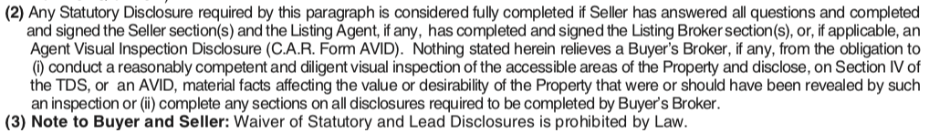
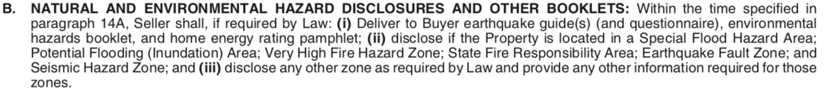
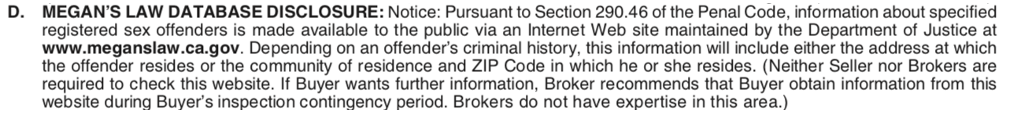
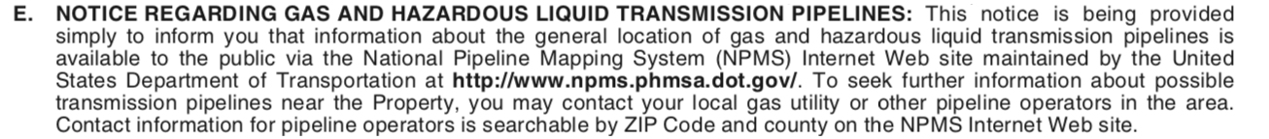
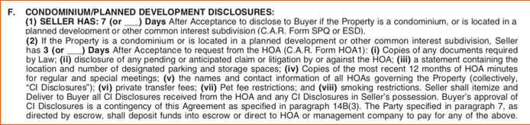
CLOSING AND POSSESSION
x
California Residential Purchase Agreement and Joint Escrow Instructions, p.4.
Paragraph 9.c.
CLOSING AND POSSESSION
Paragraph 9.d.
x
Paragraph 9.E.&F.
x
Paragraph 10.C.
x
x
CLOSING AND POSSESSION
Paragraph 10.A.(5&6)
9.C. Sometimes even though Parties have a scheduled Close of Escrow day, the seller may need to stay on the property after title is transferred. This situation often occurs when the seller needs additional time to move. A buyer does not have to agree to this; this is a point of negotiation. If Parties do agree to have a seller stay in the Property after the Close of Escrow, make sure to check the appropriate box AND have the appropriate form filled out, (C.A.R. Forms SIP or RLAS), depending on how long the seller remains.
Beware, that allowing a seller to remain can have unintended consequences such as turning the buyer/seller relationship into a landlord/tenant relationship with corresponding responsibilities and liability.
Paragraph 10.A.(1)
x
Paragraph 10.b.
x
STATUTORY AND OTHER DISCLOSURES…; WITHHOLDING TAXES
STATUTORY AND OTHER DISCLOSURES (INCLUDING LEAD-BASED PAINT HAZARD DISCLOSURES) AND CANCELLATION RIGHTS
Paragraph 10.A.(2&3)
x
9.D. This clause addresses properties that are occupied by tenants, not by the seller. The default language of the purchase agreement is that the Property will be delivered vacant. In that case, it is the responsibility of the seller to get the tenant out.
If the second box is checked, stating “Tenant to remain in possession”, make sure to use the proper addendum (C.A.R. Form TIP) and the forms the addendum requests, such as a Lease Agreement. This is important because if a buyer purchases a property with a tenant, the buyer will become the landlord. All the important information, such as lease terms, should be reviewed.
STATUTORY AND OTHER DISCLOSURES…; NATURAL AND ENVIRONMENTAL HAZARD DISCLOSURES AND OTHER BOOKLETS
STATUTORY AND OTHER DISCLOSURES (INCLUDING LEAD-BASED PAINT HAZARD DISCLOSURES) AND CANCELLATION RIGHTS
STATUTORY AND OTHER DISCLOSURES (INCLUDING LEAD-BASED PAINT HAZARD DISCLOSURES) AND CANCELLATION RIGHTS
Paragraphs
9 – Closing and Possession, C-F
10 – Statutory and Other Disclosures (Including Lead-Based Paint Hazard Disclosures) and Cancellation Rights, A-F(1)
10.C. Federal law requires a buyer to withhold part of the purchase price (10% or 15% depending on the price) and send the amount to the IRS to make sure the seller reports the sale and pays any required taxes. The seller can avoid this if the seller asserts, in writing, that the seller is a U.S. citizen, a green card holder or meets the “substantial presence” test. There is a form to do this. (C.A.R. Form AS) The seller must include a taxpayer ID (social security number) on this form and give it to the buyer.
Some sellers are concerned about giving their social security number to the buyer. That can be avoided if both of the following occur:
Paragraph 10.A.(4)
x
9.E. Third-party warranties are automatically assigned by the contract on the close of escrow. The buyer should receive copies of any such warranties. There could be warranties for personal property remaining or fixtures such as an air conditioner, heater or roof.
9.F. At the Close of Escrow, seller has to give the buyer all the keys, codes and passwords etc. This includes garage openers!
Paragraph 10.D.
x
Paragraph 10.E.
x
Paragraph 10.A.(7)
STATUTORY AND OTHER DISCLOSURES (INCLUDING LEAD-BASED PAINT HAZARD DISCLOSURES) AND CANCELLATION RIGHTS
x
10.A. (5) Once the buyer receives these disclosures, they should be reviewed carefully, and the buyer should sign them within the time specified in paragraph 14.B. (1)
10.A. (6) If prior to the Close of Escrow, seller finds out about something that negatively and materially impacts the property, or a material inaccuracy in one of their disclosures previously provided, that seller must promptly update or amend their disclosure in writing to reflect this new information!
EXCEPTION: If the buyer discovers the new information or inaccuracy on their own, or if it’s found in a report provided to or paid by the buyer, the seller is NOT obligated to update their disclosure.
STATUTORY AND OTHER DISCLOSURES…;
MEGAN’s LAW DATABASE DISCLOSURE
Paragraph 10.F. (1)
x
STATUTORY AND OTHER DISCLOSURES (INCLUDING LEAD-BASED PAINT HAZARD DISCLOSURES) AND CANCELLATION RIGHTS
STATUTORY AND OTHER DISCLOSURES…;
NOTICE REGARDING GAS AND HAZARDOUS LIQUID TRANSMISSION PIPELINES
10.B. Unless exempt, the seller must provide the buyer with a specific form called the NHD. This form discloses if the Property is in one of 6 hazard zones (2 fire zones, 2 flood zones, 2 earthquake zones). Even if the seller does not have to give that specific form, the seller must still disclose if the Property is in one of these 6 hazard zones. Regardless, most sellers satisfy this obligation by paying a third-party reporting company to check public records and make the disclosure.
10.A.(2) A seller and the listing agent have to disclose all material issues that affect the value or desirability of the property to a buyer. In most cases, a seller will also have to provide the California mandated, Real Estate Transfer Disclosure Statement (C.A.R. Form TDS). This form should be completely filled out by the seller.
The real estate brokers, through their agents, also have a duty to do a thorough visual inspection of the property and disclose material issues. This can be done on C.A.R. form AVID or the last page of TDS.
10.A.(3) Even if a buyer is not interested, the seller must still make the legally mandated disclosures.
STATUTORY AND OTHER DISCLOSURES…;
CONDOMINIUM/PLANNED DEVELOPMENT DISCLOSURES
10.A. (1) California requires sellers to tell buyers about important things concerning the house – But only if the seller is aware of them. The legislature has provided a form (C.A.R. Form TDS) for the seller to make these disclosures.
10.A. (4) The contract also requires the seller to answer additional questions (C.A.R. Form SPQ). Since some things that are not important to a seller may be important to the buyer, or the seller may not remember everything, buyers should not just rely on the seller to make disclosures but should also hire their own inspector!
10.A. (7) If the buyer gets the TDS and SPQ after the buyer has already given an offer to the seller, and the buyer does not like what is in the disclosures, the law and contract give the buyer the right, for a few days, to cancel the contract.
10.E. This paragraph is required by law. The website it references allows a buyer to look up the distance from the property to gas or hazardous liquid pipelines, since this may be a concern in case of a leak or explosion.
10.D. This paragraph is required by law. The website it references allows one to find out if there are registered sexual offenders in a particular area, including near the property the buyer is considering purchasing.
The seller gives the fully completed form to the title or escrow company instead
The title or escrow company agrees to give their own affidavit to the buyer.
10.F. (1) Within the time specified in this clause, a seller must inform the buyer if the property is a condominium, in a planned development, or is in some type of common interest subdivision. While some subdivision properties are walled or gated, others may not be as obvious.
RPA page: 1. 2. 3. 4. 5. 6. 7. 8. 9. 10.
CALIFORNIA ASSOCIATION OF REALTORS® I Residential Purchase Agreement Summary for Consumers

Slide 12
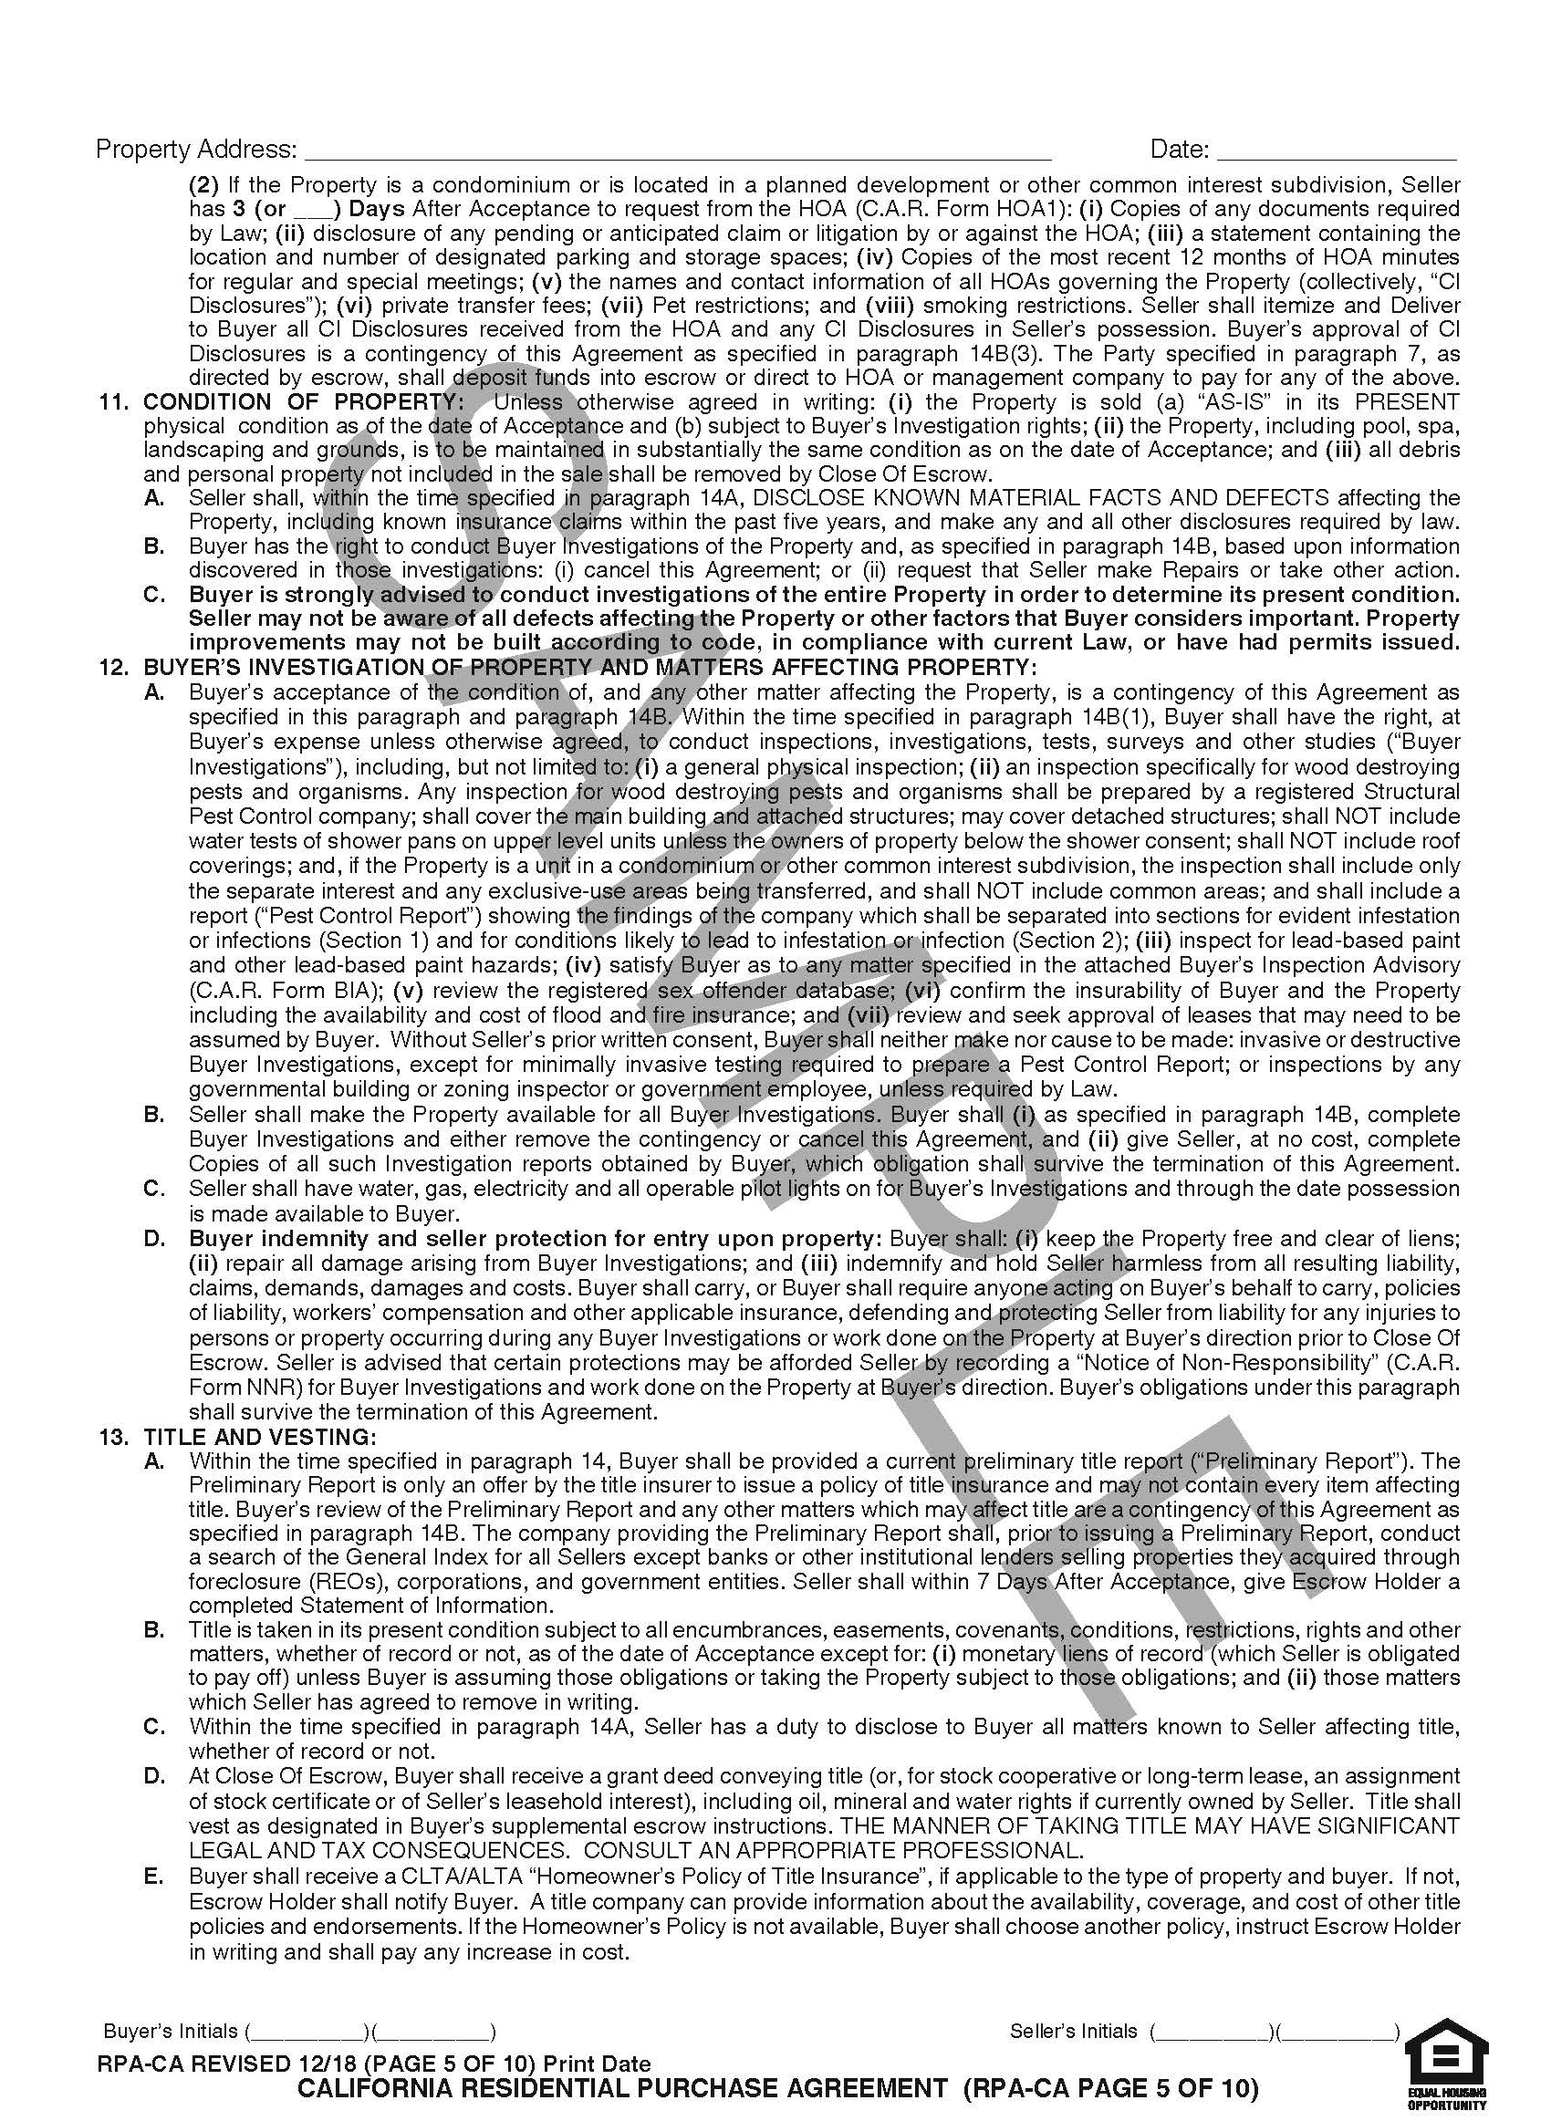
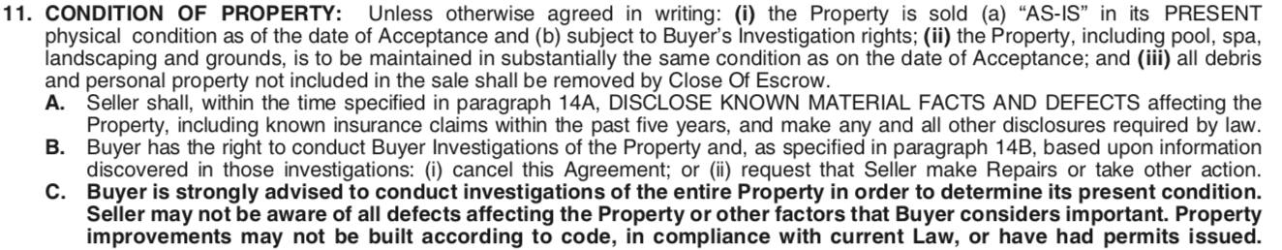
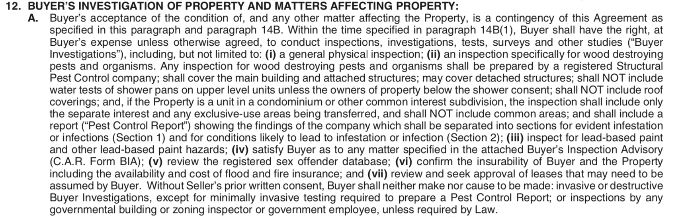
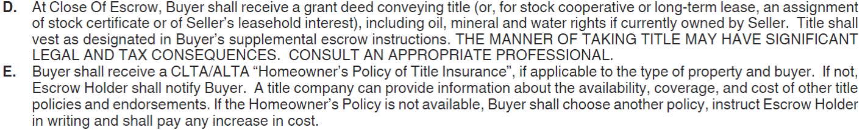
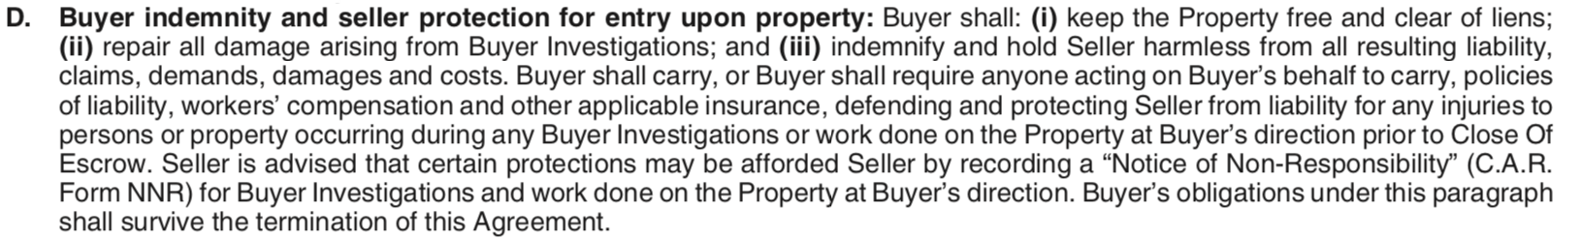
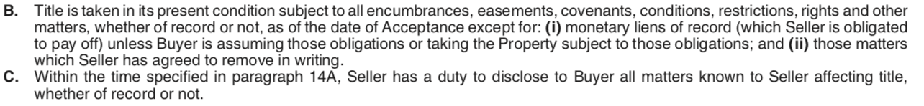
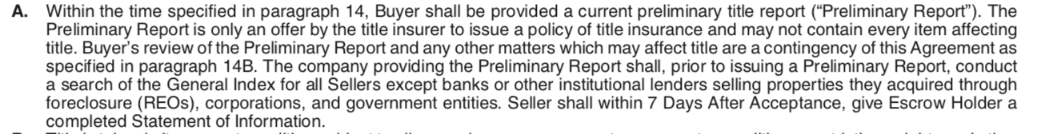
California Residential Purchase Agreement and Joint Escrow Instructions, p.5.
x
Paragraph 10.F. (2)
Paragraph 11.
x
STATUTORY AND OTHER DISCLOSURES…;
CONDOMINIUM/PLANNED DEVELOPMENT DISCLOSURES
Paragraph 12.a.
CONDITION OF PROPERTY
x
Paragraph 13.D.&E.
x
x
BUYER’S INVESTIGATION OF PROPERTY
AND MATTERS AFFECTING PROPERTY
Paragraph 12.D.
TITLE AND VESTING
BUYER’S INVESTIGATION OF PROPERTY
AND MATTERS AFFECTING PROPERTY
Paragraph 12.b.c.
x
x
11. The property is sold in its “as-is” condition. But what does that mean? Sellers must still disclose any known material facts or defects (see paragraph 10). However, if something is already broken or in disrepair, seller does not have to fix it, unless the contract specifically says so. Buyers have the right to inspect the property (see paragraph 12 and paragraph 14B(5)) and within a certain period of time back out of the contract if not satisfied. And, buyer can always ask the seller to make repairs. The worst that happens, is the seller says, “no.”
Paragraphs
10 – Statutory and Other Disclosures (Including Lead-Based Paint Hazard Disclosures) and Cancellation Rights, F(2)
11 – Condition of Property, A-C
12 – Buyer’s Investigation of Property and Matters Affecting Property, A-D
13 – Title and Vesting, A-E
Paragraph 13.B.&C.
10.F. (2) This clause says that if the property is a condominium, or in a planned development, the seller must provide all of the information listed (also see clause 7D). Most homeowner associations or their management company charge to provide these documents to a seller. If the seller has current information in possession, the seller can give that to a buyer instead.
BUYER’S INVESTIGATION OF PROPERTY AND
MATTERS AFFECTING PROPERTY
Paragraph 13.a.
x
TITLE AND VESTING
13.D. Title will be transferred to the buyer through a grant deed including rights to the Property’s oil, mineral, and water rights if the seller currently owns them. For example, a previous owner may have sold the oil rights to a gas or energy company years or decades earlier. The current owner may or may not be due royalty fees.
Of course, the way the buyer takes title can make a big difference. For example, the buyer can choose to take title solely, with a friend as a joint tenant, or with a business partner as a tenant-in-common, or a spouse as community property. How the buyer chooses to take title can have serious tax and legal consequences, so make sure to check with escrow, a tax consultant, or an attorney to make sure they’re transferring title in a way that best suits their needs!
13.E. The CLTA/ALTA Homeowners policy is the type of title insurance that is standard in the real estate industry and provides greater protection to the buyer than other types of title coverage. The buyer will get the Homeowners policy if it’s available to them, depending on the type of situation.
TITLE AND VESTING
12.D. Having the right to inspect does NOT give the buyer the right to damage the seller’s home. If the buyer, or the buyer’s workers do cause damage, the seller is entitled to be compensated.
12.B.&C. The seller must allow the buyer into the property to conduct inspections, but only during the time allowed for inspections in the contract. Of course, an inspection won’t mean much unless the utilities are on. This paragraph requires the seller to keep the utilities on not just through the inspection period but the entire escrow period.
12.A. This paragraph gives the buyer the right to inspect all aspects of the property, the inside and the outside, all the rooms, and to check out anything else of interest to the buyer. In most cases, if the buyer does not want to move forward with the sale, the buyer can cancel but only if the buyer acts within the time allowed. Every buyer should take advantage of this right to check out the property!
13.B. Just as the property improvements are being sold in as-is condition (see paragraph 11), so too is the title to the property taken in its present condition, with a few exceptions. Example include things like easements, restrictions, and CC&R’s. For example, a neighbor may have an easement to use the property’s driveway.
However if a bank or other lender has recorded a lien on title to secure a loan, that lien needs to be removed.
13.C. Seller has to disclose to the buyer all the matters that affect title...that the seller is AWARE of.
13.A. How does a buyer know the seller really owns the property? Or that no one else has the right to build on it, drill on or under it, park on it, drive across it or use it in any way? There are public records that can tell all of that or better yet, the buyer can obtain a title insurance policy effective on close of escrow. But even before, the buyer will want to look at information from the title company to make the decision as to whether it is even worth it to buy based on issues that might show up.
RPA page: 1. 2. 3. 4. 5. 6. 7. 8. 9. 10.
CALIFORNIA ASSOCIATION OF REALTORS® I Residential Purchase Agreement Summary for Consumers

Slide 13
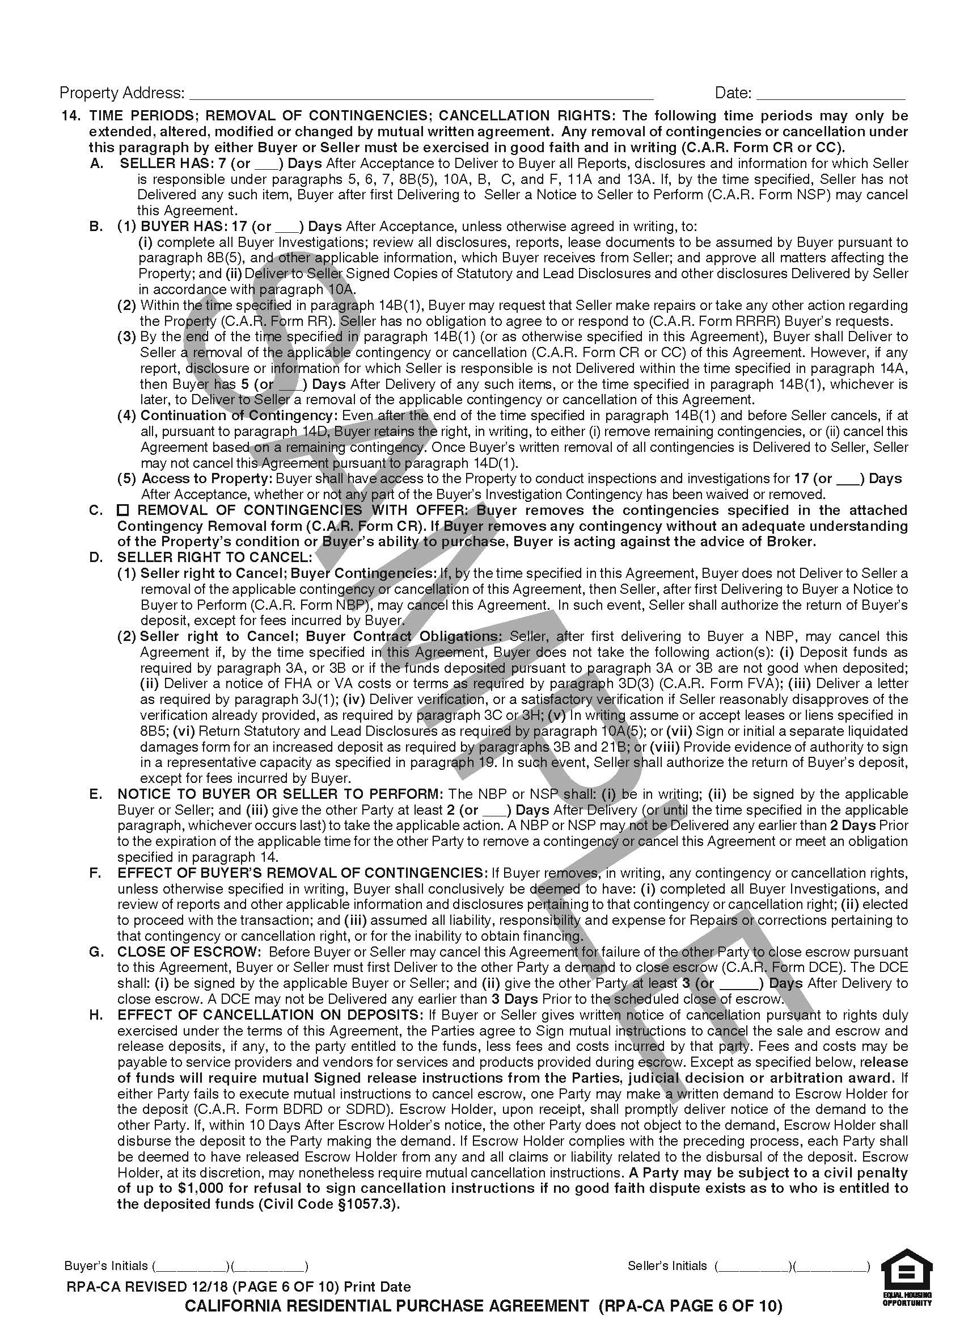
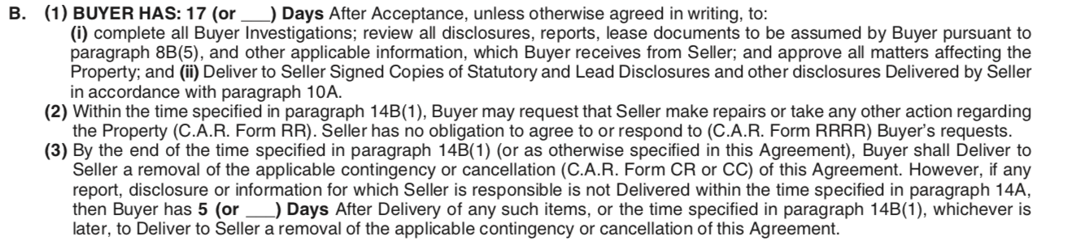
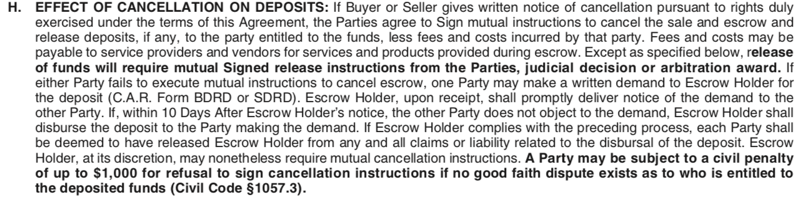
California Residential Purchase Agreement and Joint Escrow Instructions, p.6.
Paragraph 14.B. (1-3)
x
x
Paragraph 14.B. (4)
x
x
Paragraph 14.B. (5)
x
Paragraph 14.c.
Paragraph 14.
x
TIME PERIODS; REMOVAL OF CONTINGENCIES;
CANCELLATION RIGHTS; BUYER HAS
Paragraph 14.a.
TIME PERIODS; REMOVAL OF CONTINGENCIES; CANCELLATION RIGHTS;
REMOVAL OF CONTINGENCIES WITH OFFER
TIME PERIODS; REMOVAL OF CONTINGENCIES; CANCELLATION RIGHTS;
BUYER HAS: CONTINUATION OF CONTINGENCY
TIME PERIODS; REMOVAL OF CONTINGENCIES; CANCELLATION RIGHTS;
ACCESS TO PROPERTY
TIME PERIODS; REMOVAL OF CONTINGENCIES; CANCELLATION RIGHTS
Paragraph 14.d.
x
TIME PERIODS; REMOVAL OF CONTINGENCIES; CANCELLATION RIGHTS;
SELLER HAS
TIME PERIODS; REMOVAL OF CONTINGENCIES; CANCELLATION RIGHTS; SELLER RIGHT TO CANCEL
A contingency is the legal or contractual right to get out of the obligations of a contract, without consequences. Contingencies in the C.A.R. Residential Purchase Agreement can only be taken advantage of in writing, and within the time specified. Putting things in writing, prevents misunderstandings. Also, any cancellation right given must be exercised in good faith. A contingency does not give a buyer a right to cancel for any reason at all, but rather only for a reason given in the agreement. A contingency for one thing, such as an inspection, does not give the buyer a right to cancel for another reason, such as failure to get a loan.
14.B. (5) It is common for a buyer to have a right to inspect the property and potentially cancel if the buyer discovers defects that affect the property’s value. That is called an inspection contingency. Even if there is no such contingency, or it has expired, this paragraph gives the buyer the right to enter the property but only for a limited period of time. This paragraph only allows entry, it does not create a right to cancel. This right is still important as a buyer may want to measure the rooms in preparation for buying furniture or discuss remodeling with a contractor.
14.C. In some real estate markets where many buyers are competing for the same property, a seller may insist that the buyer make an offer without contingencies. If that is the case, the buyer may not have a legal excuse to cancel even if the buyer cannot get a loan or finds significant defects. In some cases, the buyer wants to make such an offer so the buyer’s offer will be competitive with others. By attaching the Contingency Removal form to the offer, and checking the applicable boxes in that form, it is clear which contingencies affect the buyer’s right to cancel and which do not. When a buyer makes an offer with no contingencies at all, it is best if the buyer has at least reviewed the seller’s disclosures first.
14.B. (4) Sometimes buyers cannot figure out what to do by the end of the time provided. Instead, they try to negotiate for more time to make a decision or just do nothing at all. In that case, the contingencies do not go away. However, the seller may have the right to cancel.
x
14.A. Sellers have many responsibilities, such as giving the buyer disclosures (see paragraph 10A(1)), ordering reports, and paying for others to create or provide documents. Sometimes a seller will not do everything on time. This could give a buyer a reason to cancel but before doing so, the buyer must first give the seller one last chance to do what was promised. The buyer does this by giving a seller a form called the Notice to Seller to Perform (C.A.R. Form NSP).
x
Paragraph 14.E.
Paragraph 14.H.
Paragraph
14 – Time Periods; Removal of Contingencies: Cancellation Rights, A-H
14.D. If the buyer does not remove contingencies on time, or cancel, but instead does nothing, then it is up to the seller to take action or the contract will just continue without direction. The seller can cancel but only after giving the buyer one last chance to do what the buyer promised to do in the first place. The seller does this by giving the buyer a form called the Notice to Buyer to Perform (C.A.R. Form NBP). The NBP is like a snooze alarm letting the buyer know that he/she has just a little more time.
14.B.(1-3) A buyer has a set period of time to do a lot of things, including inspecting the property (see paragraph 12), reviewing documents that the seller provided (see paragraph 14A), reviewing documents provided by persons hired by the buyer, and negotiating with the seller to correct or compensate for defects that have been discovered. It is a very busy time, for the buyer and real estate agents.
By the end of this time, the buyer must decide whether to remove contingencies and go forward with the purchase or cancel the transaction.
Paragraph 14.g.
x
TIME PERIODS; REMOVAL OF CONTINGENCIES; CANCELLATION RIGHTS;
NOTICE TO BUYER OR SELLER TO PERFORM
TIME PERIODS; REMOVAL OF CONTINGENCIES; CANCELLATION RIGHTS;
EFFECT OF CANCELLATION ON DEPOSITS
Paragraph 14.f.
x
TIME PERIODS; REMOVAL OF CONTINGENCIES;
CANCELLATION RIGHTS; CLOSE OF ESCROW
TIME PERIODS; REMOVAL OF CONTINGENCIES; CANCELLATION RIGHTS;
EFFECT OF BUYER’S REMOVAL OF CONTINGENCIES
14.E. The Notice to Seller to Perform and the Notice to Buyer to Perform can be viewed two ways. First, they can be used as a friendly reminder, in advance of a due date or after, to inform the other side that the buyer or seller expects something from the other. Second, they can be used as a sort of ultimatum, warning the other side that if they don’t do what is promised, the person issuing the notice could cancel.
14.G. If a seller gives a buyer a Demand to Close Escrow, and the buyer will not do so, the seller is not required to return the buyer’s deposit as part of the cancellation. The deposit will not automatically be released to the seller but will remain in escrow. Ultimately, a judge, jury or arbitrator may have to decide if seller can keep it or if it gets returned to the buyer. The Demand to Close Escrow is best used if buyer has already removed all contingencies but just won’t close escrow, for whatever reason.
14.F. Once a buyer removes contingencies, the buyer no longer has a contractual right to cancel based on that contingency even if something unexpected is discovered or occurs, later on. The buyer is taking a calculated risk that everything will be okay and may suffer the consequences if not. Removing contingencies is a serious decision that requires serious thought.
14.H. Even though the contract gives a buyer or seller a right to cancel, the escrow holder may not release a deposit unless both buyer and seller sign a mutual agreement. Refusing to release a deposit for no good reason can result in a monetary penalty.
RPA page: 1. 2. 3. 4. 5. 6. 7. 8. 9. 10.
CALIFORNIA ASSOCIATION OF REALTORS® I Residential Purchase Agreement Summary for Consumers

Slide 14
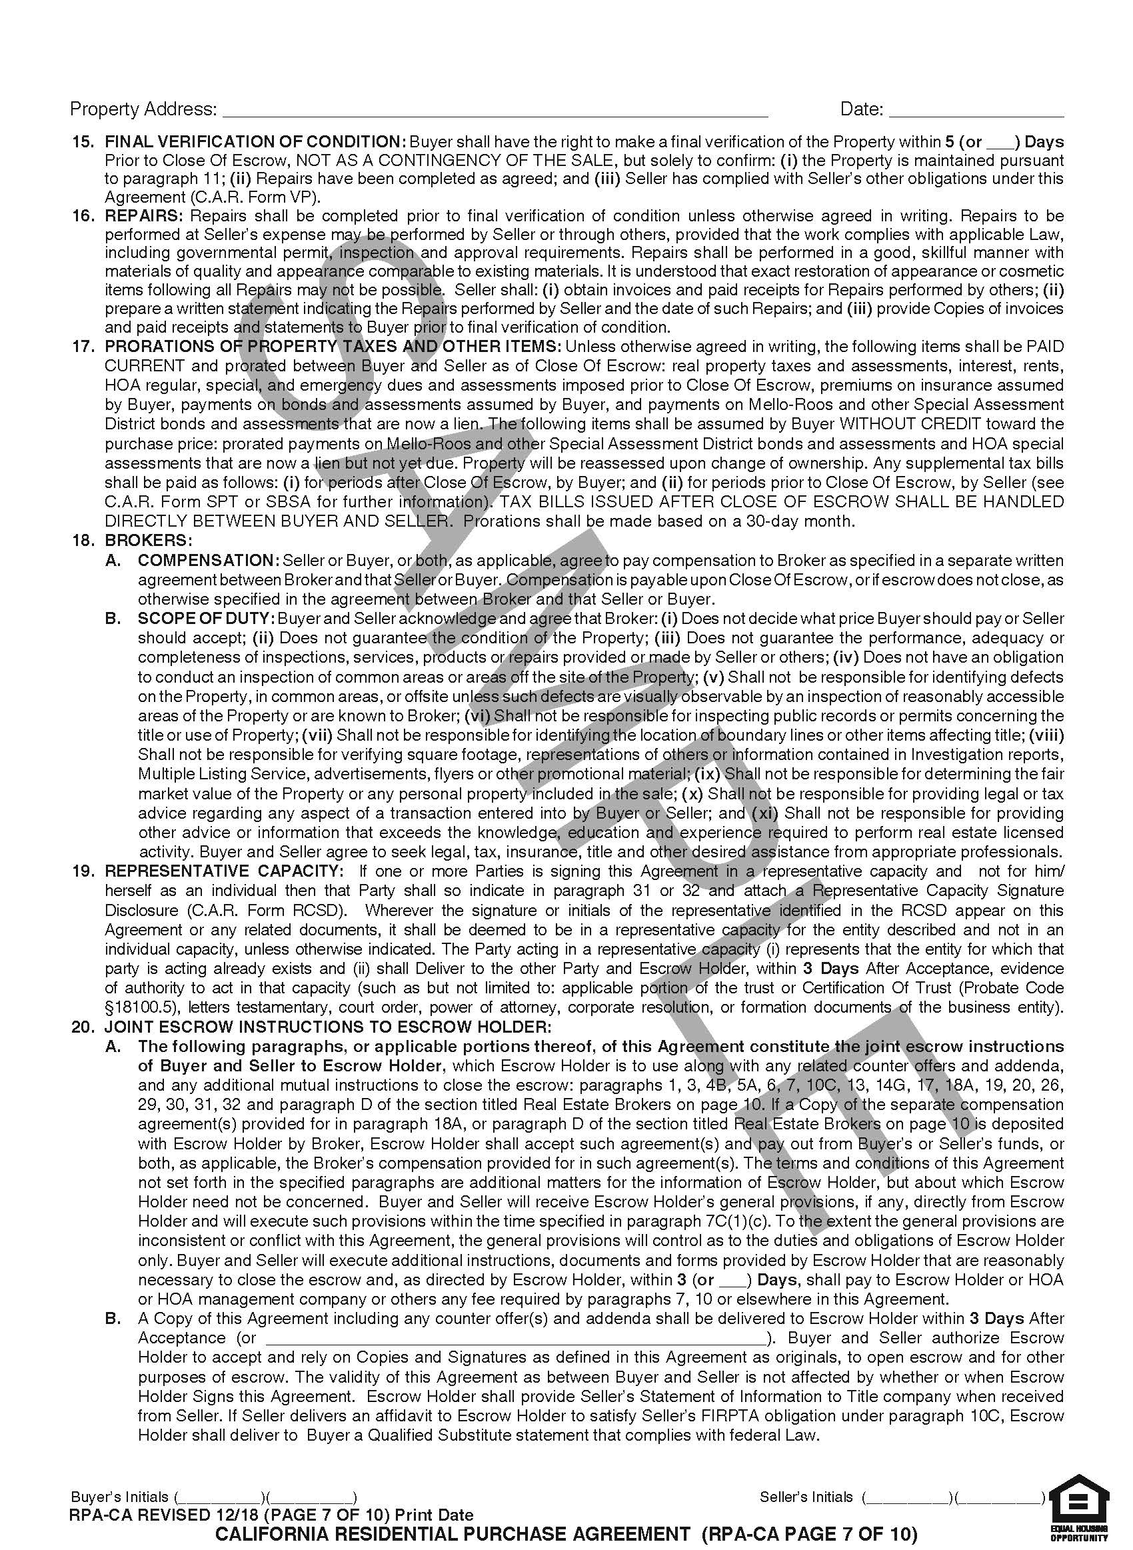
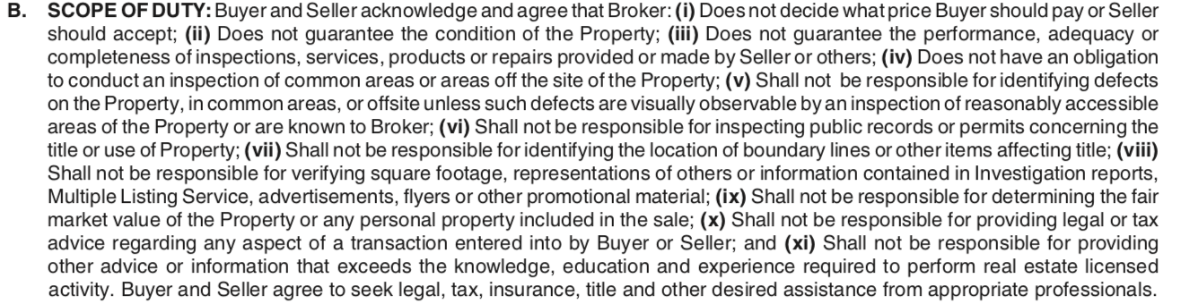
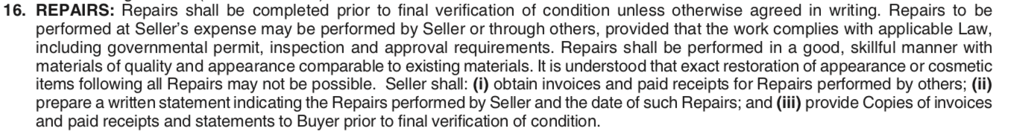
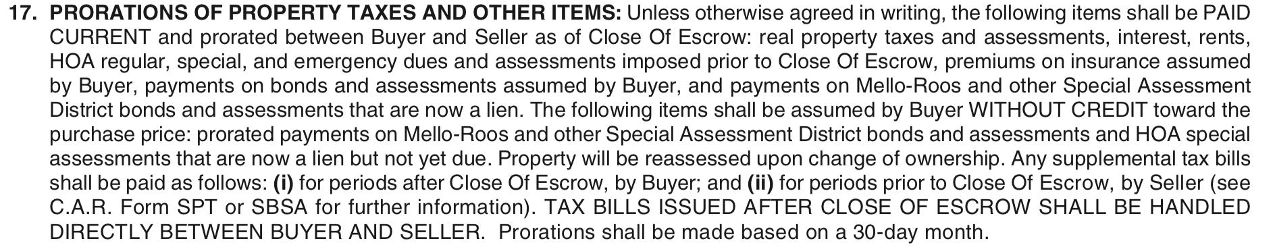
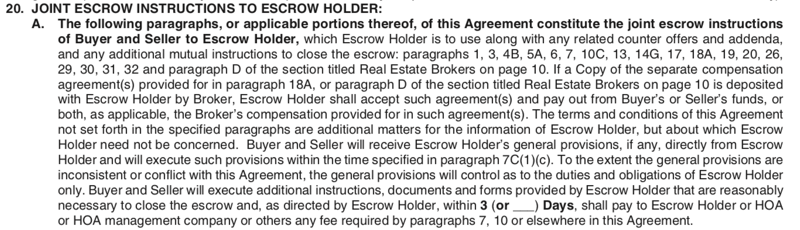
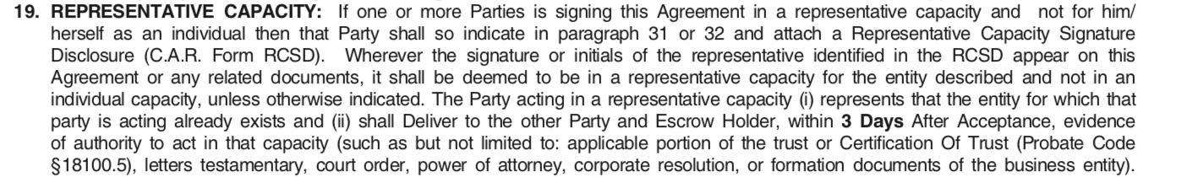

California Residential Purchase Agreement and Joint Escrow Instructions, p.7.
Paragraph 15.
x
x
x
Paragraph 18.b.
x
Paragraph 16.
Paragraph 17.
FINAL VERIFICATION OF CONDITION
BROKERS; Scope of duty
REPAIRS
PRORATIONS OF PROPERTY TAXES AND OTHER ITEMS
x
Paragraph 18.a.
x
Paragraph 20.a.
Paragraph 19.
x
BROKERS; COMPENSATION
JOINT ESCROW INSTRUCTIONS TO ESCROW HOLDER
15. What is the purpose of the final verification? Simply to make sure that everything that has been agreed to has been done. If a tenant is supposed to leave, the buyer wants to make sure the tenant is gone. If the seller agreed to repair the roof or fix the furnace, the buyer is given a chance to check it out before paying the purchase price. The final “inspection” should not be used to look for previously undiscovered defects or new excuses to get out of the contract; just to verify that what was suppose to be done, is done.
REPRESENTATIVE CAPACITY
16. If the contract or an addendum, like the Request for Repairs, (C.A.R. Form RR) requires the seller to make repairs, they should be done before the buyer’s final verification (see paragraph 15). Seller is allowed to do the repairs or hire others to do them. Seller should provide buyer with invoices and paid receipts.
Paragraph 20.b.
x
Paragraphs
15 – Final Verification of Condition
16 – Repairs
17 – Prorations of Property Taxes and Other Items
18 – Brokers, A-B
19 – Representative Capacity
20 – Joint Escrow Instructions to Escrow Holder, A-B
18.A. Real estate brokers and agents work hard finding the right property for a buyer and the right buyer for a seller. They are entitled to be paid for providing that service that benefits everyone involved. Since the RPA is an agreement between the buyer and seller, but not the broker, the fees that real estate licensees will be paid are not found in the RPA form.
17. Some expenses that are part of owning a home require payments that apply whether or not the home is being sold and apply to periods of time both before and after the sale. Generally, the seller is responsible for the costs that relate to the time the seller owned the property and the buyer after the purchase is complete. Escrow will prorate amounts that are due or have been paid so that buyer and seller each pay their fair share.
JOINT ESCROW INSTRUCTIONS TO ESCROW HOLDER
18.B. If you want a cake, you go to a bakery. If you have a toothache, you go to the dentist. If you want check out the plumbing or electrical system, or roof or foundation, of a house, you hire a contractor or inspector. If you want to check the trees for disease, you hire an arborist. If you want tax advice, you hire an attorney or CPA. Your REALTOR® can give you real estate advice, but is not an expert in many things that will affect your decision. Most real estate agents and brokers can give you recommendations and referrals to others to help you make a decision.
19. In today’s world, people don’t just buy homes in their own names but also use trusts, corporations, LLCs and other entities. When someone signs a contract on behalf of an organization or entity, for legal purposes it is important to distinguish between the individual signer and the actual principal, buyer or seller. This paragraph says that when an individual is signing for another, as a representative (like the CEO of a corporation, for example), the signer can use his/her own name but only if a Representative Capacity Signature Disclosure (C.A.R. Form RCSD) is used, and the signer gives the other proof that the entity has already been created and the signer has the authority to sign. If that is done, then every time one sees the signer’s individual name what is meant is the entity.
20.A. An escrow is a vital part of a real estate transaction. The escrow acts as an intermediary between buyer and seller and between the principals and their lenders, if any. The escrow holds money and documents and has instructions not to distribute either until each party has fulfilled its obligations. The Residential Purchase Agreement is not just a contract between buyer and seller, it is also instructions to escrow holder and should be delivered to the escrow company. The escrow company may send out supplemental instructions or require additional documents be signed as well.
20.B. An escrow holder is like a “middleman” connecting many parts in the real estate sale in order to make a real estate transaction. The applicable contract, the RPA, shall be delivered to escrow so that the escrow holder knows how much the property sold for, when is the contractual closing date, whether there are lenders to contact, and if tax withholding issues are necessary upon closing, to name just a few obligations.
RPA page: 1. 2. 3. 4. 5. 6. 7. 8. 9. 10.
CALIFORNIA ASSOCIATION OF REALTORS® I Residential Purchase Agreement Summary for Consumers

Slide 15





x
x
California Residential Purchase Agreement and Joint Escrow Instructions, p.8.
Paragraph 22.B.
Paragraph 20.C.
JOINT ESCROW INSTRUCTIONS TO ESCROW HOLDER
DISPUTE RESOLUTION - ARBITRATION OF DISPUTES
Paragraph 20.E.
x
x
Paragraph 22.A.
x
Paragraph 20.D.
JOINT ESCROW INSTRUCTIONS TO ESCROW HOLDER
Paragraph 21.b.
x
DISPUTE RESOLUTION
- MEDIATION
JOINT ESCROW INSTRUCTIONS TO ESCROW HOLDER
Paragraph 21.A.
x
REMEDIES FOR BUYER’S BREACH OF CONTRACT
-LIQUIDATED DAMAGES
20.C. While the broker’s right to be paid is found in a contract outside of the buyer and seller’s purchase agreement, payment will be made through escrow. This paragraph acknowledges that and provides the payment instructions will not be altered without the consent of the broker.
20.E. After a buyer’s offer has been accepted and before a transaction closes, buyer and seller often change one or more terms of their agreement. The escrow holder needs to be advised promptly of any such changes.
REMEDIES FOR BUYER’S BREACH OF CONTRACT
20.D. Since buyers typically send a payment (deposit) direct to escrow, and making the payment is an important first step in purchasing the property, the seller and the real estate licensees need to be informed immediately if the payment is not made or the check bounced or is not good.
Paragraphs
20 – Joint Escrow Instructions to Escrow Holder, (cont.) C-E
21 – Remedies for Buyer’s Breach of Contract, A-B
22 – Dispute Resolution, A-C(1)
21.B. While there may be legitimate reasons to get out of the real estate contract without consequences (see paragraph 14), if a buyer cancels without a legal or contractual reason, then that buyer is in “breach.” In other words, “if you break it, you buy it” or at least pay for the damage you’ve done. California law allows a buyer and seller to agree in advance how much money the seller is entitled to keep if the buyer breaks the contract. This amount will usually be the deposit but if the buyer intended to live in the home, the amount will be the lower of the deposit or 3% of the purchase price. For this law to take effect, the clause has to be written a specific way and separately signed or initialed. So, should you initial the clause? That decision is up to you. Your agent cannot decide for you.
x
21.A. California law is very specific about the language needed to be used when a seller wants to keep a buyer’s deposit money in certain circumstances (paragraph 21.B.). Sometimes the parties think they can write in their own language instead – such as a simple statement that the deposit in “non-refundable.” If the State requirements are not met, then the hand- written clause may not be enforceable. In short, required language, good; inserted language, maybe not.
Paragraph 22.C.
22.A. Disputes between buyers and sellers, although not inevitable, are common in a complicated transaction like buying a home. If a dispute cannot be resolved with the assistance of your REALTOR® or the agent’s broker, this paragraph requires that buyer and seller attempt to resolve it through mediation before running off to court. Mediation is a process in which a neutral third person acts as a facilitator to help buyer and seller come to an agreement. The mediator does not decide who is right and who is wrong but instead helps direct the discussions with the goal of reaching a settlement. Failure to attempt to mediate can result in the loss of attorney fees (see paragraph 25), ... a heavy price.
22.B. Instead of going to court, buyers and sellers can agree to resolve their differences in arbitration. An arbitrator, like a judge, has the authority to render a decision. The arbitration itself is a private hearing where both sides present evidence. Arbitration is optional in that both parties have to agree by initialing the paragraph. Once agreed, there is no right to have a trial by jury and almost no right to appeal. The arbitrator’s decision is binding and final! Many clients ask their REALTOR® if they should initial this paragraph, but your agent cannot tell you what to do. You must consider the pros and cons and make your own decision.
DISPUTE RESOLUTION - ADDITIONAL MEDIATION AND ARBITRATION TERMS
22.C. Paragraph 22.A. requires the buyer and seller to attempt to resolve any disputes through mediation before going to court or an arbitration. Some disputes may be more efficiently resolved elsewhere, such as small claims court or may be legally required to be resolved elsewhere, such as by a probate court, or a judge hearing an eviction. This paragraph states when it is okay to skip mediation and arbitration.
RPA page: 1. 2. 3. 4. 5. 6. 7. 8. 9. 10.
CALIFORNIA ASSOCIATION OF REALTORS® I Residential Purchase Agreement Summary for Consumers

Slide 16





California Residential Purchase Agreement and Joint Escrow Instructions, p.9.
x
Paragraph 30.
x
Paragraph 26.
x
Paragraph 28.
x
Paragraph 22.C.
x
Paragraph 23.
x
Paragraph 29.
DEFINITIONS
ASSIGNMENT
TERMS AND CONDITIONS
OF OFFER
SELECTION OF SERVICE PROVIDERS
DISPUTE RESOLUTION - ADDITIONAL MEDIATION
AND ARBITRATION TERMS
x
TIME OF ESSENCE;
ENTIRE CONTRACT; CHANGES
Paragraph 24.
x
Paragraph 31.
x
Paragraph 25.
MULTIPLE LISTING SERVICE
(“MLS”)
EXPIRATION OF OFFER
x
26. When a seller signs the contract, there is an agreement to sell to a particular buyer, and no one else. Of course, after the buyer takes title, the buyer can transfer to anyone the buyer wants. But if the buyer wants to bring in additional buyers or remove some named buyers before the purchase is complete, the buyer must get the seller’s consent. For example, maybe an individual wrote the offer but prefers to buy in the name of a corporation instead. Or maybe the buyer needs to add a parent as an additional buyer in order to qualify for a loan. A separate form must be presented to the seller so the seller can evaluate whether the change puts the transaction or seller at risk for delays or breach. Everyone is not interchangeable.
23. Often times, a broker might give you a recommendation for a vendor or service provider, such as a contractor or a painter. This clause says that a broker doesn’t guarantee the quality of any of these service providers’ work. Try to get recommendations of multiple service providers and use your own discretion when picking one!
Paragraph 27.
ATTORNEY FEES
x
Paragraph 30.a.
22.C. Paragraph 22.A. requires the buyer and seller to attempt to resolve any disputes through mediation before going to court or an arbitration. Some disputes may be more efficiently resolved elsewhere, such as small claims court or may be legally required to be resolved elsewhere, such as by a probate court, or a judge hearing an eviction. This paragraph states when it is okay to skip mediation and arbitration.
EQUAL HOUSING OPPORTUNITY
29. The contract requires buyers and sellers to do various things at various times (see, for example, paragraph 14). This paragraph says it is important to meet those deadlines and there are consequences for failing to do so. There are no automatic extensions. Remember, the Notices to Perform can be given in advance of a deadline to make sure everything goes as scheduled. Verbal agreements changing the contract are unenforceable. A handshake or a verbal promise is only as good as the paper it is written on. If something or some time needs to be changed, DO IT IN WRITING.
DEFINITIONS - ACCEPTANCE
Paragraphs
22 – Dispute of Resolution (cont.) C(2)-(3)
23 – Selection of Service Providers
24 – Multiple Listing Service (“MLS”)
25 – Attorney Fees
26 – Assignment
27 – Equal Housing Opportunity
28 – Terms and Conditions of Offer
29 – Time of Essence; Entire Contract: Changes
30 – Definitions, A-M
31 – Expiration of Offer
28. Under California law, certain contract terms need to be initialed by both buyer and seller. These clauses are the Liquidated Damages clause (paragraph 21.B.) and Arbitration clause (paragraph 22.B.). If either of those two paragraphs is initialed by one and not the other it is important to address the issue before the offer is accepted.
Even if a buyer writes an offer, the seller can keep advertising the property, and negotiate with other buyers until the offer has been accepted (see paragraph 30.A.).
The buyer and seller do not have to sign the offer at the same time (they usually do not), or even sign the same piece of paper that the offer is written on. And, since many signatures are electronic, there may not be a paper document with signatures but the computer program will show who signed and when.
Paragraph 30.f.
x
24. MLS is a company/tool that brokers use to find and/or market properties that are for sale. The MLS used to be a really big book with information on all the properties offered for sale. Today, of course, all of the information is online. This clause gives permission to brokers to release the sales price and some other terms to the MLS. Having that information allows buyers and sellers to compare properties and price.
25. Unfortunately, sometimes it can cost more to resolve a dispute than the amount in dispute. This paragraph says that the losing side in the dispute must pay the attorney’s fees for the winning side. The loser will not only have to pay their own attorney, and the judgement, but also pay for the winner’s attorney. Thus, someone will win big and someone will lose big, if the matter does not get resolved – another good reason to try to reach resolution in mediation (see paragraph 22A). There is an exception to this rule for any party who does not try to mediate the dispute, even if they wind up prevailing in an eventual lawsuit.
27. The law tries to make sure people are treated fairly when deciding to purchase or sell property. As a result, it’s illegal to discriminate against someone based on things like race, color, religion, sex, handicap, familial status or national origin, to name a few.
DEFINITIONS - DAYS
30.A. Acceptance is when the contract begins. The acceptance date is not when the buyer signs the offer, or even when the seller signs the offer. The contract begins when the last person who signs the offer or counter offer delivers back a copy of that signed document to the other side. A lot of dates and deadlines in the RPA are based on the day of Acceptance; for example, you may have to remove a contingency 17 days after acceptance or the close of escrow date may be 30 days after acceptance.
31. Here is where the buyer signs. Once the buyer signs, a contract has not yet been formed. The seller has to respond within the stated period. Even after the seller signs on the next page a contract has still not yet been formed. The document with the seller’s signature has to be delivered back to the buyer or the buyer’s designated agent specified in this paragraph. If the person signing is not the actual buyer, the box above the signature line should be checked and the RCSD form attached (see paragraph 19). If there are more than two buyers, the box below the signature line should be checked and another form (C.A.R. Form ASA) added to show that the additional buyers agree with the offer (see paragraph 1). The process is far from over, but by making an offer, the buyer is on the way.
30. Some words are frequently used throughout the RPA, and have a meaning specific to this agreement. Those frequently used words or phrases are defined here.
30.F. Days. When referring to days, the contract means calendar days, with a few exceptions. However, after Acceptance, the last day to perform anything required by the contract can’t fall on a Saturday, Sunday, or a legal holiday. If the last day to perform falls on one of these days, the last day to perform will be the next possible day that doesn’t fall on a weekend or a legal holiday.
RPA page: 1. 2. 3. 4. 5. 6. 7. 8. 9. 10.
CALIFORNIA ASSOCIATION OF REALTORS® I Residential Purchase Agreement Summary for Consumers

Slide 17






Paragraph 32. cont.
x
California Residential Purchase Agreement and Joint Escrow Instructions, p.10.
x
Paragraph 32.
Paragraph 32. cont.
ACCEPTANCE OF OFFER
x
ACCEPTANCE OF OFFER
ACCEPTANCE OF OFFER
x
32. The seller does not have to accept the buyer’s offer as it is written. The seller may decide to make some changes. For example, the seller may want a higher price, or a shorter escrow period, or want the buyer to make a bigger deposit to name a few common requests. In order to do so, the sellers should check the box that says, “Subject to Attached Counter Offer” and attach the appropriate form. If that is the case, the seller may sign in paragraph 32 or may instead choose to only sign on the Counter Offer form. When a counter offer is made by the seller, a contract is not formed until the buyer signs it and returns it back to the seller.
CONFIRMATION OF ACCEPTANCE
x
REAL ESTATE BROKERS
x
32. If the seller is responding to more than one buyer at the same time, the use of the Multiple Counter Offer form (C.A.R. Form SMCO) is appropriate. In that case, a contract is NOT formed by the buyer signing and returning. The seller will likely want to review all of the multiple counter offers that were returned and then choose among them. No contract is formed until the seller makes that decision by signing the multiple counter offer a second time.
ESCROW HOLDER ACKNOWLEDGEMENT
32. Now that a buyer has made an offer (see paragraph 31), the seller has to decide how to respond. If the seller agrees with all of the terms, the seller needs to sign in this paragraph. However, once the seller signs, a contract has still not yet been formed. The document with the seller’s signature has to be delivered back to the buyer or the buyer’s designated agent (see paragraph 31) within the specified time. If the person signing is not the actual seller, the box above the signature line should be checked and the RCSD form attached (see paragraph 19). If there are more than two sellers, the box below the signature line should be checked and another form (C.A.R. Form ASA) added to show that the additional sellers agree with the offer.
Paragraphs
32 – Acceptance of Offer
Confirmation of Acceptance
Real Estate Brokers, A-E
Escrow Holder Acknowledgement
Presentation of Offer
Rejection of Offer
CONFIRMATION OF ACCEPTANCE: In a straight-up offer and acceptance situation, the contract does not become binding until the seller signs the RPA presented by the buyer and that accepted offer is personally received by the buyer OR their authorized agent. Initialing this clause documents when the contract became binding and when the clock starts ticking for the contractual dates and deadlines. While initialing the Confirmation of Acceptance isn’t necessarily required, it’s important to prevent confusion or disputes later about contractual deadlines
x
PRESENTATION OF OFFER
x
REJECTION OF OFFER
ESCROW HOLDER ACKNOWLEDGEMENT: Here is where the Escrow Holder can acknowledge that they received the contract, and that they agree to act as the escrow holder. Here you’ll find other important information like contact information for the escrow holder, the escrow holder’s license number and the reference number for the escrow for the particular transaction.
REAL ESTATE BROKERS: Here is where the real estate brokers put their information. This box doesn’t make the broker a party to the transaction.
PRESENTATION OF OFFER: As a professional courtesy, a listing agent may fill this section out documenting when the offer was presented to the seller. This section is optional.
REJECTION OF OFFER: Sometimes a buyer suspects the seller may have never received the buyer’s offer. Here the seller can end the potential for confusion and specifically indicate that the offer is being rejected. This section is optional.
RPA page: 1. 2. 3. 4. 5. 6. 7. 8. 9. 10.
CALIFORNIA ASSOCIATION OF REALTORS® I Residential Purchase Agreement Summary for Consumers

Slide 18

Buyer’s Inspection Advisory
x
Buyer Inspection Advisory
This form contains a list of items a buyer may want to look into further before removing contingencies. It is important to know that measurements are not always exact and that one professional to another may find different things.
This form is pre-attached to the RPA and is the last form you will see, unless any addenda are attached.
RPA page: 1. 2. 3. 4. 5. 6. 7. 8. 9. 10.
CALIFORNIA ASSOCIATION OF REALTORS® I Residential Purchase Agreement Summary for Consumers

Slide 19
Disclosure Regarding
Real Estate Agency Relationship
This form lets you know that a real estate broker can represent only a seller, only a buyer or both buyer and seller in the same transaction.
This form does not tell you specifically who the broker represents; that information comes later in the purchase agreement (paragraph 2B).
The back or second page of the form is simply a reprint of the entire law.
No matter who the broker represents, the broker through its agents must treat all parties honestly and fairly.
RPA page: 1. 2. 3. 4. 5. 6. 7. 8. 9. 10.

Slide 20
POSSIBLE REPRESENTATION OF
MORE THAN ONE BUYER OR SELLER
- DISCLOSURE AND CONSENt
This form lets you know that a real estate broker, through its agents, can represent many buyers or sellers at the same time.
Some of these buyers or sellers may be competing against you.
If you are writing an offer, the seller and seller’s broker may let others know everything about the offer.
BROKER
AGENT
AGENT
AGENT
SELLER
SELLER
SELLER
BUYER
BUYER
BUYER
RPA page: 1. 2. 3. 4. 5. 6. 7. 8. 9. 10.

Slide 21

WIRE FRAUD AND ELECTRONIC
FUNDS TRANSFER ADVISORY
Modern criminals have found ways to interfere with modern ways of transferring money. Whether a deposit, down payment or sale proceeds are transferred from one account to another via some kind of electronic method, such as a wire transfer, hackers have the ability to intercept messages about that transfer and steal the funds. This form advises both buyer and seller of the risks, some ways to minimize the risk, and what to do in case a theft of money being transferred has in fact occurred.
RPA page: 1. 2. 3. 4. 5. 6. 7. 8. 9. 10.

Slide 22

RPA TITLE
Title. This form is used by a buyer to make an offer on a seller’s property. Once accepted by the seller, the form creates a binding agreement. It can be used anywhere in California.
RPA page: 1. 2. 3. 4. 5. 6. 7. 8. 9. 10.

Slide 23
DATE PREPARED
Date Prepared. This blank line should be filled in with the date that a real estate agent prepares the offer for the buyer’s signature, not the date the buyer (or seller) actually signs.
The purpose of this line is to be able to easily reference this document, as opposed to any other offers received, in any counter offers, addenda or other relevant documents.
Other paragraphs identify when an offer has been accepted and the parties have formed a binding contract (paragraphs 30.A. and 32).
RPA page: 1. 2. 3. 4. 5. 6. 7. 8. 9. 10.

Slide 24

Paragraph 1.a.
OFFER
1.A. All buyers should be listed here. If there is not room, use an addendum. If the buyer is a corporation, LLC, or trust, enter the entity or trust name here. When you get to the signature page make sure to check the box to add the form RCSD so everyone knows who will actually sign on behalf of the entity or trust.
1.A. Make sure all buyers listed here are also listed on the signature page. If there are more than two buyers, use an Additional Signature Addendum form for the others.
RPA page: 1. 2. 3. 4. 5. 6. 7. 8. 9. 10.

Slide 25
PARAGRAPH 1.B.,C. & D.
OFFER
1.B. This identifies the property by address and legally recorded document.
1.C. The price here should match the price in 3.G. Buyer may have other costs such as escrow or title fees. Seller may use the price to pay off loans, and broker, title and escrow fees.
1.D. Close of escrow date is not just aspirational, it is contractual. If one party is not able to close escrow on time, the other party may have a right to cancel.
RPA page: 1. 2. 3. 4. 5. 6. 7. 8. 9. 10.

Slide 26
Paragraph 2.a.
AGENCY;
DISCLOSURE
2.A. All buyers and sellers should have received the form on screens 3 and 4.
This form lets you know that a real estate broker can represent only a seller, only a buyer or both buyer and seller in the same transaction.
This form does not tell you specifically who the broker represents; that information comes later in the purchase agreement (paragraph 2B).
The back or second page of the form is simply a reprint of the entire law.
No matter who the broker represents, the broker through its agents must treat all parties honestly and fairly.
RPA page: 1. 2. 3. 4. 5. 6. 7. 8. 9. 10.

Slide 27
Paragraph 2.b.
AGENCY;
CONFIRMATION
2.B. Here is where the brokers and individual real estate agents declare who they are representing; it could be seller only; buyer only or both. Even if you are working with a specific agent only, if the brokerage company represents both buyer and seller, so does “your” agent. No matter who has your back, every agent is required to treat all parties honestly and fairly.
RPA page: 1. 2. 3. 4. 5. 6. 7. 8. 9. 10.

Slide 28
Paragraph 2.c.
AGENCY;
POTENTIALLY competing
BUYERS AND SELLERS
2.C. All buyers and sellers should have received the form on screen 5.
This form lets you know that a real estate broker, through its agents, can represent many buyers or sellers at the same time.
Some of these buyers or sellers may be competing against you.
If you are writing an offer, the seller and seller’s broker may let others know everything about the offer.
RPA page: 1. 2. 3. 4. 5. 6. 7. 8. 9. 10.

Slide 29
Paragraph 3.A. (1)&(2)
FINANCE TERMS;
initial DEPOSIT
3.A. (1) This is the amount of money the buyer gives to an escrow to let the seller know the buyer is serious. Most people use wire transfer rather than cash or check. Before wiring funds, confirm instructions with the escrow officer.
3.A. (1) A typical deposit is around 3% of the price. But it could be more or less depending on what the buyer and seller each want.
3.A. (2) Sometimes the buyer gives a check to the broker, but this is rare. Usually, the money goes direct from buyer to escrow.
RPA page: 1. 2. 3. 4. 5. 6. 7. 8. 9. 10.

Slide 30

Paragraph 3.b.
FINANCE TERMS;
INCREASED DEPOSIT
3.B. Sometimes, especially if the initial deposit is low, the seller thinks the buyer should put in more money later in the transaction to show the buyer is truly committed to buying the property.
RPA page: 1. 2. 3. 4. 5. 6. 7. 8. 9. 10.

Slide 31

Paragraph 3.c.
FINANCE TERMS;
ALL CASH OFFER
3.C. This paragraph should only be checked when the buyer has enough money to buy the property without getting a loan. Buyer should never bring actual cash to the escrow.
3.C. Some buyers think they can “trick” the seller into accepting their offer by checking this paragraph even if they will still apply for a loan. But the buyer still has to prove the full cash amount is available.
If the buyer really needs a loan but is willing to take the chance the lender won’t approve, the buyer should check paragraph 3.J. (4) instead.
RPA page: 1. 2. 3. 4. 5. 6. 7. 8. 9. 10.

Slide 32

Paragraph 3.D. (1)&(2)
FINANCE TERMS;
LOAN(S)
3.D. (1) and (2) Here is where the buyer will show the seller how much money the buyer needs to borrow and the terms on which they are willing to borrow.
RPA page: 1. 2. 3. 4. 5. 6. 7. 8. 9. 10.

Slide 33
Paragraph 3.D. (3)
FINANCE TERMS;
LOAN(S) - FHA/VA
3.D. (3) Some buyers use specific loan programs rather than getting a conventional loan from a bank. FHA loan programs usually require very little down payment. VA loan programs are only available to U.S. veterans and often involve low or no down payment.
RPA page: 1. 2. 3. 4. 5. 6. 7. 8. 9. 10.

Slide 34
Paragraph 3.e.
FINANCE TERMS;
ADDITIONAL FINANCING TERMS
3.E. There are things that affect financing which do not necessarily affect the price of the property. An example would be if the buyer wants the seller to pay for certain costs of obtaining a loan (recurring or non-recurring closing costs). Those items can be written into paragraph 3E but no dollar amount is carried over into the column that adds up to the purchase price. These are extras that need to be written into the contract. Some agents use paragraph 6 or 7.D. (8) or (9) instead.
RPA page: 1. 2. 3. 4. 5. 6. 7. 8. 9. 10.

Slide 35
Paragraph 3.f.
FINANCE TERMS;
Balance of Down Payment
or Purchase Price
3.F. This paragraph identifies the amount of money the buyer needs to place into escrow after the deposit (paragraph 3A), increased deposits, if any, (paragraph 3B) and loan amount(s), if any, (paragraph 3D) have already been counted. If there are no loans, then this is the cash balance the buyer is responsible for. Escrow holder will require payment a few days before the scheduled close of escrow to make sure the money is in place. Buyers should use caution when transferring these funds electronically or through wire transfer (C.A.R. Form WFA). Seller has the right to verify that the buyer actually has access to the funds (paragraph 3H)
RPA page: 1. 2. 3. 4. 5. 6. 7. 8. 9. 10.

Slide 36

Paragraph 3.g.
FINANCE TERMS;
Purchase Price (TOTAL)
3.G. The total is the amount of money that is the agreed price the buyer will pay for the property. A buyer who has negotiated for the seller to give a credit (paragraph 3.J. (5)) still pays the total amount. The credit is often used to pay other costs (such as escrow, title or lender fees) the buyer is responsible for in the transaction and may not be returned to the buyer in cash. The seller will usually not receive the total amount because the seller must pay any necessary title fees, escrow fees, repair costs, broker commissions and other expenses out of the total.
RPA page: 1. 2. 3. 4. 5. 6. 7. 8. 9. 10.

Slide 37
Paragraph 3.h.
FINANCE TERMS;
VERIFICATION OF DOWN
PAYMENT AND CLOSING COSTS
3.H. Since a lender will usually not finance the entire purchase, the buyer needs to show the seller that the buyer has the difference, usually in the bank.
RPA page: 1. 2. 3. 4. 5. 6. 7. 8. 9. 10.

Slide 38
Paragraph 3.i.
FINANCE TERMS;
APPRAISAL CONTINGENCY
AND REMOVAL
3.I. An appraisal is a written statement by a professional saying what the property is worth. If the appraiser says the property is not worth the price the buyer agreed to pay, then the buyer could have a legal excuse to get out of the contract and have the deposit returned.
RPA page: 1. 2. 3. 4. 5. 6. 7. 8. 9. 10.

Slide 39
Paragraph 3.J. (1)
FINANCE TERMS; LOAN TERMS –
LOAN APPLICATIONS
3.J. (1) If a buyer needs a loan to purchase property, this paragraph requires the buyer to prove to the seller that the buyer is making efforts to get the loan. The seller will lose confidence in the buyer’s ability to perform if the buyer has not even started the process of getting a loan. Pre-approval or pre-qualification is not a guarantee the loan will be obtained but rather proof that the buyer is taking the necessary steps to purchase. Seller has the right to potentially cancel on a buyer who cannot even show that this minimum obligation is in process.
RPA page: 1. 2. 3. 4. 5. 6. 7. 8. 9. 10.

Slide 40
Paragraph 3.J. (2)&(3)
FINANCE TERMS; LOAN TERMS –
LOAN CONTINGENCY AND REMOVAL
3.J.(2)and(3) If the lender will not make the buyer a loan, either because the property is not worth the price or the buyer is not qualified for the loan, the buyer can walk away from the contract without consequence. But, if the buyer already removed the appraisal contingency, then the buyer loses that excuse to cancel the contract even if that’s why the lender will not loan the money.
3.J.(2)and(3) If the buyer removes the loan contingency before the lender makes a decision, the buyer is at risk.
3.J. (2) and (3) The buyer has 21 days to decide whether to remove this contingency or cancel the contract.
RPA page: 1. 2. 3. 4. 5. 6. 7. 8. 9. 10.

Slide 41

Paragraph 3.J. (4)
FINANCE TERMS; LOAN TERMS –
NO LOAN CONTINGENCY
3.J. (4) If the buyer checks this box, the message the buyer is giving is that the buyer needs a loan to purchase the property but is willing to take the risk that the buyer will not get the loan.
RPA page: 1. 2. 3. 4. 5. 6. 7. 8. 9. 10.

Slide 42

Paragraph 3.J. (5)
FINANCE TERMS; LOAN TERMS –
LENDER LIMITS ON BUYER CREDITS
3.J. (5) Some sellers agree to give the buyer back part of the purchase price to help the buyer pay for certain costs. If the buyer is getting a loan, the lender needs to be told about this. And if the lender will not approve the full amount, then the seller only has to give the buyer the amount lender will allow.
RPA page: 1. 2. 3. 4. 5. 6. 7. 8. 9. 10.

Slide 43
Paragraph 3.K.
FINANCE TERMS;
BUYER STATED FINANCING
3.K. This paragraph tells the buyer that it is important to be honest in how you write your offer. Buyers are expected to pursue the financing they specified. For example, if buyer’s offer says the buyer has 20% down payment then the buyer needs to try and get a 80% loan. The buyer can try to get something different but the buyer should still try to get what was promised in the offer and the seller does not have cooperate with anything else.
3.K. If the buyer says, for example, that the buyer has all cash or a 20% down payment and really doesn’t, then that is like breaking a promise and could cause the buyer to lose the deposit or suffer some other consequences.
RPA page: 1. 2. 3. 4. 5. 6. 7. 8. 9. 10.

Slide 44

Paragraph 4.A.&B.
SALE OF BUYER’S PROPERTY
4.A. The buyer says that it is not necessary to sell an existing home in order to purchase the one from the seller.
4.B. Here is where the buyer declares that in order to buy from the seller, the buyer first has to sell a house that the buyer owns. If the buyer cannot sell that house within the identified period, the buyer can get out of the contract. If this paragraph is checked, an additional form, (C.A.R. Form COP) should be attached to the agreement.
RPA page: 1. 2. 3. 4. 5. 6. 7. 8. 9. 10.

Slide 45
Paragraph 5.a.
ADDENDA
5.A. Many other forms may be attached to this agreement. Most of these boxes will not be checked. A few are named here.
Addendum (C.A.R. Form ADM): This form will include language to be added that is usually unique to the buyer’s situation.
Back-Up Offer (C.A.R. Form BUO): This form is used when the seller is already in a contract with another buyer and the buyer writing this offer wants to be next in line.
Court Confirmation (C.A.R. Form CCA): This form is used when the seller needs to go to court to get permission to sell the property. That can happen, for example, if the seller is going through a bankruptcy, or a divorce, or a business break-up with a partner.
Continued on next screen
RPA page: 1. 2. 3. 4. 5. 6. 7. 8. 9. 10.

Slide 46
Paragraph 5.a.
ADDENDA cont.
5.A. Many other forms may be attached to this agreement. Most of these boxes will not be checked. A few are named here.
Septic, Well … (C.A.R. Form SWPI): In most cities, water arrives through a water line and waste goes through a sewer line. In more rural, and sometimes suburban, areas, water may come from a well and waste goes into a septic system on the property. Certain inspections and reports are unique to these items and should be addressed in an addendum.
Short Sale (C.A.R. Form SSA): Some sellers owe more on their house than it is worth (the house is “upside down” or “under water”). The seller’s lender needs to approve the sale and this form gives the time to do so.
RPA page: 1. 2. 3. 4. 5. 6. 7. 8. 9. 10.

Slide 47
Paragraph 5.b.
BUYER AND SELLER ADVISORIES
5.B. There are other forms that give both buyer and seller advice but don’t actually require either one to act. They should be read carefully.
Probate Advisory (C.A.R. Form PA): When the owner has died, the sale may go through an estate, which is a court process. This form says what laws do or do not apply.
Trust Advisory (C.A.R. Form TA): If the owner put the property in trust, usually for some tax or planning purpose, the trustee is the actual seller and may not have lived there. This form says what laws do or do not apply.
Short Sale (C.A.R. Form SSIA): There are a lot of considerations, such as taxes, credit, and right of lender to approve or disapprove a sale that should be considered by both buyer and seller in this kind of sale.
Continued on next screen
RPA page: 1. 2. 3. 4. 5. 6. 7. 8. 9. 10.

Slide 48
Paragraph 5.b.
BUYER AND SELLER ADVISORIES cont.
5.B. There are other forms that give both buyer and seller advice but don’t actually require either one to act. They should be read carefully.
Buyer Inspection Advisory (C.A.R. Form BIA): This one-page form mentions many things that the buyer should probably look into, like the size and condition of the property, and the neighborhood.
Statewide Advisory (C.A.R. Form SBSA): This multi-page form mentions lots of things that the buyer should think about and also the seller.
REO Advisory (C.A.R. Form REO): If the former owner does not make payments, the lender, or bank, could become the owner through a foreclosure or similar process. This form says what laws do or do not apply.
RPA page: 1. 2. 3. 4. 5. 6. 7. 8. 9. 10.

Slide 49
Paragraph 6.
OTHER TERMS
6. The contract is created to cover most situations that are legally required or likely to occur in residential purchase and sale transactions throughout California. But, not every scenario can be anticipated. This paragraph allows a buyer, seller or real estate licensee to insert language that may be unique or that one or more of the parties want to emphasize or clarify.
RPA page: 1. 2. 3. 4. 5. 6. 7. 8. 9. 10.

Slide 50

Paragraph 7.a.
ALLOCATION OF COSTS;
Inspections, Reports
and Certificates
7.A. In most transactions, one of the parties pays for a natural hazard disclosure report. The NHD report is prepared by a professional company that examines public documents to determine if the property is in a flood, fire or earthquake zone designated by the State or Federal government. Many such reports also indicate what tax zones affect the property and if there are other environmental concerns. Knowing these things can affect the availability, and cost, of certain insurance.
RPA page: 1. 2. 3. 4. 5. 6. 7. 8. 9. 10.

Slide 51
Paragraph 7.b. (1&2)
ALLOCATION OF COSTS;
Government Requirements
and Retrofit
7.B. California law requires residential property to have certain safety features whether or not the property is being sold. Local law may require that property be inspected prior to a sale or that safety or environmentally conscious features exist in order to even sell a home. This paragraph determines who is to pay for what and under what circumstance.
RPA page: 1. 2. 3. 4. 5. 6. 7. 8. 9. 10.

Slide 52
Paragraph 7.c.
ALLOCATION OF COSTS;
ESCROW AND TITLE
7.C. Here parties pick who is responsible for paying the escrow fee and who the Escrow Holder will be. Escrow is the “middleman” who holds the seller’s deed and buyer’s funds until both buyer and seller meet their obligations under the RPA. Escrow then distributes the money. The clause also designates who pays for the owner’s title insurance policy. Title insurance assures a buyer that it will have proper ownership of the property upon purchase. See paragraph 13 in the RPA.
RPA page: 1. 2. 3. 4. 5. 6. 7. 8. 9. 10.

Slide 53
Paragraph 7.d.
ALLOCATION OF COSTS;
OTHER COSTS
7.D. This section designates who will pay various other fees that are included in a typical real estate transaction. Most of these fees are negotiable but in certain parts of the State it is more common for one party to pay than another. Lines (8) and (9) can be used to cover fees for items not covered by the preprinted paragraphs.
7.D.(10) A home warranty is like insurance to help pay for repairs to defects to certain items that develop after close of escrow. If a seller will not pay, a buyer has a right to purchase a home warranty plan during escrow.
RPA page: 1. 2. 3. 4. 5. 6. 7. 8. 9. 10.

Slide 54
Paragraph 8.A.&B.(1-3)
ITEMS INCLUDED IN
AND EXCLUDED FROM SALE
8.A. Just because an item or feature appears in a picture or ad, doesn’t mean it comes with the property. It must be mentioned in this paragraph to be included. If a buyer wants something and is not sure if it is included or excluded, the buyer should write the item in 8.B.(3). See paragraph 8.C. for those items that go with the seller.
8.B. (2) Anything that is attached to the Property, or a “fixture” is included. Many items that are not attached are also included but only if listed in this paragraph. Pay special attention to the checkboxes towards the end of the clause referencing the stove(s), refrigerator(s), washer(s), and dryer(s)! If you want these items included in the sale, make sure to check the appropriate box!
RPA page: 1. 2. 3. 4. 5. 6. 7. 8. 9. 10.

Slide 55

Paragraph 8.B.(4)
ITEMS INCLUDED IN
AND EXCLUDED FROM SALE
8.B. (4) Many homes today have “smart” features that are built in to the property, such as interconnected phone systems, thermostat or temperature control system, or even a home specific intranet. To the extent a system like that is fully “integrated” with the property it is included in the sale. Outside components such as the seller’s mobile phone or a cable company’s server are not included. It can often be difficult to tell. To avoid any disputes or confusion, it’s a good practice to communicate specifically what the parties are including in written communications, as well as in this clause or an addendum as needed.
RPA page: 1. 2. 3. 4. 5. 6. 7. 8. 9. 10.

Slide 56

Paragraph 8.B.(5)
ITEMS INCLUDED IN
AND EXCLUDED FROM SALE
- LEASED OR LIENED ITEMS AND SYSTEMS
8.B.(5) This clause addresses leased and liened items on the Property. A good example of leased items are solar panels, as property owners rarely own these outright. Buyers should get relevant documents, such as leases and warranties, pertaining to the item, as these will likely bind the Property even after title is transferred to the Buyer.
Note that there is a contingency for BOTH the buyer AND seller allowing either party to cancel if the Buyer can’t or doesn’t want to assume the lien/encumbrance for the item.
RPA page: 1. 2. 3. 4. 5. 6. 7. 8. 9. 10.

Slide 57

Paragraph 8.B.(6)
ITEMS INCLUDED IN
AND EXCLUDED FROM SALE
- LEASED OR LIENED ITEMS AND SYSTEMS
8.B. (6) Unless the seller tells the buyer otherwise (per clause 8.B(5)) the seller is claiming to own and have the ability to transfer clause 8 items, but without warranty. This means that the seller is not promising, for example, the items are in good or working condition or that they will last for a period of time.
RPA page: 1. 2. 3. 4. 5. 6. 7. 8. 9. 10.

Slide 58
Paragraph 8.c.
ITEMS EXCLUDED FROM SALE
8.C. This is the paragraph where you can list items that are excluded from sale. If a flat screen tv is attached to a bracket which is attached to a wall, the bracket stays with the property but the tv goes with the seller.
RPA page: 1. 2. 3. 4. 5. 6. 7. 8. 9. 10.

Slide 59

Paragraph 9.A.&B.
CLOSING AND POSSESSION
9.A. Whether the buyer plans on occupying the Property as a primary residence can impact what rules and regulations apply to the transaction, the type of loan the buyer will be eligible for, the type of insurance the buyer needs and even the length of notice necessary to terminate the tenancy of any tenants who are already in the Property.
9.B. Here is where Parties agree when possession of the Property will be delivered, and the default rule is 6pm on the date that escrow closes. A seller who can’t deliver possession on time, may be in breach of contract. Note that “Close of Escrow” is defined in the RPA in clause 30D and that delivery of possession means the property is vacant and free from all debris.
RPA page: 1. 2. 3. 4. 5. 6. 7. 8. 9. 10.

Slide 60
Paragraph 9.c.
CLOSING AND POSSESSION
9.C. Sometimes even though Parties have a scheduled Close of Escrow day, the seller may need to stay on the property after title is transferred. This situation often occurs when the seller needs additional time to move. A buyer does not have to agree to this; this is a point of negotiation. If Parties do agree to have a seller stay in the Property after the Close of Escrow, make sure to check the appropriate box AND have the appropriate form filled out, (C.A.R. Forms SIP or RLAS), depending on how long the seller remains.
Beware, that allowing a seller to remain can have unintended consequences such as turning the buyer/seller relationship into a landlord/tenant relationship with corresponding responsibilities and liability.
RPA page: 1. 2. 3. 4. 5. 6. 7. 8. 9. 10.

Slide 61
Paragraph 9.d.
CLOSING AND POSSESSION
9.D. This clause addresses properties that are occupied by tenants, not by the seller. The default language of the purchase agreement is that the Property will be delivered vacant. In that case, it is the responsibility of the seller to get the tenant out.
If the second box is checked, stating “Tenant to remain in possession”, make sure to use the proper addendum (C.A.R. Form TIP) and the forms the addendum requests, such as a Lease Agreement. This is important because if a buyer purchases a property with a tenant, the buyer will become the landlord. All the important information, such as lease terms, should be reviewed.
RPA page: 1. 2. 3. 4. 5. 6. 7. 8. 9. 10.

Slide 62

Paragraph 9.E.&F.
CLOSING AND POSSESSION
9.E. Third-party warranties are automatically assigned by the contract on the close of escrow. The buyer should receive copies of any such warranties. There could be warranties for personal property remaining or fixtures such as an air conditioner, heater or roof.
9.F. At the Close of Escrow, seller has to give the buyer all the keys, codes and passwords etc. This includes garage openers!
RPA page: 1. 2. 3. 4. 5. 6. 7. 8. 9. 10.

Slide 63
Paragraph 10.A.(1)
STATUTORY AND OTHER DISCLOSURES (INCLUDING LEAD-BASED PAINT HAZARD DISCLOSURES) AND CANCELLATION RIGHTS
10.A. (1) California requires sellers to tell buyers about important things concerning the house – But only if the seller is aware of them. The legislature has provided a form (C.A.R. Form TDS) for the seller to make these disclosures.
Continued on next screen
RPA page: 1. 2. 3. 4. 5. 6. 7. 8. 9. 10.

Slide 64
Paragraph 10.A.(1)
STATUTORY AND OTHER DISCLOSURES (INCLUDING LEAD-BASED PAINT HAZARD DISCLOSURES) AND CANCELLATION RIGHTS
10.A. (1) The contract requires the seller to disclose even more things that the seller is aware of – such as repairs made to the property. Another form (C.A.R. Form SPQ) is available for those disclosures. Even some sellers who do not have to complete those forms still have an obligation to tell the buyer what they know. There is a form (C.A.R. Form ESD) for that too. Since sellers may not remember everything, or some things that are not important to a seller may be important to the buyer, a buyer should hire an inspector and not just rely on what the seller says.
If the property was built before 1978, the seller is required by law to provide the buyer with a Lead-Based Paint Disclosure (C.A.R. Form FLD) and a pamphlet. These same documents may be given even for properties built on or after that date.
RPA page: 1. 2. 3. 4. 5. 6. 7. 8. 9. 10.

Slide 65
Paragraph 10.A.(2&3)
STATUTORY AND OTHER DISCLOSURES (INCLUDING LEAD-BASED PAINT HAZARD DISCLOSURES) AND CANCELLATION RIGHTS
10.A.(2) A seller and the listing agent have to disclose all material issues that affect the value or desirability of the property to a buyer. In most cases, a seller will also have to provide the California mandated, Real Estate Transfer Disclosure Statement (C.A.R. Form TDS). This form should be completely filled out by the seller.
The real estate brokers, through their agents, also have a duty to do a thorough visual inspection of the property and disclose material issues. This can be done on C.A.R. form AVID or the last page of TDS.
10.A.(3) Even if a buyer is not interested, the seller must still make the legally mandated disclosures.
RPA page: 1. 2. 3. 4. 5. 6. 7. 8. 9. 10.

Slide 66
Paragraph 10.A.(4)
STATUTORY AND OTHER DISCLOSURES (INCLUDING LEAD-BASED PAINT HAZARD DISCLOSURES) AND CANCELLATION RIGHTS
10.A. (4) The contract also requires the seller to answer additional questions (C.A.R. Form SPQ). Since some things that are not important to a seller may be important to the buyer, or the seller may not remember everything, buyers should not just rely on the seller to make disclosures but should also hire their own inspector!
RPA page: 1. 2. 3. 4. 5. 6. 7. 8. 9. 10.

Slide 67
Paragraph 10.A.(5&6)
STATUTORY AND OTHER DISCLOSURES (INCLUDING LEAD-BASED PAINT HAZARD DISCLOSURES) AND CANCELLATION RIGHTS
10.A. (5) Once the buyer receives these disclosures, they should be reviewed carefully, and the buyer should sign them within the time specified in paragraph 14.B. (1)
10.A. (6) If prior to the Close of Escrow, seller finds out about something that negatively and materially impacts the property, or a material inaccuracy in one of their disclosures previously provided, that seller must promptly update or amend their disclosure in writing to reflect this new information!
EXCEPTION: If the buyer discovers the new information or inaccuracy on their own, or if it’s found in a report provided to or paid by the buyer, the seller is NOT obligated to update their disclosure.
RPA page: 1. 2. 3. 4. 5. 6. 7. 8. 9. 10.

Slide 68

Paragraph 10.A.(7)
STATUTORY AND OTHER DISCLOSURES (INCLUDING LEAD-BASED PAINT HAZARD DISCLOSURES) AND CANCELLATION RIGHTS
10.A. (7) If the buyer gets the TDS and SPQ after the buyer has already given an offer to the seller, and the buyer does not like what is in the disclosures, the law and contract give the buyer the right, for a few days, to cancel the contract.
RPA page: 1. 2. 3. 4. 5. 6. 7. 8. 9. 10.

Slide 69

Paragraph 10.b.
STATUTORY AND OTHER DISCLOSURES…;
NATURAL AND ENVIRONMENTAL HAZARD DISCLOSURES AND OTHER BOOKLETS
10.B. Unless exempt, the seller must provide the buyer with a specific form called the NHD. This form discloses if the Property is in one of 6 hazard zones (2 fire zones, 2 flood zones, 2 earthquake zones). Even if the seller does not have to give that specific form, the seller must still disclose if the Property is in one of these 6 hazard zones. Regardless, most sellers satisfy this obligation by paying a third-party reporting company to check public records and make the disclosure.
RPA page: 1. 2. 3. 4. 5. 6. 7. 8. 9. 10.

Slide 70
Paragraph 10.C.
STATUTORY AND OTHER DISCLOSURES…;
WITHHOLDING TAXES
10.C. Federal law requires a buyer to withhold part of the purchase price (10% or 15% depending on the price) and send the amount to the IRS to make sure the seller reports the sale and pays any required taxes. The seller can avoid this if the seller asserts, in writing, that the seller is a U.S. citizen, a green card holder or meets the “substantial presence” test. There is a form to do this. (C.A.R. Form AS) The seller must include a taxpayer ID (social security number) on this form and give it to the buyer.
Some sellers are concerned about giving their social security number to the buyer. That can be avoided if both of the following occur:
The seller gives the fully completed form to the title or escrow company instead
The title or escrow company agrees to give their own affidavit to the buyer.
RPA page: 1. 2. 3. 4. 5. 6. 7. 8. 9. 10.

Slide 71
Paragraph 10.D.
STATUTORY AND OTHER DISCLOSURES…;
MEGAN’s LAW
DATABASE DISCLOSURE
10.D. This paragraph is required by law. The website it references allows one to find out if there are registered sexual offenders in a particular area, including near the property the buyer is considering purchasing.
RPA page: 1. 2. 3. 4. 5. 6. 7. 8. 9. 10.

Slide 72

Paragraph 10.E.
STATUTORY AND OTHER DISCLOSURES…;
NOTICE REGARDING GAS AND HAZARDOUS
LIQUID TRANSMISSION PIPELINES
10.E. This paragraph is required by law. The website it references allows a buyer to look up the distance from the property to gas or hazardous liquid pipelines, since this may be a concern in case of a leak or explosion.
RPA page: 1. 2. 3. 4. 5. 6. 7. 8. 9. 10.

Slide 73
Paragraph 10.F. (1&2)
STATUTORY AND OTHER DISCLOSURES…;
CONDOMINIUM/PLANNED
DEVELOPMENT DISCLOSURES
10.F. (1) Within the time specified in this clause, a seller must inform the buyer if the property is a condominium, in a planned development, or is in some type of common interest subdivision. While some subdivision properties are walled or gated, others may not be as obvious.
10.F. (2) This clause says that if the property is a condominium, or in a planned development, the seller must provide all of the information listed (also see clause 7D). Most homeowner associations or their management company charge to provide these documents to a seller. If the seller has current information in possession, the seller can give that to a buyer instead.
RPA page: 1. 2. 3. 4. 5. 6. 7. 8. 9. 10.

Slide 74

Paragraph 11.
CONDITION OF PROPERTY
11. The property is sold in its “as-is” condition. But what does that mean? Sellers must still disclose any known material facts or defects (see paragraph 10). However, if something is already broken or in disrepair, seller does not have to fix it, unless the contract specifically says so. Buyers have the right to inspect the property (see paragraph 12 and paragraph 14B(5)) and within a certain period of time back out of the contract if not satisfied. And, buyer can always ask the seller to make repairs. The worst that happens, is the seller says, “no.”
RPA page: 1. 2. 3. 4. 5. 6. 7. 8. 9. 10.

Slide 75
Paragraph 12.a.
BUYER’S INVESTIGATION OF PROPERTY AND MATTERS AFFECTING PROPERTY
12.A. This paragraph gives the buyer the right to inspect all aspects of the property, the inside and the outside, all the rooms, and to check out anything else of interest to the buyer. In most cases, if the buyer does not want to move forward with the sale, the buyer can cancel but only if the buyer acts within the time allowed. Every buyer should take advantage of this right to check out the property!
RPA page: 1. 2. 3. 4. 5. 6. 7. 8. 9. 10.

Slide 76

Paragraph 12.b.c.
BUYER’S INVESTIGATION OF PROPERTY AND MATTERS AFFECTING PROPERTY
12.B.&C. The seller must allow the buyer into the property to conduct inspections, but only during the time allowed for inspections in the contract. Of course, an inspection won’t mean much unless the utilities are on. This paragraph requires the seller to keep the utilities on not just through the inspection period but the entire escrow period.
RPA page: 1. 2. 3. 4. 5. 6. 7. 8. 9. 10.

Slide 77
Paragraph 12.D.
BUYER’S INVESTIGATION OF PROPERTY AND MATTERS AFFECTING PROPERTY
12.D. Having the right to inspect does NOT give the buyer the right to damage the seller’s home. If the buyer, or the buyer’s workers do cause damage, the seller is entitled to be compensated.
RPA page: 1. 2. 3. 4. 5. 6. 7. 8. 9. 10.

Slide 78

Paragraph 13.a.
TITLE AND VESTING
13.A. How does a buyer know the seller really owns the property? Or that no one else has the right to build on it, drill on or under it, park on it, drive across it or use it in any way? There are public records that can tell all of that or better yet, the buyer can obtain a title insurance policy effective on close of escrow. But even before, the buyer will want to look at information from the title company to make the decision as to whether it is even worth it to buy based on issues that might show up.
RPA page: 1. 2. 3. 4. 5. 6. 7. 8. 9. 10.

Slide 79
Paragraph 13.B.&C.
TITLE AND VESTING
13.B. Just as the property improvements are being sold in as-is condition (see paragraph 11), so too is the title to the property taken in its present condition, with a few exceptions. Example include things like easements, restrictions, and CC&R’s. For example, a neighbor may have an easement to use the property’s driveway.
However if a bank or other lender has recorded a lien on title to secure a loan, that lien needs to be removed.
13.C. Seller has to disclose to the buyer all the matters that affect title...that the seller is AWARE of.
RPA page: 1. 2. 3. 4. 5. 6. 7. 8. 9. 10.

Slide 80
Paragraph 13.D.&E.
TITLE AND VESTING
13.D. Title will be transferred to the buyer through a grant deed including rights to the Property’s oil, mineral, and water rights if the seller currently owns them. For example, a previous owner may have sold the oil rights to a gas or energy company years or decades earlier. The current owner may or may not be due royalty fees.
Of course, the way the buyer takes title can make a big difference. For example, the buyer can choose to take title solely, with a friend as a joint tenant, or with a business partner as a tenant-in-common, or a spouse as community property. How the buyer chooses to take title can have serious tax and legal consequences, so make sure to check with escrow, a tax consultant, or an attorney to make sure they’re transferring title in a way that best suits their needs!
13.E. The CLTA/ALTA Homeowners policy is the type of title insurance that is standard in the real estate industry and provides greater protection to the buyer than other types of title coverage. The buyer will get the Homeowners policy if it’s available to them, depending on the type of situation.
RPA page: 1. 2. 3. 4. 5. 6. 7. 8. 9. 10.

Slide 81
Paragraph 14.
TIME PERIODS;
REMOVAL OF CONTINGENCIES;
CANCELLATION RIGHTS
A contingency is the legal or contractual right to get out of the obligations of a contract, without consequences. Contingencies in the C.A.R. Residential Purchase Agreement can only be taken advantage of in writing, and within the time specified. Putting things in writing, prevents misunderstandings. Also, any cancellation right given must be exercised in good faith. A contingency does not give a buyer a right to cancel for any reason at all, but rather only for a reason given in the agreement. A contingency for one thing, such as an inspection, does not give the buyer a right to cancel for another reason, such as failure to get a loan.
RPA page: 1. 2. 3. 4. 5. 6. 7. 8. 9. 10.

Slide 82

Paragraph 14.a.
TIME PERIODS;
REMOVAL OF CONTINGENCIES;
CANCELLATION RIGHTS;
SELLER HAS
14.A. Sellers have many responsibilities, such as giving the buyer disclosures (see paragraph 10A(1)), ordering reports, and paying for others to create or provide documents. Sometimes a seller will not do everything on time. This could give a buyer a reason to cancel but before doing so, the buyer must first give the seller one last chance to do what was promised. The buyer does this by giving a seller a form called the Notice to Seller to Perform (C.A.R. Form NSP).
RPA page: 1. 2. 3. 4. 5. 6. 7. 8. 9. 10.

Slide 83
Paragraph 14.B. (1-3)
TIME PERIODS;
REMOVAL OF CONTINGENCIES;
CANCELLATION RIGHTS;
BUYER HAS
14.B.(1-3) A buyer has a set period of time to do a lot of things, including inspecting the property (see paragraph 12), reviewing documents that the seller provided (see paragraph 14A), reviewing documents provided by persons hired by the buyer, and negotiating with the seller to correct or compensate for defects that have been discovered. It is a very busy time, for the buyer and real estate agents.
By the end of this time, the buyer must decide whether to remove contingencies and go forward with the purchase or cancel the transaction.
RPA page: 1. 2. 3. 4. 5. 6. 7. 8. 9. 10.

Slide 84

Paragraph 14.B. (4)
TIME PERIODS;
REMOVAL OF CONTINGENCIES;
CANCELLATION RIGHTS;
BUYER HAS: CONTINUATION OF CONTINGENCY
14.B. (4) Sometimes buyers cannot figure out what to do by the end of the time provided. Instead, they try to negotiate for more time to make a decision or just do nothing at all. In that case, the contingencies do not go away. However, the seller may have the right to cancel.
RPA page: 1. 2. 3. 4. 5. 6. 7. 8. 9. 10.

Slide 85
Paragraph 14.B. (5)
TIME PERIODS;
REMOVAL OF CONTINGENCIES;
CANCELLATION RIGHTS;
ACCESS TO PROPERTY
14.B. (5) It is common for a buyer to have a right to inspect the property and potentially cancel if the buyer discovers defects that affect the property’s value. That is called an inspection contingency. Even if there is no such contingency, or it has expired, this paragraph gives the buyer the right to enter the property but only for a limited period of time. This paragraph only allows entry, it does not create a right to cancel. This right is still important as a buyer may want to measure the rooms in preparation for buying furniture or discuss remodeling with a contractor.
RPA page: 1. 2. 3. 4. 5. 6. 7. 8. 9. 10.

Slide 86
Paragraph 14.c.
TIME PERIODS;
REMOVAL OF CONTINGENCIES;
CANCELLATION RIGHTS;
REMOVAL OF CONTINGENCIES WITH OFFER
14.C. In some real estate markets where many buyers are competing for the same property, a seller may insist that the buyer make an offer without contingencies. If that is the case, the buyer may not have a legal excuse to cancel even if the buyer cannot get a loan or finds significant defects. In some cases, the buyer wants to make such an offer so the buyer’s offer will be competitive with others. By attaching the Contingency Removal form to the offer, and checking the applicable boxes in that form, it is clear which contingencies affect the buyer’s right to cancel and which do not. When a buyer makes an offer with no contingencies at all, it is best if the buyer has at least reviewed the seller’s disclosures first.
RPA page: 1. 2. 3. 4. 5. 6. 7. 8. 9. 10.

Slide 87
Paragraph 14.d.
TIME PERIODS;
REMOVAL OF CONTINGENCIES;
CANCELLATION RIGHTS;
SELLER RIGHT TO CANCEL
14.D. If the buyer does not remove contingencies on time, or cancel, but instead does nothing, then it is up to the seller to take action or the contract will just continue without direction. The seller can cancel but only after giving the buyer one last chance to do what the buyer promised to do in the first place. The seller does this by giving the buyer a form called the Notice to Buyer to Perform (C.A.R. Form NBP). The NBP is like a snooze alarm letting the buyer know that he/she has just a little more time.
Continued on next screen
RPA page: 1. 2. 3. 4. 5. 6. 7. 8. 9. 10.

Slide 88

Paragraph 14.D. Cont.
TIME PERIODS;
REMOVAL OF CONTINGENCIES;
CANCELLATION RIGHTS;
SELLER RIGHT TO CANCEL
14.D. If a seller gives a buyer a Notice to Perform, and the seller later cancels because the buyer does not do what was agreed, the seller is contractually obligated to return the buyer’s deposit. That is the trade-off for having the contractual right to cancel.
RPA page: 1. 2. 3. 4. 5. 6. 7. 8. 9. 10.

Slide 89

Paragraph 14.E.
TIME PERIODS;
REMOVAL OF CONTINGENCIES;
CANCELLATION RIGHTS;
NOTICE TO BUYER OR SELLER TO PERFORM
14.E. The Notice to Seller to Perform and the Notice to Buyer to Perform can be viewed two ways. First, they can be used as a friendly reminder, in advance of a due date or after, to inform the other side that the buyer or seller expects something from the other. Second, they can be used as a sort of ultimatum, warning the other side that if they don’t do what is promised, the person issuing the notice could cancel.
RPA page: 1. 2. 3. 4. 5. 6. 7. 8. 9. 10.

Slide 90

Paragraph 14.f.
TIME PERIODS;
REMOVAL OF CONTINGENCIES;
CANCELLATION RIGHTS;
EFFECT OF BUYER’S REMOVAL OF CONTINGENCIES
14.F. Once a buyer removes contingencies, the buyer no longer has a contractual right to cancel based on that contingency even if something unexpected is discovered or occurs, later on. The buyer is taking a calculated risk that everything will be okay and may suffer the consequences if not. Removing contingencies is a serious decision that requires serious thought.
RPA page: 1. 2. 3. 4. 5. 6. 7. 8. 9. 10.

Slide 91
Paragraph 14.g.
TIME PERIODS;
REMOVAL OF CONTINGENCIES;
CANCELLATION RIGHTS;
CLOSE OF ESCROW
14.G. If a seller gives a buyer a Demand to Close Escrow, and the buyer will not do so, the seller is not required to return the buyer’s deposit as part of the cancellation. The deposit will not automatically be released to the seller but will remain in escrow. Ultimately, a judge, jury or arbitrator may have to decide if seller can keep it or if it gets returned to the buyer. The Demand to Close Escrow is best used if buyer has already removed all contingencies but just won’t close escrow, for whatever reason.
RPA page: 1. 2. 3. 4. 5. 6. 7. 8. 9. 10.

Slide 92
Paragraph 14.H.
TIME PERIODS;
REMOVAL OF CONTINGENCIES;
CANCELLATION RIGHTS;
EFFECT OF CANCELLATION ON DEPOSITS
14.H. Even though the contract gives a buyer or seller a right to cancel, the escrow holder may not release a deposit unless both buyer and seller sign a mutual agreement. Refusing to release a deposit for no good reason can result in a monetary penalty.
RPA page: 1. 2. 3. 4. 5. 6. 7. 8. 9. 10.

Slide 93

Paragraph 15.
FINAL VERIFICATION OF CONDITION
15. What is the purpose of the final verification? Simply to make sure that everything that has been agreed to has been done. If a tenant is supposed to leave, the buyer wants to make sure the tenant is gone. If the seller agreed to repair the roof or fix the furnace, the buyer is given a chance to check it out before paying the purchase price. The final “inspection” should not be used to look for previously undiscovered defects or new excuses to get out of the contract; just to verify that what was suppose to be done, is done.
RPA page: 1. 2. 3. 4. 5. 6. 7. 8. 9. 10.

Slide 94

Paragraph 16.
REPAIRS
16. If the contract or an addendum, like the Request for Repairs, (C.A.R. Form RR) requires the seller to make repairs, they should be done before the buyer’s final verification (see paragraph 15). Seller is allowed to do the repairs or hire others to do them. Seller should provide buyer with invoices and paid receipts.
RPA page: 1. 2. 3. 4. 5. 6. 7. 8. 9. 10.

Slide 95

Paragraph 17.
PRORATIONS OF PROPERTY TAXES AND OTHER ITEMS
17. Some expenses that are part of owning a home require payments that apply whether or not the home is being sold and apply to periods of time both before and after the sale. Generally, the seller is responsible for the costs that relate to the time the seller owned the property and the buyer after the purchase is complete. Escrow will prorate amounts that are due or have been paid so that buyer and seller each pay their fair share.
RPA page: 1. 2. 3. 4. 5. 6. 7. 8. 9. 10.

Slide 96
Paragraph 18.a.
BROKERS;
COMPENSATION
18.A. Real estate brokers and agents work hard finding the right property for a buyer and the right buyer for a seller. They are entitled to be paid for providing that service that benefits everyone involved. Since the RPA is an agreement between the buyer and seller, but not the broker, the fees that real estate licensees will be paid are not found in the RPA form.
RPA page: 1. 2. 3. 4. 5. 6. 7. 8. 9. 10.

Slide 97
Paragraph 18.b.
BROKERS;
Scope of duty
18.B. If you want a cake, you go to a bakery. If you have a toothache, you go to the dentist. If you want check out the plumbing or electrical system, or roof or foundation, of a house, you hire a contractor or inspector. If you want to check the trees for disease, you hire an arborist. If you want tax advice, you hire an attorney or CPA. Your REALTOR® can give you real estate advice, but is not an expert in many things that will affect your decision. Most real estate agents and brokers can give you recommendations and referrals to others to help you make a decision.
RPA page: 1. 2. 3. 4. 5. 6. 7. 8. 9. 10.

Slide 98
Paragraph 19.
REPRESENTATIVE CAPACITY
19. In today’s world, people don’t just buy homes in their own names but also use trusts, corporations, LLCs and other entities. When someone signs a contract on behalf of an organization or entity, for legal purposes it is important to distinguish between the individual signer and the actual principal, buyer or seller. This paragraph says that when an individual is signing for another, as a representative (like the CEO of a corporation, for example), the signer can use his/her own name but only if a Representative Capacity Signature Disclosure (C.A.R. Form RCSD) is used, and the signer gives the other proof that the entity has already been created and the signer has the authority to sign. If that is done, then every time one sees the signer’s individual name what is meant is the entity.
RPA page: 1. 2. 3. 4. 5. 6. 7. 8. 9. 10.

Slide 99
Paragraph 20.a.
JOINT ESCROW INSTRUCTIONS TO ESCROW HOLDER
20.A. An escrow is a vital part of a real estate transaction. The escrow acts as an intermediary between buyer and seller and between the principals and their lenders, if any. The escrow holds money and documents and has instructions not to distribute either until each party has fulfilled its obligations. The Residential Purchase Agreement is not just a contract between buyer and seller, it is also instructions to escrow holder and should be delivered to the escrow company. The escrow company may send out supplemental instructions or require additional documents be signed as well.
Broker
Broker
Seller
ESCROW
Buyer
Lender
Lender
RPA page: 1. 2. 3. 4. 5. 6. 7. 8. 9. 10.

Slide 100
Paragraph 20.b.
JOINT ESCROW INSTRUCTIONS TO ESCROW HOLDER
20.B. An escrow holder is like a “middleman” connecting many parts in the real estate sale in order to make a real estate transaction. The applicable contract, the RPA, shall be delivered to escrow so that the escrow holder knows how much the property sold for, when is the contractual closing date, whether there are lenders to contact, and if tax withholding issues are necessary upon closing, to name just a few obligations.
RPA page: 1. 2. 3. 4. 5. 6. 7. 8. 9. 10.

Slide 101
Paragraph 20.C.
JOINT ESCROW INSTRUCTIONS TO ESCROW HOLDER
20.C. While the broker’s right to be paid is found in a contract outside of the buyer and seller’s purchase agreement, payment will be made through escrow. This paragraph acknowledges that and provides the payment instructions will not be altered without the consent of the broker.
RPA page: 1. 2. 3. 4. 5. 6. 7. 8. 9. 10.

Slide 102
Paragraph 20.D.
JOINT ESCROW INSTRUCTIONS TO ESCROW HOLDER
20.D. Since buyers typically send a payment (deposit) direct to escrow, and making the payment is an important first step in purchasing the property, the seller and the real estate licensees need to be informed immediately if the payment is not made or the check bounced or is not good.
RPA page: 1. 2. 3. 4. 5. 6. 7. 8. 9. 10.

Slide 103
Paragraph 20.E.
JOINT ESCROW INSTRUCTIONS TO ESCROW HOLDER
20.E. After a buyer’s offer has been accepted and before a transaction closes, buyer and seller often change one or more terms of their agreement. The escrow holder needs to be advised promptly of any such changes.
RPA page: 1. 2. 3. 4. 5. 6. 7. 8. 9. 10.

Slide 104


Paragraph 21.A.
REMEDIES FOR BUYER’S
BREACH OF CONTRACT
21.A. California law is very specific about the language needed to be used when a seller wants to keep a buyer’s deposit money in certain circumstances (paragraph 21.B.). Sometimes the parties think they can write in their own language instead – such as a simple statement that the deposit in “non-refundable.” If the State requirements are not met, then the hand- written clause may not be enforceable. In short, required language, good; inserted language, maybe not.
RPA page: 1. 2. 3. 4. 5. 6. 7. 8. 9. 10.

Slide 105
Paragraph 21.b.
REMEDIES FOR BUYER’S
BREACH OF CONTRACT
-LIQUIDATED DAMAGES
21.B. While there may be legitimate reasons to get out of the real estate contract without consequences (see paragraph 14), if a buyer cancels without a legal or contractual reason, then that buyer is in “breach.” In other words, “if you break it, you buy it” or at least pay for the damage you’ve done. California law allows a buyer and seller to agree in advance how much money the seller is entitled to keep if the buyer breaks the contract. This amount will usually be the deposit but if the buyer intended to live in the home, the amount will be the lower of the deposit or 3% of the purchase price. For this law to take effect, the clause has to be written a specific way and separately signed or initialed. So, should you initial the clause? That decision is up to you. Your agent cannot decide for you.
RPA page: 1. 2. 3. 4. 5. 6. 7. 8. 9. 10.

Slide 106
Paragraph 22.A.
DISPUTE RESOLUTION
- MEDIATION
22.A. Disputes between buyers and sellers, although not inevitable, are common in a complicated transaction like buying a home. If a dispute cannot be resolved with the assistance of your REALTOR® or the agent’s broker, this paragraph requires that buyer and seller attempt to resolve it through mediation before running off to court. Mediation is a process in which a neutral third person acts as a facilitator to help buyer and seller come to an agreement. The mediator does not decide who is right and who is wrong but instead helps direct the discussions with the goal of reaching a settlement. Failure to attempt to mediate can result in the loss of attorney fees (see paragraph 25), ... a heavy price.
RPA page: 1. 2. 3. 4. 5. 6. 7. 8. 9. 10.

Slide 107
Paragraph 22.B.
DISPUTE RESOLUTION
- ARBITRATION OF DISPUTES
22.B. Instead of going to court, buyers and sellers can agree to resolve their differences in arbitration. An arbitrator, like a judge, has the authority to render a decision. The arbitration itself is a private hearing where both sides present evidence. Arbitration is optional in that both parties have to agree by initialing the paragraph. Once agreed, there is no right to have a trial by jury and almost no right to appeal. The arbitrator’s decision is binding and final! Many clients ask their REALTOR® if they should initial this paragraph, but your agent cannot tell you what to do. You must consider the pros and cons and make your own decision.
RPA page: 1. 2. 3. 4. 5. 6. 7. 8. 9. 10.

Slide 108


Paragraph 22.C.
DISPUTE RESOLUTION
-ADDITIONAL MEDIATION
AND ARBITRATION TERMS
22.C. Paragraph 22.A. requires the buyer and seller to attempt to resolve any disputes through mediation before going to court or an arbitration. Some disputes may be more efficiently resolved elsewhere, such as small claims court or may be legally required to be resolved elsewhere, such as by a probate court, or a judge hearing an eviction. This paragraph states when it is okay to skip mediation and arbitration.
RPA page: 1. 2. 3. 4. 5. 6. 7. 8. 9. 10.

Slide 109

Paragraph 23.
SELECTION OF SERVICE PROVIDERS
23. Often times, a broker might give you a recommendation for a vendor or service provider, such as a contractor or a painter. This clause says that a broker doesn’t guarantee the quality of any of these service providers’ work. Try to get recommendations of multiple service providers and use your own discretion when picking one!
RPA page: 1. 2. 3. 4. 5. 6. 7. 8. 9. 10.

Slide 110
Paragraph 24.
MULTIPLE LISTING SERVICE
(“MLS”)
24. MLS is a company/tool that brokers use to find and/or market properties that are for sale. The MLS used to be a really big book with information on all the properties offered for sale. Today, of course, all of the information is online. This clause gives permission to brokers to release the sales price and some other terms to the MLS. Having that information allows buyers and sellers to compare properties and price.
RPA page: 1. 2. 3. 4. 5. 6. 7. 8. 9. 10.

Slide 111
Paragraph 25.
ATTORNEY FEES
25. Unfortunately, sometimes it can cost more to resolve a dispute than the amount in dispute. This paragraph says that the losing side in the dispute must pay the attorney’s fees for the winning side. The loser will not only have to pay their own attorney, and the judgement, but also pay for the winner’s attorney. Thus, someone will win big and someone will lose big, if the matter does not get resolved – another good reason to try to reach resolution in mediation (see paragraph 22A). There is an exception to this rule for any party who does not try to mediate the dispute, even if they wind up prevailing in an eventual lawsuit.
RPA page: 1. 2. 3. 4. 5. 6. 7. 8. 9. 10.

Slide 112
Paragraph 26.
ASSIGNMENT
26. When a seller signs the contract, there is an agreement to sell to a particular buyer, and no one else. Of course, after the buyer takes title, the buyer can transfer to anyone the buyer wants. But if the buyer wants to bring in additional buyers or remove some named buyers before the purchase is complete, the buyer must get the seller’s consent. For example, maybe an individual wrote the offer but prefers to buy in the name of a corporation instead. Or maybe the buyer needs to add a parent as an additional buyer in order to qualify for a loan. A separate form must be presented to the seller so the seller can evaluate whether the change puts the transaction or seller at risk for delays or breach. Everyone is not interchangeable.
RPA page: 1. 2. 3. 4. 5. 6. 7. 8. 9. 10.

Slide 113

Paragraph 27.
EQUAL HOUSING OPPORTUNITY
27. The law tries to make sure people are treated fairly when deciding to purchase or sell property. As a result, it’s illegal to discriminate against someone based on things like race, color, religion, sex, handicap, familial status or national origin, to name a few.
RPA page: 1. 2. 3. 4. 5. 6. 7. 8. 9. 10.

Slide 114
Paragraph 28.
TERMS AND CONDITIONS
OF OFFER
28. Under California law, certain contract terms need to be initialed by both buyer and seller. These clauses are the Liquidated Damages clause (paragraph 21.B.) and Arbitration clause (paragraph 22.B.). If either of those two paragraphs is initialed by one and not the other it is important to address the issue before the offer is accepted.
Even if a buyer writes an offer, the seller can keep advertising the property, and negotiate with other buyers until the offer has been accepted (see paragraph 30.A.).
The buyer and seller do not have to sign the offer at the same time (they usually do not), or even sign the same piece of paper that the offer is written on. And, since many signatures are electronic, there may not be a paper document with signatures but the computer program will show who signed and when.
RPA page: 1. 2. 3. 4. 5. 6. 7. 8. 9. 10.

Slide 115
Paragraph 29.
TIME OF ESSENCE;
ENTIRE CONTRACT; CHANGES
29. The contract requires buyers and sellers to do various things at various times (see, for example, paragraph 14). This paragraph says it is important to meet those deadlines and there are consequences for failing to do so. There are no automatic extensions. Remember, the Notices to Perform can be given in advance of a deadline to make sure everything goes as scheduled. Verbal agreements changing the contract are unenforceable. A handshake or a verbal promise is only as good as the paper it is written on. If something or some time needs to be changed, DO IT IN WRITING.
RPA page: 1. 2. 3. 4. 5. 6. 7. 8. 9. 10.

Slide 116
Paragraph 30.
DEFINITIONS
30. Some words are frequently used throughout the RPA, and have a meaning specific to this agreement. Those frequently used words or phrases are defined here.
RPA page: 1. 2. 3. 4. 5. 6. 7. 8. 9. 10.

Slide 117
Paragraph 30.a.
DEFINITIONS -
ACCEPTANCE
30.A. Acceptance is when the contract begins. The acceptance date is not when the buyer signs the offer, or even when the seller signs the offer. The contract begins when the last person who signs the offer or counter offer delivers back a copy of that signed document to the other side. A lot of dates and deadlines in the RPA are based on the day of Acceptance; for example, you may have to remove a contingency 17 days after acceptance or the close of escrow date may be 30 days after acceptance.
RPA page: 1. 2. 3. 4. 5. 6. 7. 8. 9. 10.

Slide 118

Paragraph 30.f.
DEFINITIONS -
DAYS
30.F. Days. When referring to days, the contract means calendar days, with a few exceptions. However, after Acceptance, the last day to perform anything required by the contract can’t fall on a Saturday, Sunday, or a legal holiday. If the last day to perform falls on one of these days, the last day to perform will be the next possible day that doesn’t fall on a weekend or a legal holiday.
RPA page: 1. 2. 3. 4. 5. 6. 7. 8. 9. 10.

Slide 119
Paragraph 31.
EXPIRATION OF OFFER
31. Here is where the buyer signs. Once the buyer signs, a contract has not yet been formed. The seller has to respond within the stated period. Even after the seller signs on the next page a contract has still not yet been formed. The document with the seller’s signature has to be delivered back to the buyer or the buyer’s designated agent specified in this paragraph. If the person signing is not the actual buyer, the box above the signature line should be checked and the RCSD form attached (see paragraph 19). If there are more than two buyers, the box below the signature line should be checked and another form (C.A.R. Form ASA) added to show that the additional buyers agree with the offer (see paragraph 1). The process is far from over, but by making an offer, the buyer is on the way.
RPA page: 1. 2. 3. 4. 5. 6. 7. 8. 9. 10.

Slide 120
Paragraph 32.
ACCEPTANCE OF OFFER
32. Now that a buyer has made an offer (see paragraph 31), the seller has to decide how to respond. If the seller agrees with all of the terms, the seller needs to sign in this paragraph. However, once the seller signs, a contract has still not yet been formed. The document with the seller’s signature has to be delivered back to the buyer or the buyer’s designated agent (see paragraph 31) within the specified time. If the person signing is not the actual seller, the box above the signature line should be checked and the RCSD form attached (see paragraph 19). If there are more than two sellers, the box below the signature line should be checked and another form (C.A.R. Form ASA) added to show that the additional sellers agree with the offer.
Continued on next screen
RPA page: 1. 2. 3. 4. 5. 6. 7. 8. 9. 10.

Slide 121
Paragraph 32. cont.
ACCEPTANCE OF OFFER
32. The seller does not have to accept the buyer’s offer as it is written. The seller may decide to make some changes. For example, the seller may want a higher price, or a shorter escrow period, or want the buyer to make a bigger deposit to name a few common requests. In order to do so, the sellers should check the box that says, “Subject to Attached Counter Offer” and attach the appropriate form. If that is the case, the seller may sign in paragraph 32 or may instead choose to only sign on the Counter Offer form. When a counter offer is made by the seller, a contract is not formed until the buyer signs it and returns it back to the seller.
Continued on next screen
RPA page: 1. 2. 3. 4. 5. 6. 7. 8. 9. 10.

Slide 122
Paragraph 32. cont.
ACCEPTANCE OF OFFER
32. If the seller is responding to more than one buyer at the same time, the use of the Multiple Counter Offer form (C.A.R. Form SMCO) is appropriate. In that case, a contract is NOT formed by the buyer signing and returning. The seller will likely want to review all of the multiple counter offers that were returned and then choose among them. No contract is formed until the seller makes that decision by signing the multiple counter offer a second time.
RPA page: 1. 2. 3. 4. 5. 6. 7. 8. 9. 10.

Slide 123
CONFIRMATION OF ACCEPTANCE
CONFIRMATION OF ACCEPTANCE: In a straight-up offer and acceptance situation, the contract does not become binding until the seller signs the RPA presented by the buyer and that accepted offer is personally received by the buyer OR their authorized agent. Initialing this clause documents when the contract became binding and when the clock starts ticking for the contractual dates and deadlines. While initialing the Confirmation of Acceptance isn’t necessarily required, it’s important to prevent confusion or disputes later about contractual deadlines
RPA page: 1. 2. 3. 4. 5. 6. 7. 8. 9. 10.

Slide 124
REAL ESTATE BROKERS
REAL ESTATE BROKERS: Here is where the real estate brokers put their information. This box doesn’t make the broker a party to the transaction.
RPA page: 1. 2. 3. 4. 5. 6. 7. 8. 9. 10.

Slide 125
ESCROW HOLDER ACKNOWLEDGEMENT
ESCROW HOLDER ACKNOWLEDGEMENT: Here is where the Escrow Holder can acknowledge that they received the contract, and that they agree to act as the escrow holder. Here you’ll find other important information like contact information for the escrow holder, the escrow holder’s license number and the reference number for the escrow for the particular transaction.
RPA page: 1. 2. 3. 4. 5. 6. 7. 8. 9. 10.

Slide 126
PRESENTATION OF OFFER
PRESENTATION OF OFFER: As a professional courtesy, a listing agent may fill this section out documenting when the offer was presented to the seller. This section is optional.
RPA page: 1. 2. 3. 4. 5. 6. 7. 8. 9. 10.

Slide 127
REJECTION OF OFFER
REJECTION OF OFFER: Sometimes a buyer suspects the seller may have never received the buyer’s offer. Here the seller can end the potential for confusion and specifically indicate that the offer is being rejected. This section is optional.
RPA page: 1. 2. 3. 4. 5. 6. 7. 8. 9. 10.

Slide 128
Buyer Inspection Advisory
This form contains a list of items a buyer may want to look into further before removing contingencies. It is important to know that measurements are not always exact and that one professional to another may find different things.
RPA page: 1. 2. 3. 4. 5. 6. 7. 8. 9. 10.

Slide 129
Residential Purchase Agreement
Now that you have a basic understanding of what the Residential Purchase Agreement says, you should discuss with your REALTOR© for more specific information regarding the form. There could be a long and winding road ahead but with your new knowledge and the help of a REALTOR© you should be able to reach the finish line and successfully complete the purchase or sale of a home.
RPA page: 1. 2. 3. 4. 5. 6. 7. 8. 9. 10.

