Slide 1

Notes:
With the upcoming 250th anniversary of the United States in 2026, REALTORS® have a powerful opportunity in their marketing to extend to the military community a true understanding of their needs. ​
​

Slide 2
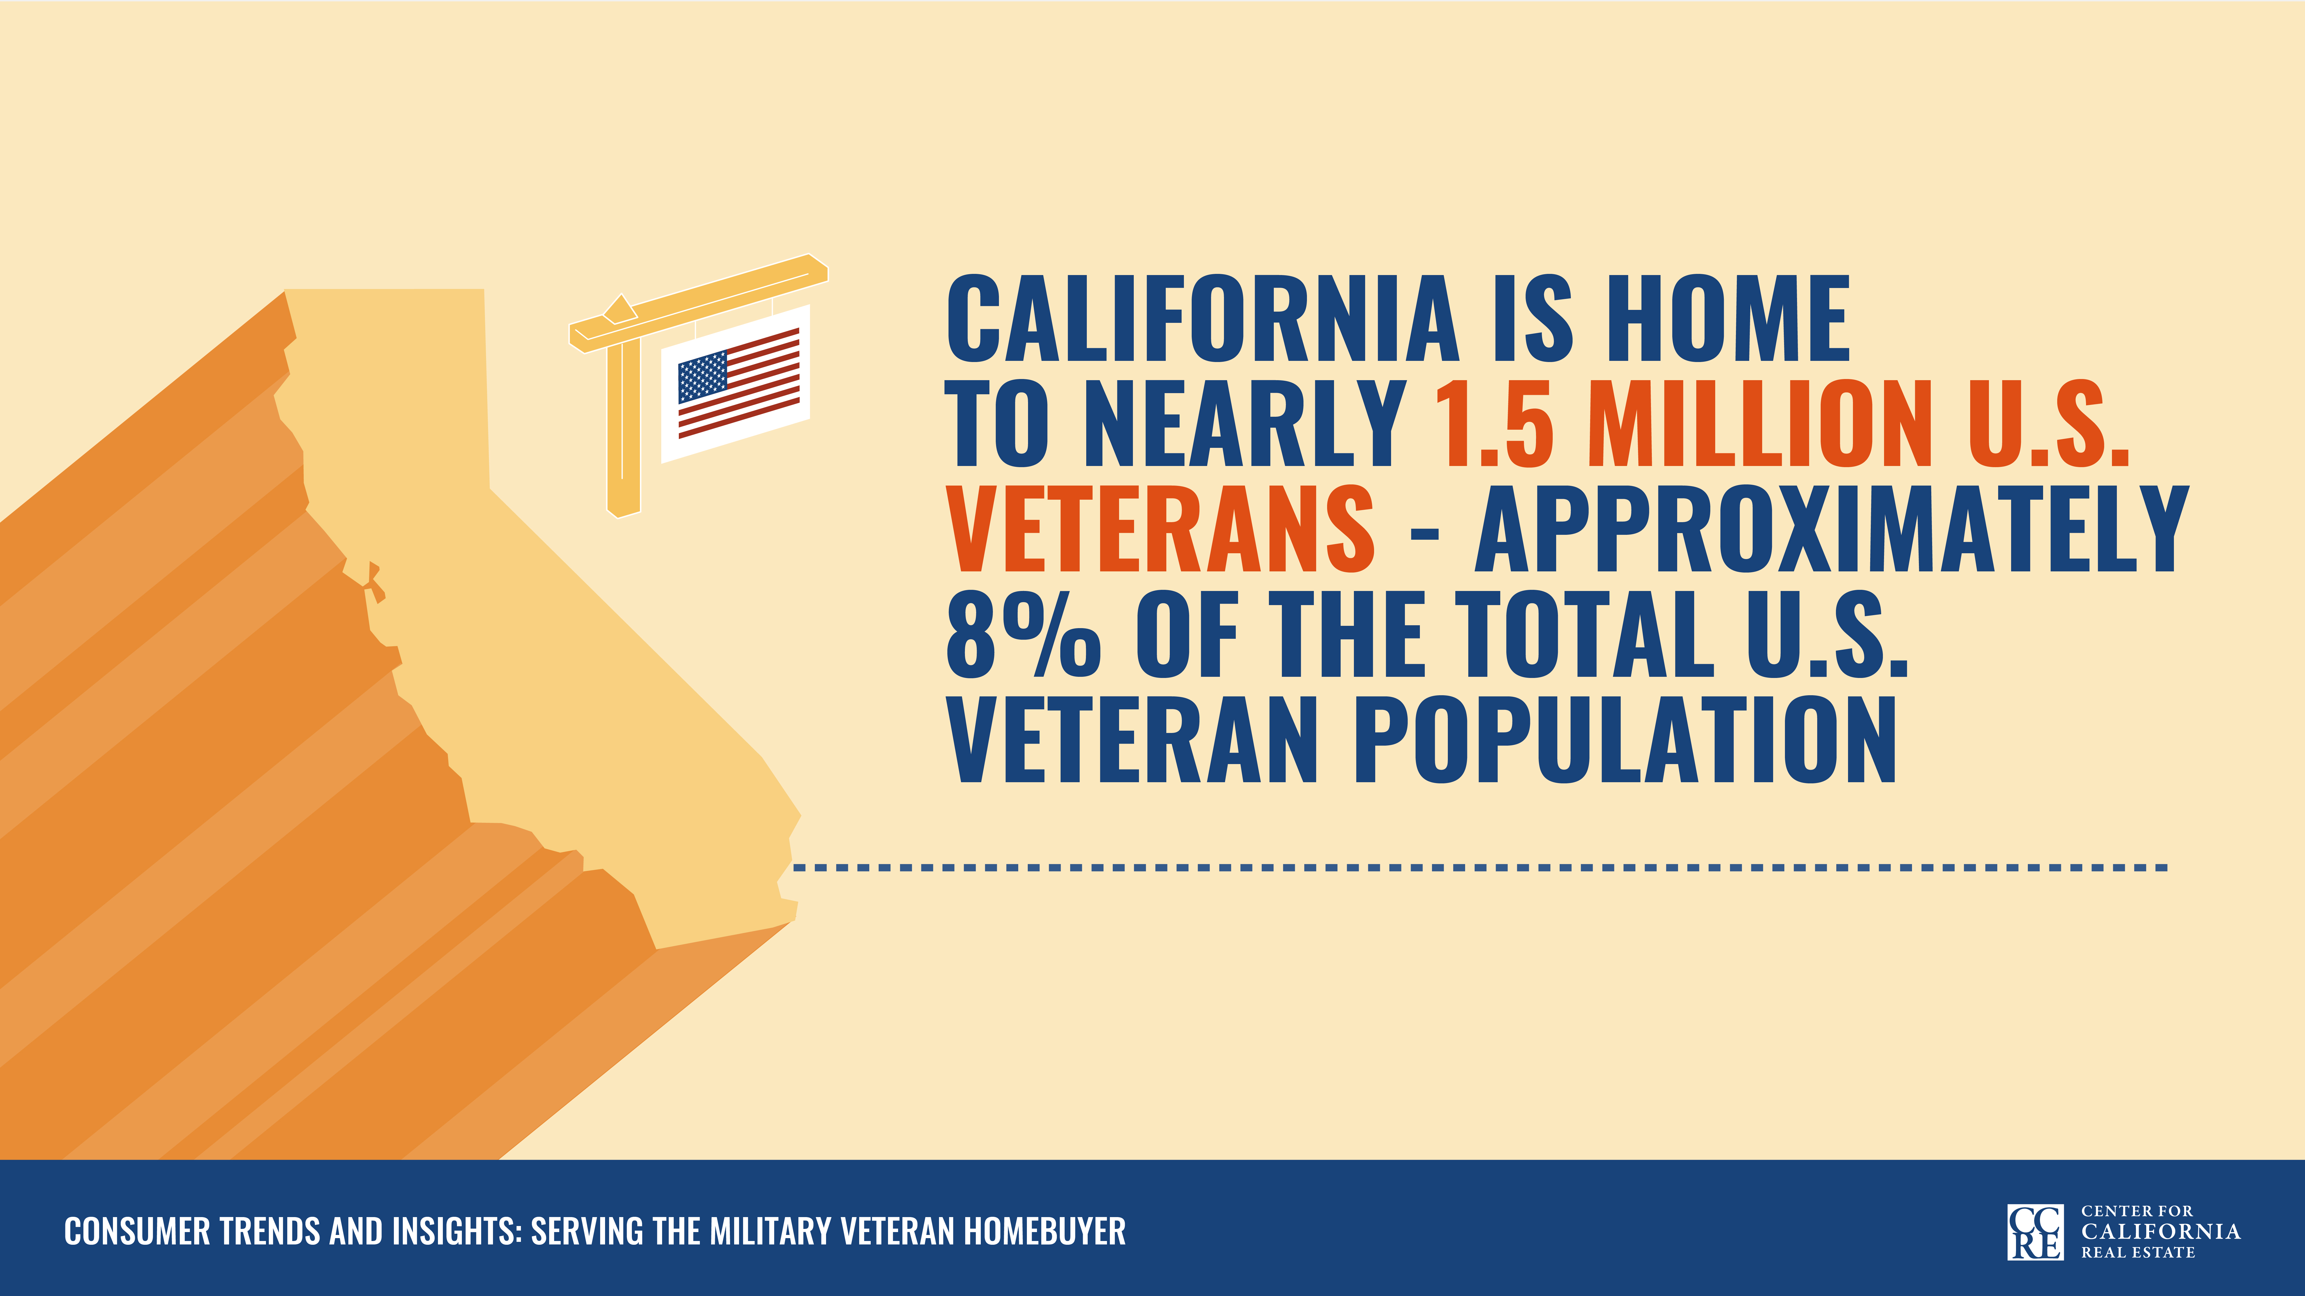
Notes:
Many military veterans seek to partner with REALTORS® as they transition to civilian life and explore homeownership. From San Diego's Point Loma to the Sierra Army Depot, California is home to much of the nation's defense infrastructure. Upon exiting the military, many veterans choose to stay in the state. Consequently, California is home to nearly 1.5 million U.S. veterans.​

Slide 3
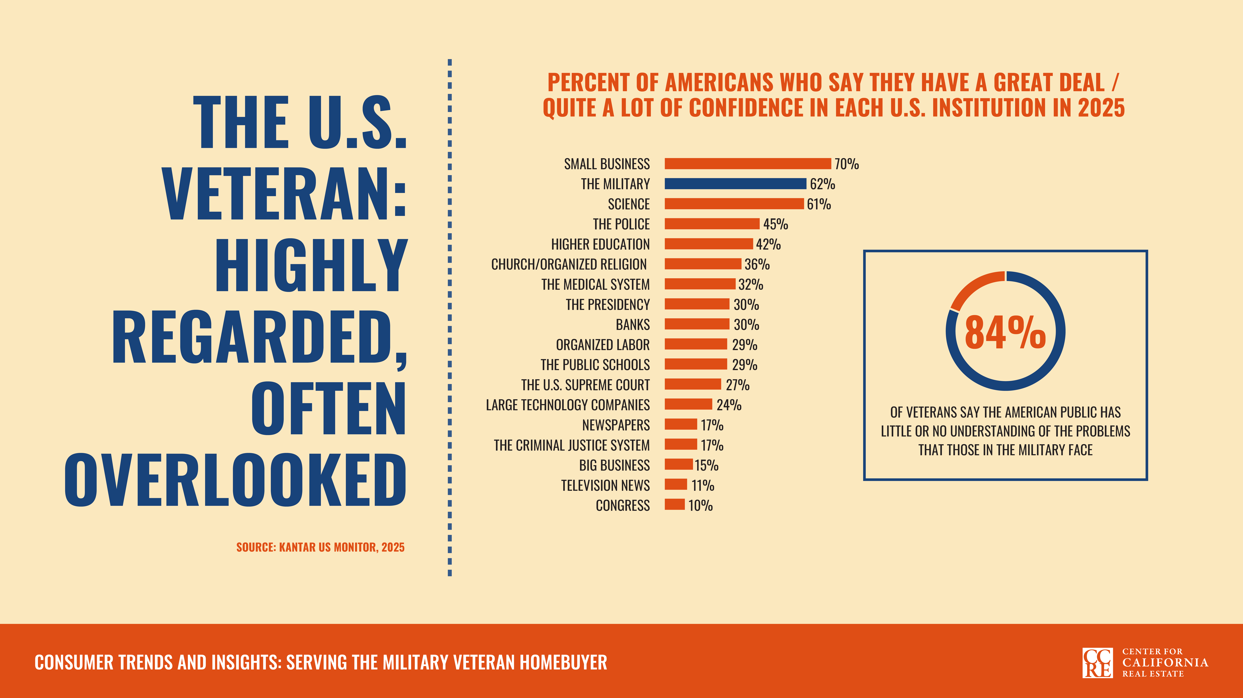
Notes:
Public perceptions of the military have fluctuated over the past several decades, typically in response to major military engagements and geopolitical events. In recent years, confidence in the military has been lower, reflecting a broader decline in public confidence in several public institutions. However, despite this decline, most Americans still hold the military in high regard—one of only three institutions a majority of Americans feel this way about. ​

Slide 4
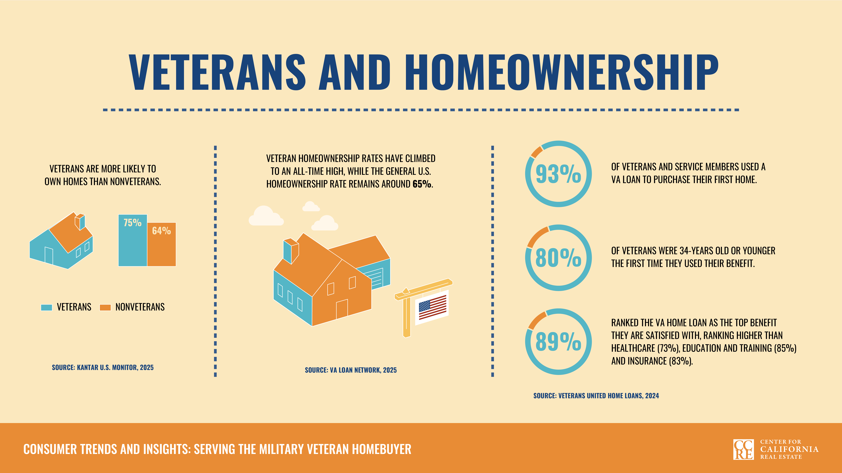
Notes:
The military also offers unique benefits for housing that encourage homeownership among veterans. Veterans often rank the VA home loan as the top benefit they receive as a result of their service. The VA home loan waives a down payment and mortgage insurance and usually offers lower interest rates and more flexible credit requirements than conventional mortgages.​

Slide 5
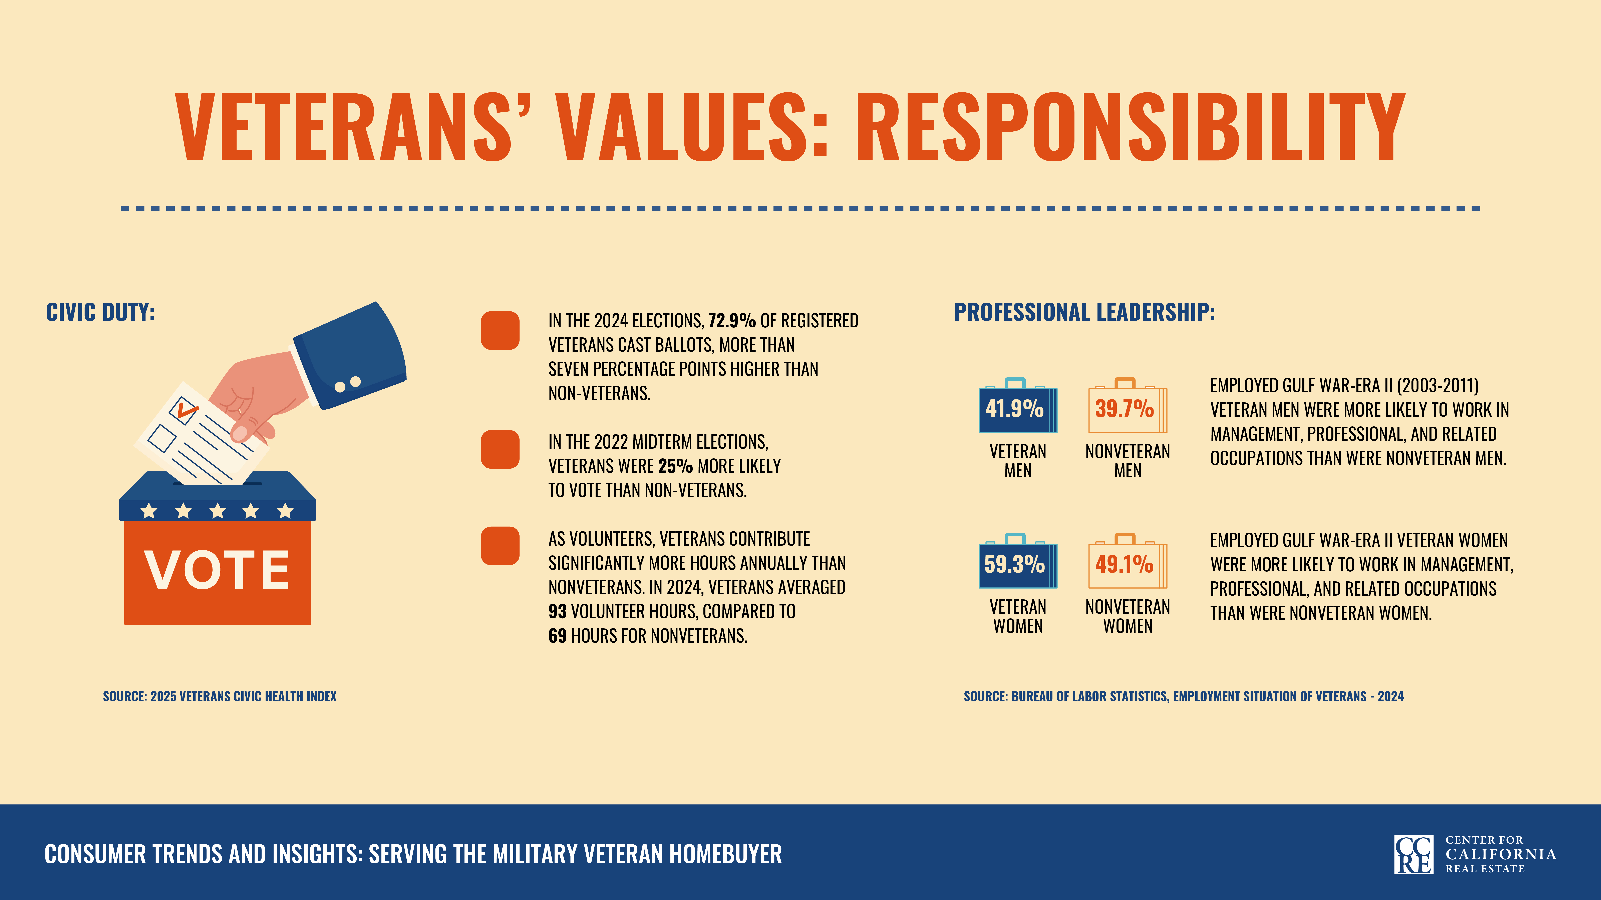
Notes:
Veterans' heightened sense of responsibility doesn't end when their military service does. Veterans are more likely to vote and volunteer more often than nonveterans. They are also more likely to be employed in managerial positions.​

Slide 6
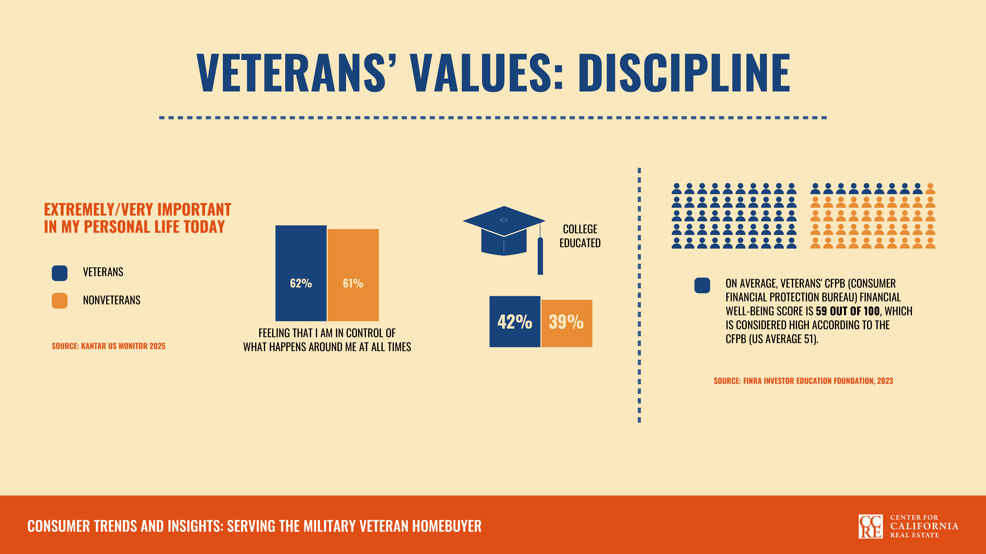
Notes:
Veterans prioritize having a sense of control and stability in their lives, which may contribute to their ability to succeed at achieving long-term goals, such as a college education and increased financial well-being. ​

Slide 7
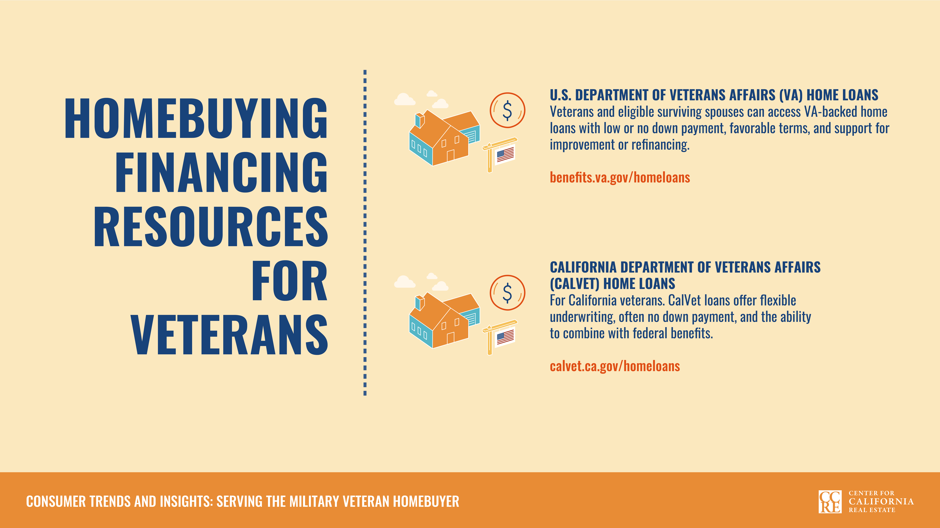
Notes:
When veterans are ready to become homeowners, they have access to several programs to help with financing. In addition to the VA home loan, CA veterans are may be eligible for CalVet home loans, such as the CalHFA 30-year fixed interest rate first mortgage, and grants from the Veterans Housing Alliance.​

Slide 8
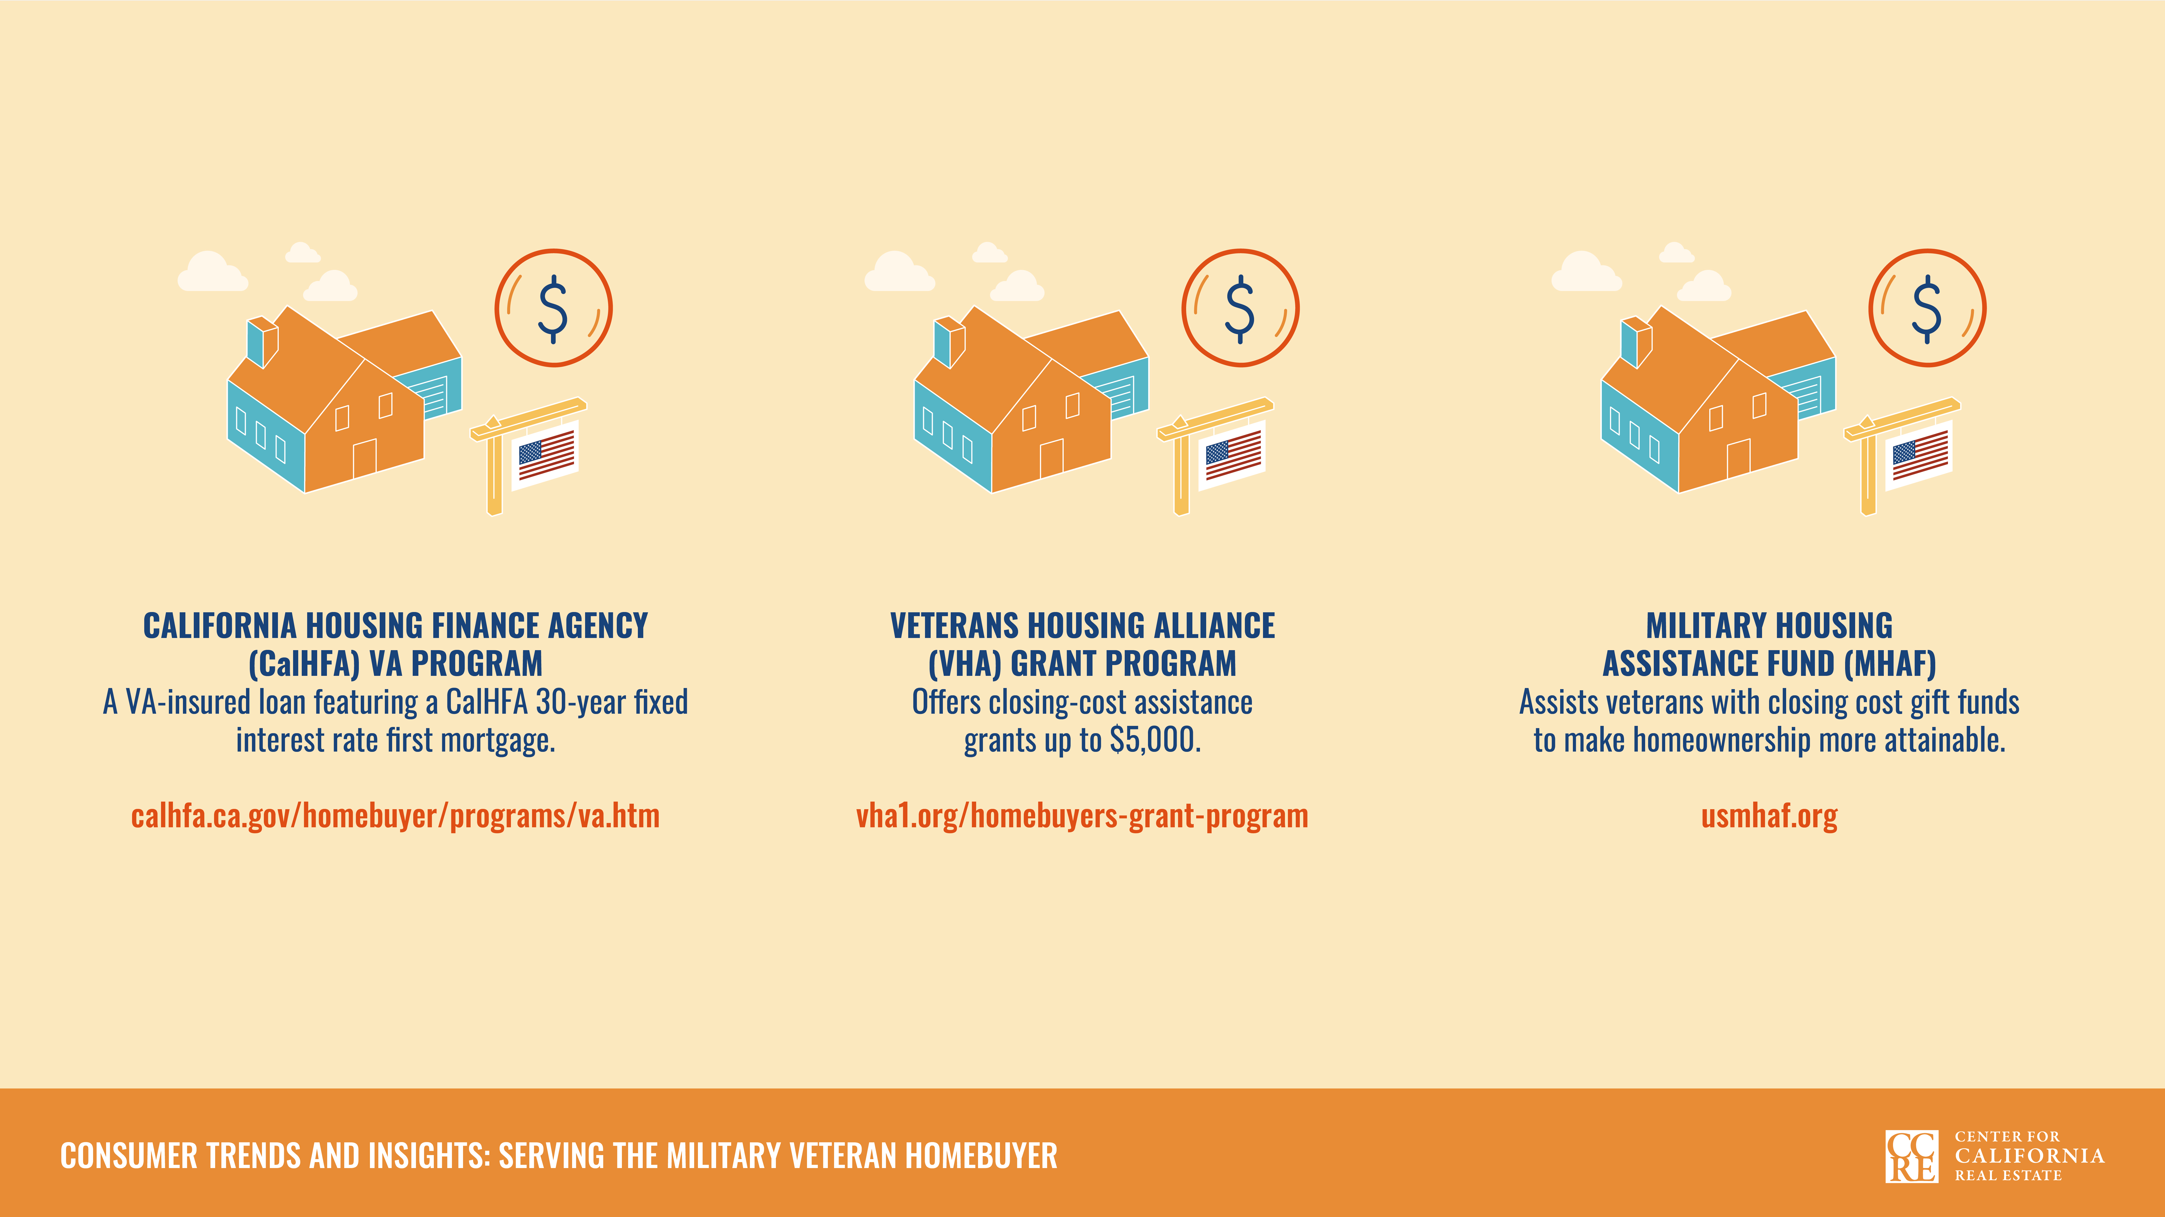

Slide 9
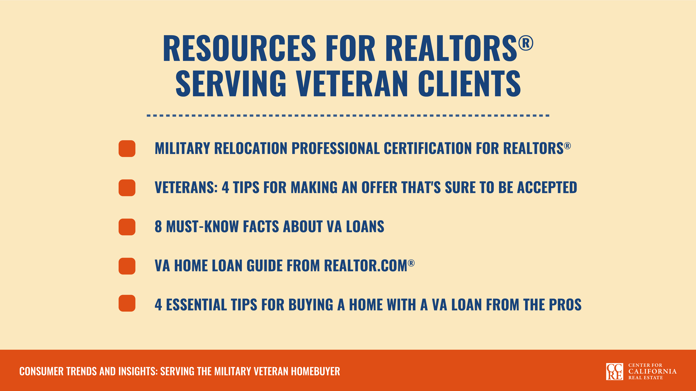
Notes:
Surveys find that rather than price, quality or convenience, the key to veterans as consumers lies in connection—specifically how well businesses understand and reflect the military community. Take advantage of C.A.R.’s resources to become a trusted guide to veterans throughout the home buying and selling process.​

